Slide 1


Hybrid reasoning, the scope of knowledge, and what is beyond ontologies?
by Anatoly Levenchuk
Aisystant
ailev@asmp.msk.su
Ontolog Forum,
November 8, 2023

Slide 2
4E cognitive architectures with knowledge graphs and LLMs
4E Cognition:
Embodied – not only brain, exist in body beyond the brain itself and depend on body properties
Embedded – have input-output, always is embedded in the environment
Extended – brain/computer, body/robot, environment/physical world are all participate in cognition
Enactive – purpose of cognition is support of an action, it is part of some activity.
Cognitive architecture refers to both a theory about the structure of the human mind and to a computational instantiation of such a theory used in the fields of artificial intelligence (AI) and computational cognitive science – https://en.wikipedia.org/wiki/Cognitive_architecture
Knowledge graph – https://ontologforum.s3.amazonaws.com/OntologySummit2020/Communique/OntologySummit2020Communique.pdf
KG is a representation of a set of a statements in the form of a multigraph. [statements are representation of knowledge on what is in the world]
KG Schema is a collection of definitional statements specifying the meaning of the knowledge graph’s labels (is part of KG).
KG architecture (KGA) provides a combination of scalable technologies, specifications, and data cultures for representing densely interconnected statements derived from structured or unstructured sources across domains in a reasonable way that is both human- and machine-readable.
KG system (KGS) is a KGA with a collection of KGs
Large language model – https://ontologforum.com/index.php/OntologySummit2024 (Fall series)
  MLLM (multimodal LLM, foundational model) is representation of knowledge about what is in the world that compressed from a multimodal description of the world (dataset) in the form of generative neural network.
  There is no Schema with depiction of meaning, but meaning is specified. It is according to Ludwig Wittgenstein and Charles Pierce, «meaning is in use», words/tokens is «tools and instruments» – https://wab.uib.no/agora/tools/alws/collection-5-issue-1-article-27.annotate
  LLM architecture (LLMA, е.g. LLM is in graph-of-thoughts or student-teacher architectures) is a combination of scalable technologies, specifications, and data cultures for representing densely interconnected LLMs trained on structured or unstructured sources across domains in a reasonable way that is both human- and machine/self-superwised.
  ChatLLM is a LLM architecture with a collection of LLMs.
KG and LLM along with other types of monoparadigm knowledge representations (e.g. physical models) can be supported by multiparadigm cognitive architectures. Cognitive system/agent is a (multiparadigm) cognitive architecture with a collection of KGs, LLMs and other knowledge representations.

Slide 3
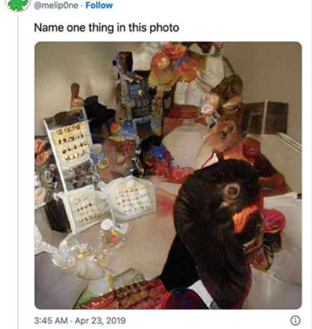
Cognition as a knowledge evolution
Evolution: novelty and growth of complexity, multilevel optimization, open-ended.
Exists with quantum/digital memory (more 70% persistence between generations) for representations of gene/meme.
Darwinian evolution: a genetic one (self-replicated, genome is in every cell in the form of DNA). The central dogma of molecular biology: changes in genome are directly expressed in phenome, but changes in phenome are expressed in genome via mutations and survival of fittest organisms.
Techno-evolution: a memetic one (constructors that developing system-of-interest via smart mutations. Information models are memomes for engineered systems, phenomes can inform genomes via contstructor’s action).
Cognition is multilevel (Vanchurin) techno-evolutionary process (Karl Popper) that give us actionable («taken seriously», pragmatic turn in philosophy) knowledge (replicated memome on a vast set of media) that is counterfactually explain the world (David Deutsch).
LLM (generative model)
Main usage is guessing, «ontology hypothesis, an axiomatics about the world»
Ontology description at an arbitrary level of formality/rigor (e.g. books, papers)
Remember new guesses (memory!)
Criticize new guesses for logical consistency with old taken seriously guesses
Suggest experiments for comparison of survived guesses
Take victorious guess seriously
Tell new guess
Find discrepancies in experiments
KG (discriminative model)
Main usage in critics
Ontology as an area of inquiry asks what is there?
Loop of ontology guessing and logical+expertimental (extended cognition) criticism for better fitting

Slide 4
≈5 ontology/modeling levels with ≈5 levels of rigor
L4 - Objects, relations, attributes, types - this is a foundational ontology/theoretical theory of concepts/meta-meta-meta-model.
L3 - Types of systems, practices, agents, representations of space and time, forms and roles are upper ontology/meta-meta-model.
L2 - Types of objects in activities/practices/work methods are middle ontology/meta-meta-model.
L1 - Set of object types of separate applied disciplines (domain/ subject domain is a domain of objects of one subject/discipline) - this is a domain ontology/metaC model/ data model in database.
L0 - Enterprise object instance model - operational model/model/instance ontology/data in database.
This is activation of S2 (slow thinking according to Kaneman), theory theory of concepts. No formal form, exclusively in methodologist/ontologist human head (may be modeled by LLM). Texbooks.
This is general knowledge about world, exclusively in human head. Needed for type checking, preventing errors with improper relations and operations for strong typing (may be modeled by LLM). Textbooks.
Domain textbooks, but with strong typing from upper ontology (analog – industrial usage of ISO 15926-2, but in texts in NL, not formal models)
Database schema (usually in table columns and table names). Strong typing from domain ontology (in the human’s head, learned from textbook and experience). Provided by universal modelers (coda.io, notion.so).
Actual reference/master data and transactions data
Aisystant, Corp.
“Organizational Development” courses (120 students daily):
Modeling and Attention management
Systems thinking
Methodology
Systems Engineering
Systems Management
Person Engineering
text
text
Applied knowledge (not provided by Aisystant)
Columns
Homework (ontology engineering for student’s actual job projects).
tables
cells
Provided by student’s colleagues at work

Slide 5
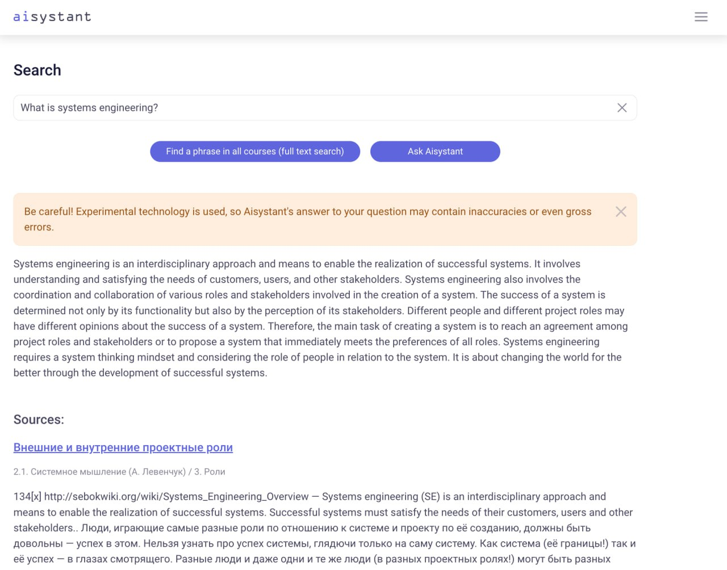
LLM: as interface to upper ontology
In production since March 28, 2023. In active use by students (provided with warning about possible inaccuracy)
Upper ontology exists not as definitions, but as “concept usage” in text (with synonym chains to emphasis concepts, not words). Strongly oppose definitions in upper ontology! It exists for people, not for a computer reasoner!
LLM can translate to English and to Russian
Based on GPT-3.5-turbo (its cheap!) and LangChain.
Upper ontology is based on 3rd generation systems thinking, https://arxiv.org/abs/2310.11524

Slide 6
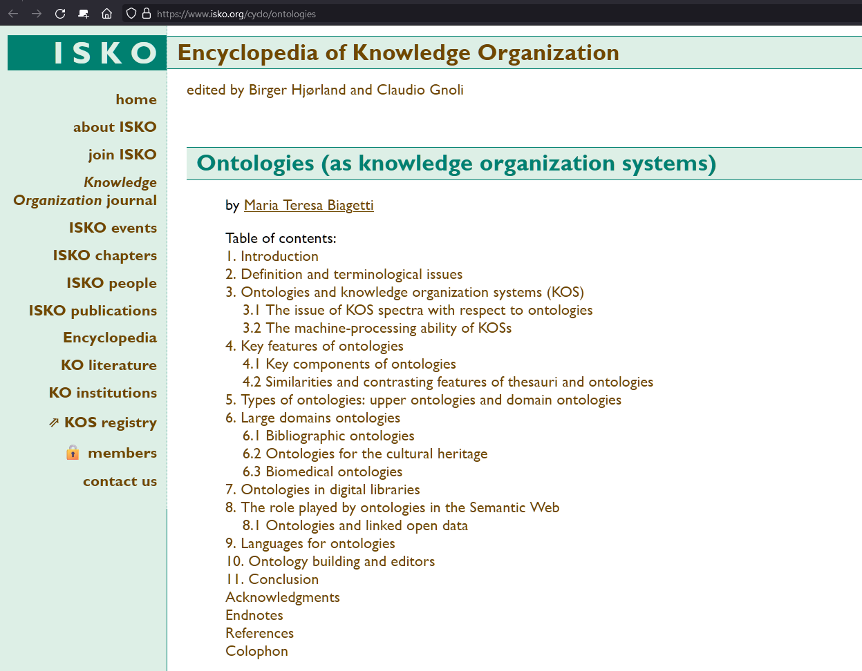
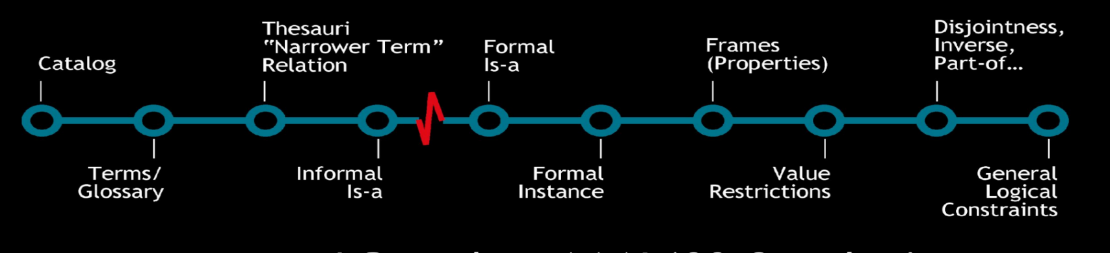
Knowledge organization
Ontology can be viewed as a knowledge organization system, https://www.isko.org/cyclo/ontologies.
Ontology is not mandatory formal! There is ontology formality/complexity spectrum (But opinions of ontologists here vastly differs).
Ontology give us answers for “What is in the world?” question. LLM can give us answer for the same question, even accounting for a context. Context and text ontology alignment – is very important!
Deborah McGuinnes (2003)
Not in use. Full search provides all of it. Yahoo! and Google Catalog are absent in the area. Classifications become obsolete (except government).
Ask LLM (that has internet access) for a newest concepts about «what is in the world?».
Knowledge graphs are here (hugely compressed incomplete knowledge, but convenient for proving. Not giving answers for «what is in the world?» for most of the questions, only for a few of them!).

Slide 7
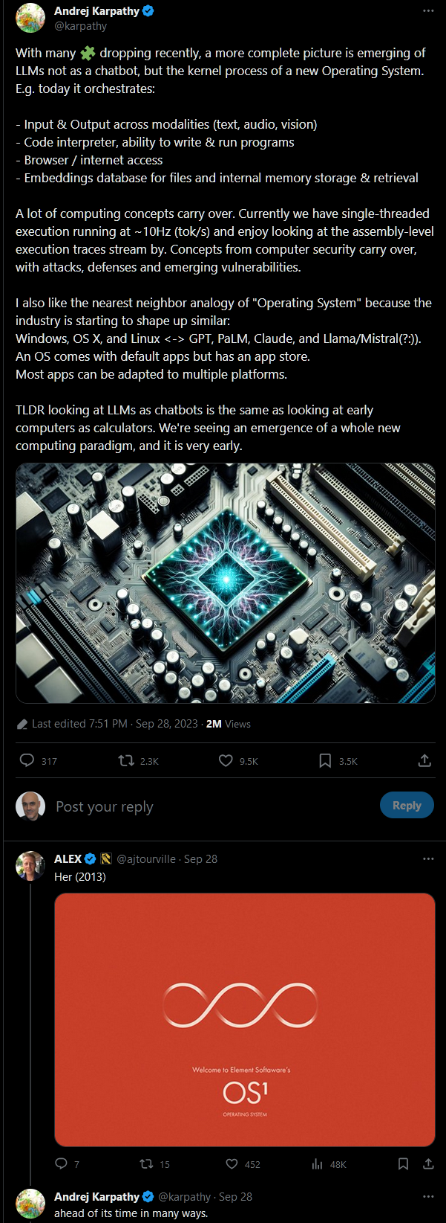
Opinion of Andrej Karpathy: LLM system (where LLM is a kernel process) functionally is a future operating system.
(And KG systems are not, they are «expert systems» for particular expert tasks. CYC is already not pure KG system, it has «neural accelerators»).
Andrej Karpathy, https://twitter.com/karpathy/status/1707437820045062561 (Last edited 7:51 PM · Sep 28, 2023 · 2M Views)
LLMs not as a chatbot, but the kernel process of a new Operating System. E.g. today it orchestrates:
Input & Output across modalities (text, audio, vision)
Code interpreter, ability to write & run programs
Browser / internet access
Embeddings database for files and internal memory storage & retrieval
A lot of computing concepts carry over. Currently we have single-threaded execution running at ~10Hz (tok/s) and enjoy looking at the assembly-level execution traces stream by. Concepts from computer security carry over, with attacks, defenses and emerging vulnerabilities.
I also like the nearest neighbor analogy of "Operating System" because the industry is starting to shape up similar:
Windows, OS X, and Linux <-> GPT, PaLM, Claude, and Llama/Mistral(?:)).
An OS comes with default apps but has an app store.
Most apps can be adapted to multiple platforms.
TLDR looking at LLMs as chatbots is the same as looking at early computers as calculators. We're seeing an emergence of a whole new computing paradigm, and it is very early.

Slide 8
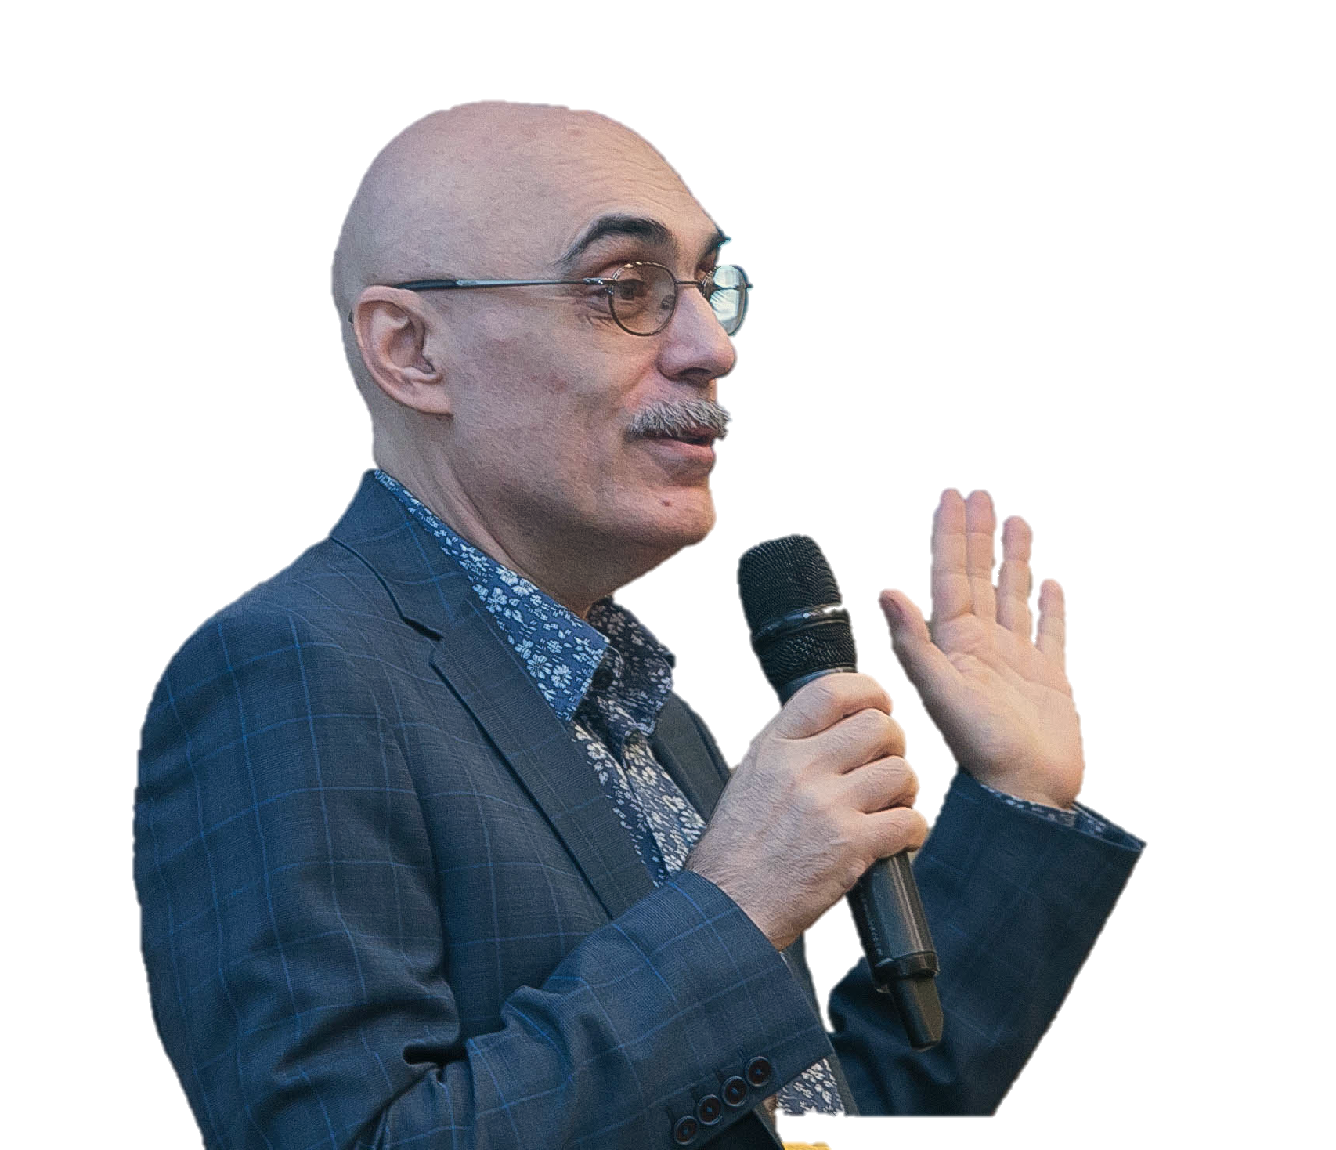
Anatoly Levenchuk
http://ailev.livejournal.com (Russian language blog)
ailev@asmp.msk.su

