Slide 1



2021 Disasters Pilot

Slide 2




Agenda
Disasters Pilot Mission & Overview
Health Spatial Data Infrastructure
Expanding the Health SDI Concept Development Study
Peru Medical Supply Needs Analysis with a Coincident Flood Scenario
Louisiana Pandemic Medical Supply Needs Analysis
Additional Analytics
2021 Disasters Pilot

Slide 3




2021 Disasters Pilot
ACTIONABLE
SOLUTIONS
DATA

Slide 4


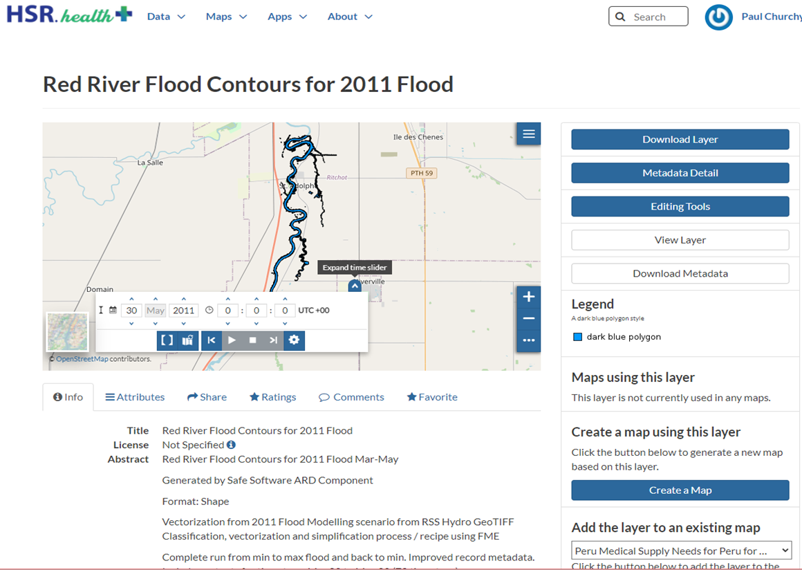
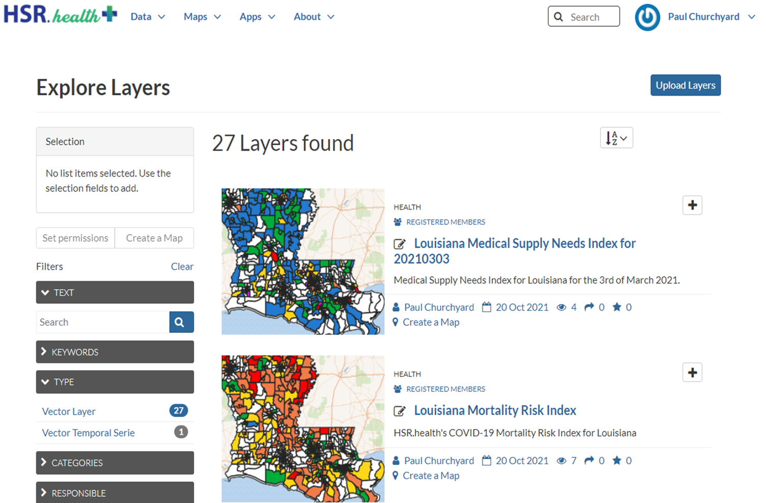

Health Spatial Data Infrastructure
2021 Disasters Pilot
https://geoplatform.hsrhealthanalytics.org/

Slide 5
Expanding the Health Spatial Data Infrastructure Data Model
2021 Disasters Pilot
Essential Foundation Data and Technology
Hazard and Vulnerability Areas (High Risk) | Social Resistance Index (SRI)
Imagery with x,y Coordinates or Grid addresses | Resistance to Modifying Behavior
Address Database and GeoCoding Application | Resistance to Vaccines (Vaccine Hesitancy)
Habitation Layer (villages, homes, farms) | Registry of Disabled, Device Dependent, Other Highly Vulnerable Individuals
Demographic Layers | Resilient and Quickly Reparable Wireless Telecom Network
Health System Boundaries (i.e., hospital catchment areas) | Road Network, Freight Train Routes
Health Facilities and Resources Layers | Helicopter and Aircraft Landing Zones
Jurisdictional Boundaries (e.g., States, Election Districts) | Inventory of Available Aircraft
Emergency Dispatch Centers | Routes and Facilities for Critical Supply Chains
Social Facilities (See Code List in Health CDM) | Tracking Shipments of Critical Supplies
Diagnostic Testing Centers | Anticipating Needs Based on RO
Critical Infrastructure Layers (E.g. water, power) | Measure of mobile phone access
Social Vulnerability Index (Customized to Region) | Inventory and Location of Heavy Equipment
Vaccination Prevalence | Pre-Existing Conditions
Health Indicators for Disasters
Area and Population encompassed by Disaster and Cascading Effects | Vector (Disease Carrying Mosquitoes)
Area, Structures, and Population Covered by Floodwaters | Pandemic Spread
Damaged and Destroyed Structures incl. Critical Infrastructure, Houses | Respiratory Illnesses
Infected Responders | Digestive Illnesses
Homeless Population, Groups Seeking Shelter | Crushing Trauma
Deaths Above Normal | Drownings/Suffocation
Population of Power Outage Area | Mental Health
Population with Compromised Water Systems | Criminal Victimization
Population in Area of Dangerous Air Pollution | Pathogen Identification In Water
Population in Area Lacking Communications | Pathogen Identification in Vectors (e.g. Mosquitoes)
Incidents of Panic Buying and Looting | Dangerous Chemicals in Water and Air
Weather Forecasts
Types of Health Impacts On People
Exposure (Cold, Heat)

Slide 6
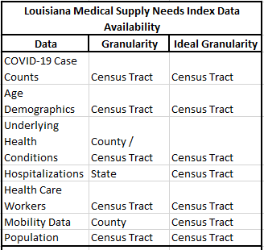
Expanding the Health Spatial Data Infrastructure Data Model
& Louisiana Health Data Availability
2021 Disasters Pilot
Health Indicators for Pandemics
Pandemic tracking worldwide | Testing and Diagnosis at First Contact with Health System
Symptomatic travellers/Frequent Destinations | Diagnosis at Triage and After Hospitalization
Infected Responders | RO Measurements in Micro Areas
Social Media Content Harvesting | Predicted Increases in Illnesses
Syndromic Surveillance (E.g. Drug sales, Health supply sales) | Inventory levels of medical devices, respirators, pharmaceuticals
Internet Linked Thermometers (E.g. Kinsa) | Utilization levels of medical devices
Structured Voice & Written Messages | Inventory levels of medical supplies
Structured Info from Political, Military, Religious, Community Leaders | Raw materials for tests, vaccines, treatments
Information from Health Care workers | Supply levels of Other Essential Supplies (E.g. food, water, sanitary products, etc.)
Information from Health Care Facilities | Patient to Health Worker ratio
Structured Info from 1st Responders | Percent testing positive/negative
Information from Contact Tracers | Positives by age, vulnerability, ethnicity, gender
Wastewater Testing for Pathogen
Hotspot and Micro-Cluster Identification

Slide 7
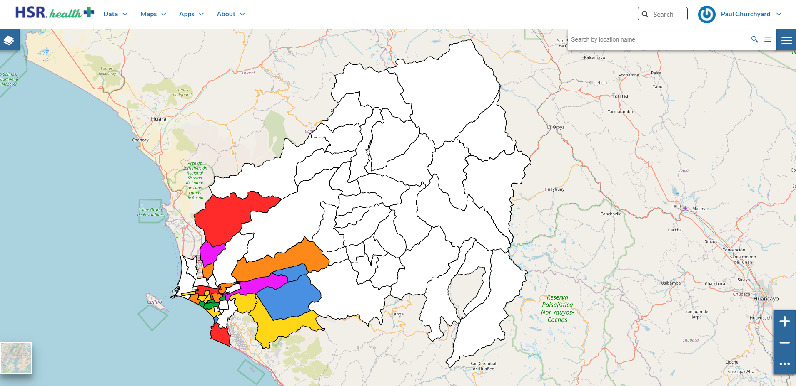
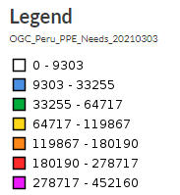
Peru Rimac River Basin Medical Supply Needs Index
2021 Disasters Pilot
Supply Need

Slide 8
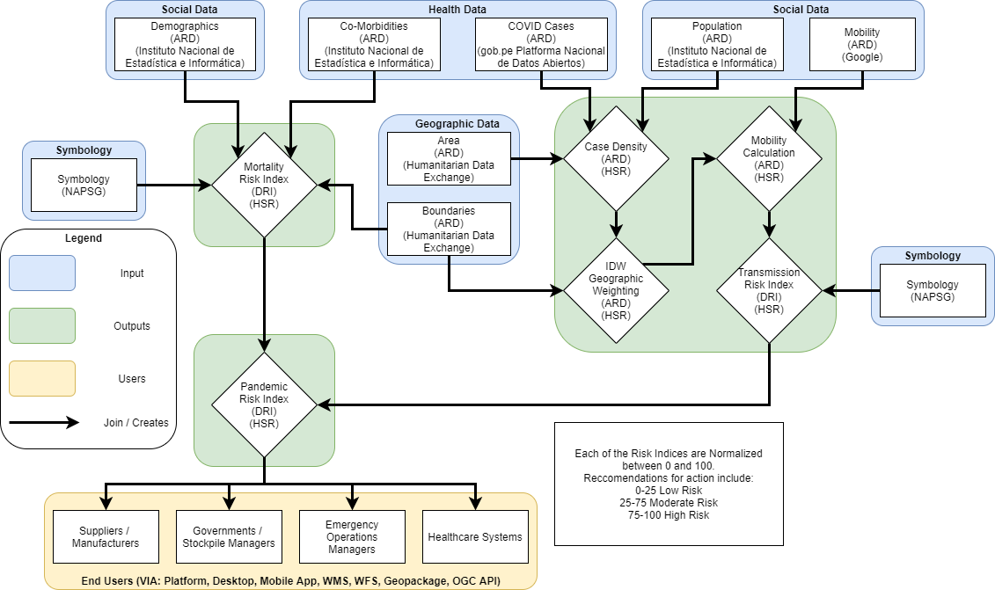
Pandemic Risk Index Workflow
2021 Disasters Pilot
Notes:
Ref that we designed it

Slide 9
Pandemic Risk Index Workflow
2021 Disasters Pilot
Mortality Risk
Index Components

Slide 10
Pandemic Risk Index Workflow
2021 Disasters Pilot
Transmission Risk
Index Components

Slide 11
Pandemic Risk Index Workflow
2021 Disasters Pilot
Pandemic Risk
Index Output

Slide 12
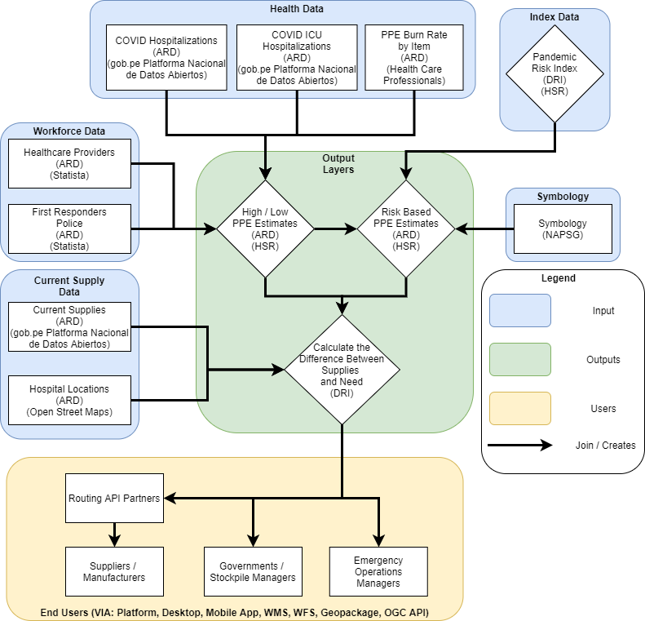
Medical Supply Needs Index Workflow
2021 Disasters Pilot

Slide 13
Medical Supply Needs Index Workflow
2021 Disasters Pilot
High / Low Medical Supply Needs Index Components

Slide 14
Medical Supply Needs Index Workflow
2021 Disasters Pilot
Index Based Medical Supply Needs Index Components

Slide 15
Medical Supply Needs Index Workflow
2021 Disasters Pilot
Medical Supply Needs Index Output

Slide 16
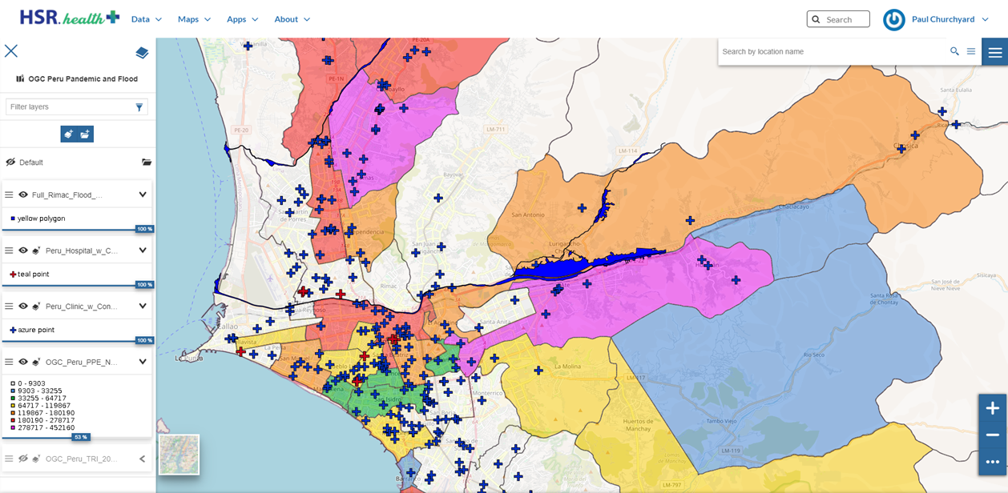
Rimac Basin Medical Supply Needs Index with
Hospital Locations, Clinic Locations, and Flood Extent
2021 Disasters Pilot

Slide 17
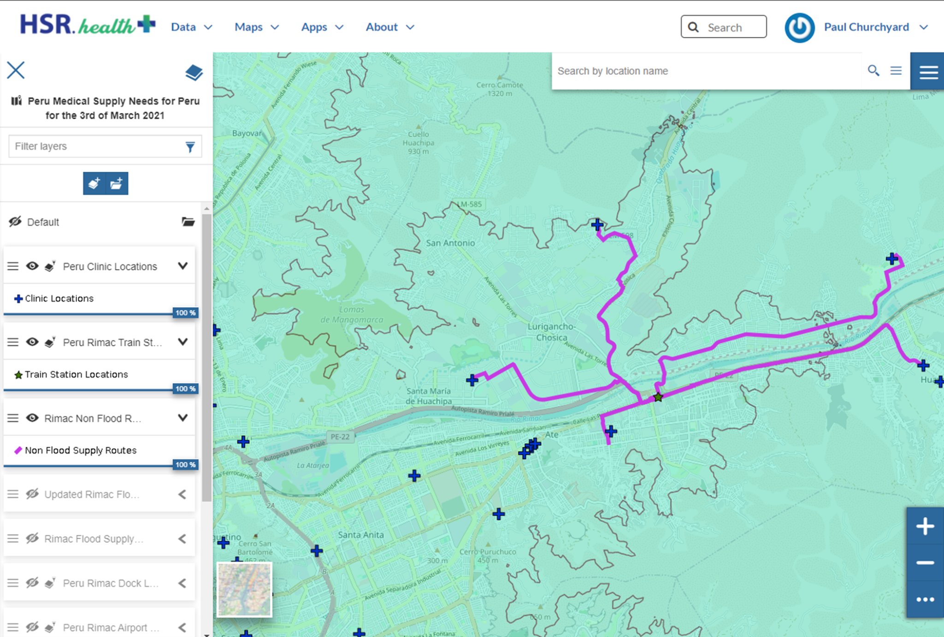
Rimac Pre-Flood Medical Supply Routes
2021 Disasters Pilot
1
2

Slide 18
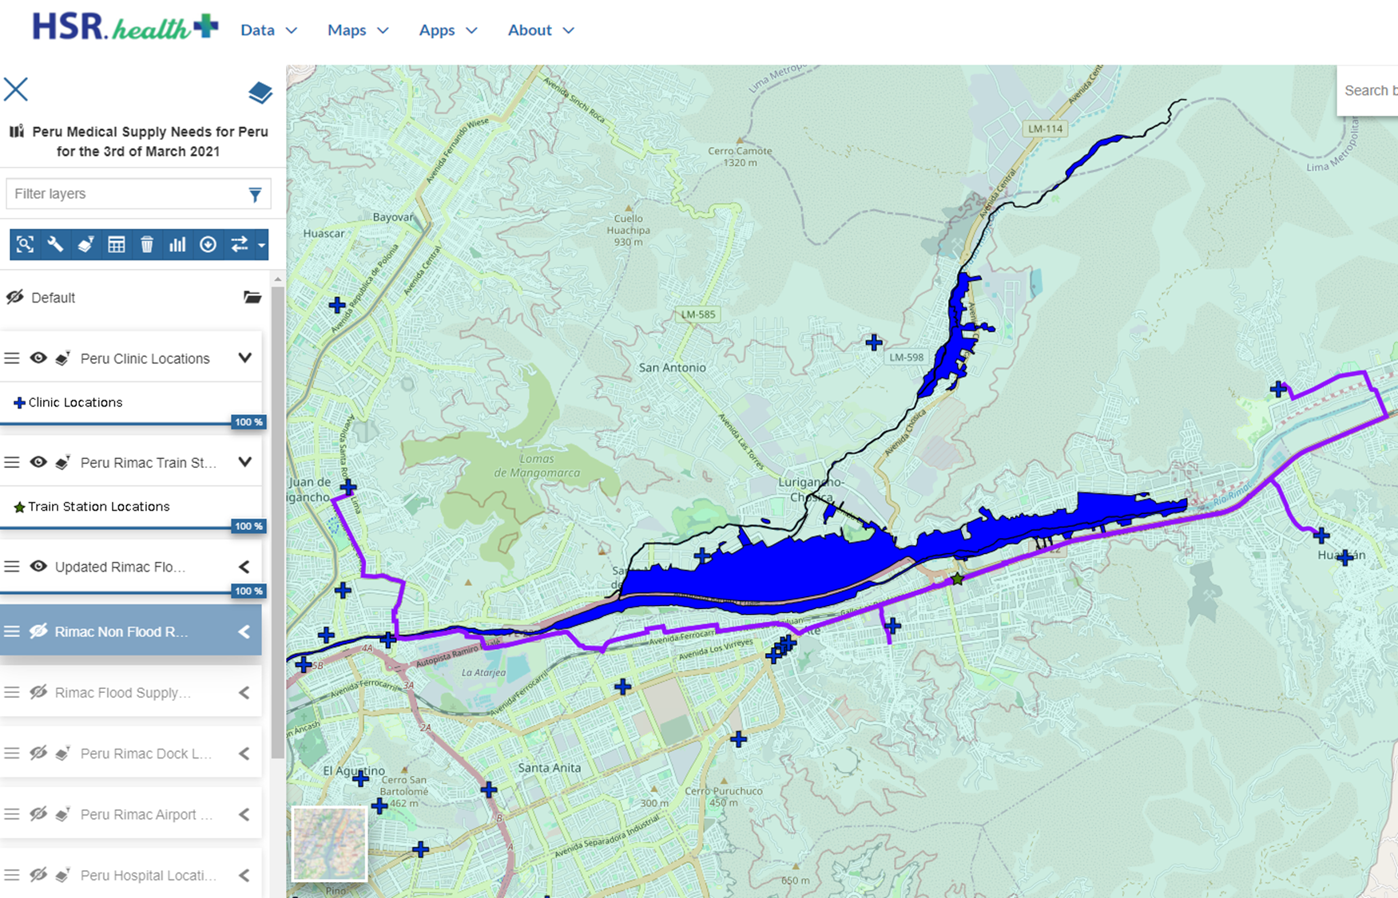
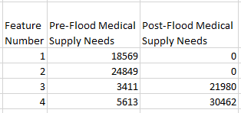
Rimac Post-Flood Medical Supply Routes
2021 Disasters Pilot
1
3
2
4

Slide 19
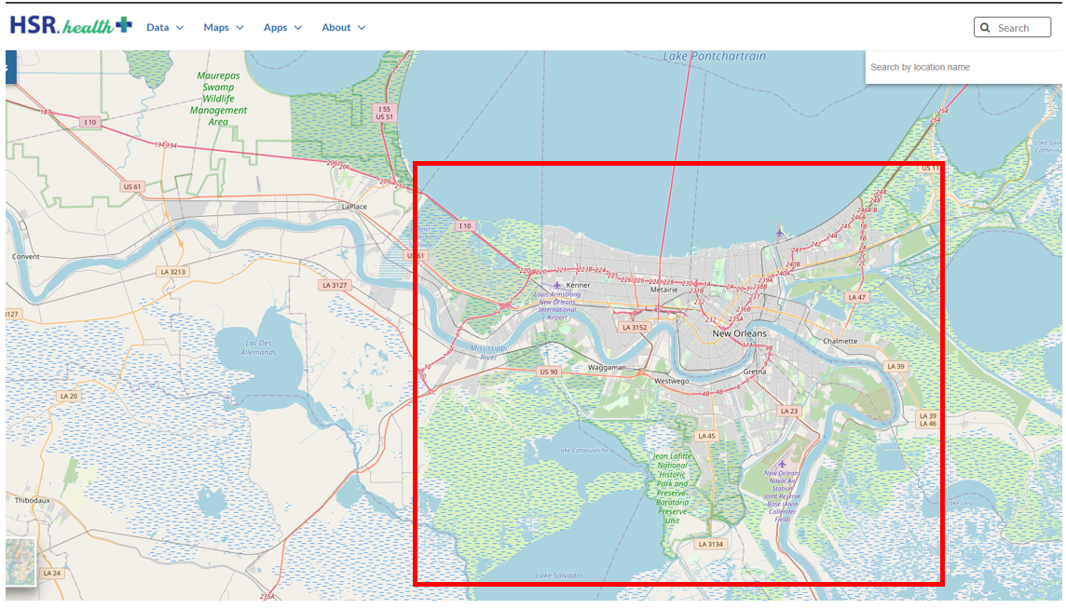
2021 Disasters Pilot
New Orleans Louisiana

Slide 20
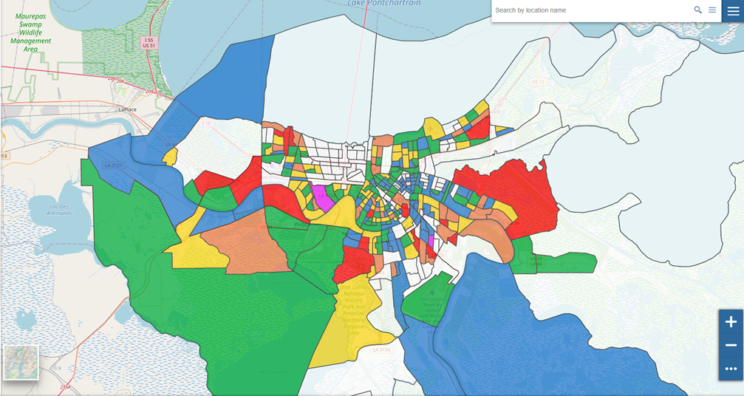
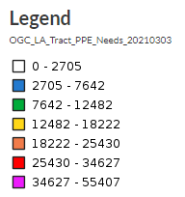
New Orleans Louisiana Medical Supply Needs Index by Census Tract
2021 Disasters Pilot
Supply Need
New Orleans, Louisiana Medical Supply Needs Index by Census Tract

Slide 21
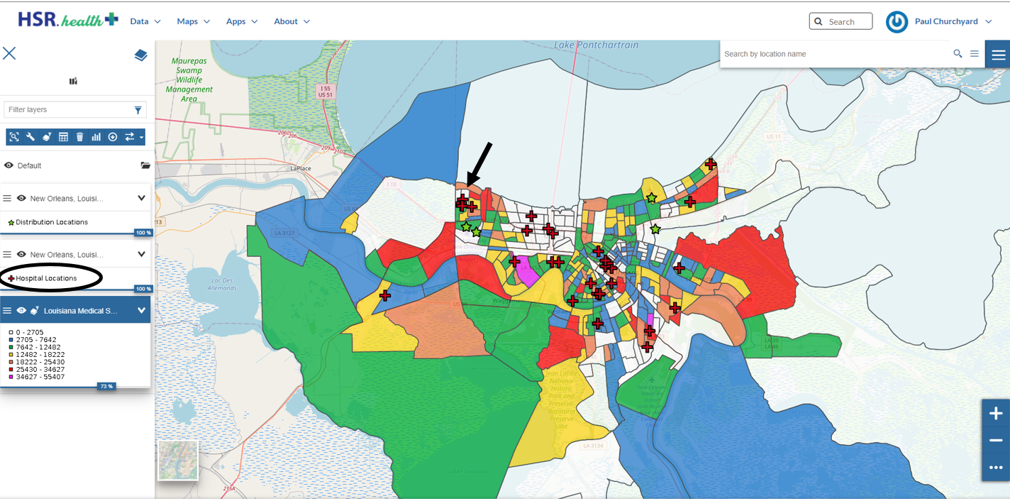
New Orleans, Louisiana Medical Supply Needs Index with Hospital Locations
2021 Disasters Pilot
Supply Need
New Orleans, Louisiana Medical Supply Needs Index with Hospital Locations

Slide 22
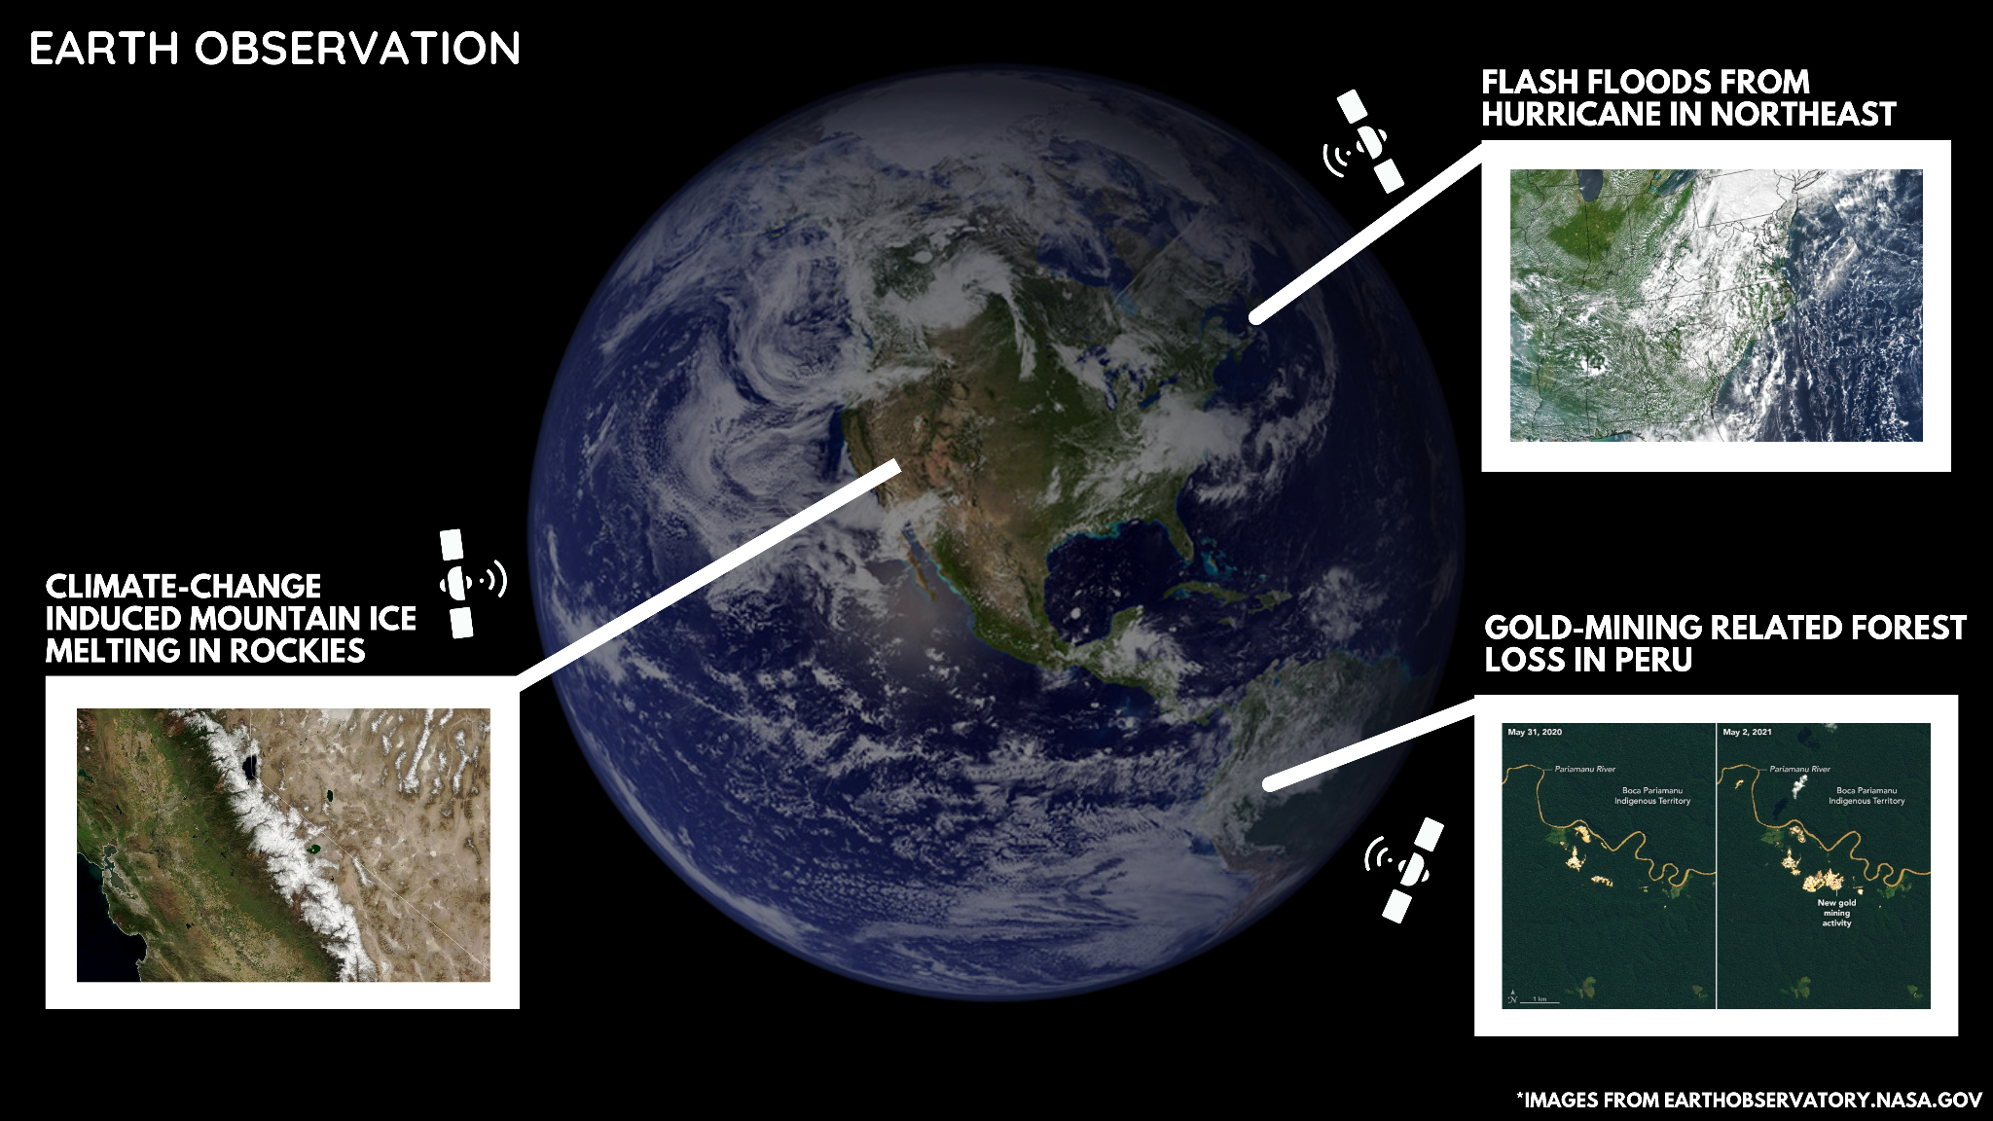

Slide 23

Future Work
Thank You!
Expanding the Louisiana Scenario to incorporate more coincident natural disasters
Further expansion of the Health SDI
Exploring more Earth Observation use-cases relating to health and pandemics
Deploying our Climate Change and Zoonotic Spillover impact on Human Health model
Paul Churchyard / HSR.health
paul@healthsolutionsresearch.org

