Slide 1

The NSF Convergence Accelerator Pilot
Track A – Open Knowledge Network
Chaitan Baru, Senior Science Advisor
Convergence Accelerator Office, Office of the Director
National Science Foundation

Slide 2
Outline
The NSF Convergence Accelerator Pilot program
Convergence Accelerator Pilot Tracks
CA Track A: Open Knowledge Network
OKN: Projects and topics
Next steps, Future Directions

Slide 3
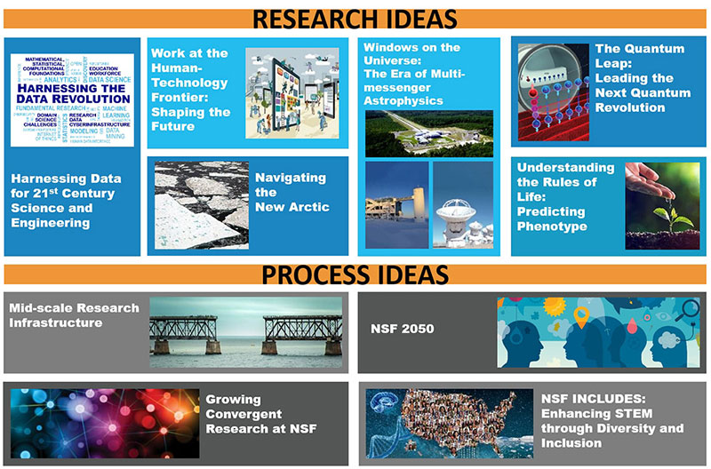
NSF Big Ideas

Slide 4
The NSF Convergence Accelerator Pilot Program:
Convergence Research
The convergence paradigm intentionally brings together intellectually-diverse researchers to develop effective ways of communicating across disciplines by adopting common frameworks and a new scientific language…
To solve the grand challenges of today that require the merging of ideas, approaches and technologies from widely diverse fields of knowledge to stimulate innovation and discovery.

Slide 5
NSF Convergence Accelerator
WHY: Leverage the science across all fields of NSF research to produce outcomes in an accelerated timeframe, with streamlined operations allowing for nimbleness to support the most innovative results
WHAT: A new organizational structure to accelerate the transition of convergence research into practice, in areas of national importance
Characteristics
Management
Use-inspired research
Testbeds, tools, living labs…
Larger, national scale
Requires partnerships with industry
Clear goals, milestones, directed deliverables
Time-limited “tracks”
Teams and Cohorts
  Cooperation and Competition
More directed management
Mission-driven evaluation

Slide 6
Convergence Accelerator Pilot Tracks
Harnessing the Data Revolution and Future of Work at the Human-Technology Frontier, selected as the track themes for the Pilot
Open Knowledge Network and AI and Future Work, selected as the track topics
Choosing track topics
  Use-inspired research; require convergence, i.e. strong multidisciplinarity; national priority areas; doable within the NSF CA format (6 months planning; 2 years of implementation)
Research Concept Outlines (RCOs)
  Community is invited to submit 2-page RCOs about their track ideas.
  RCOs are reviewed, and teams are invited to submit Phase I planning proposals based on the RCOs.

Slide 7










Tracks for 2019 CA Pilot
Vertical: Challenges specific to different topical domains such as geosciences, education, smart health, finance, and manufacturing.
Horizontal: Challenges that apply to all domains, such as developing the underlying representation of facts or developing secured access capabilities.
Open Knowledge Network
Track A1
Goal: Enhancing scientific data discovery and use
Track: Open Knowledge Networks
Big Idea: Harnessing the Data Revolution
Harnessing the Data Revolution
Others
AI & Future Jobs
Track B1
Goal: Connecting, retraining and reskilling for jobs using AI
Track: AI & Future Jobs
Big Idea: Future of Work at the Human Technology Frontier
Future of Work at the Human-Technology Frontier
National Talent Ecosystem
Track B2
Goal: Building STEM talent in a changing workplace
Track: National Talent Ecosystem
Big Idea: Future of Work at the Human Technology Frontier

Slide 8
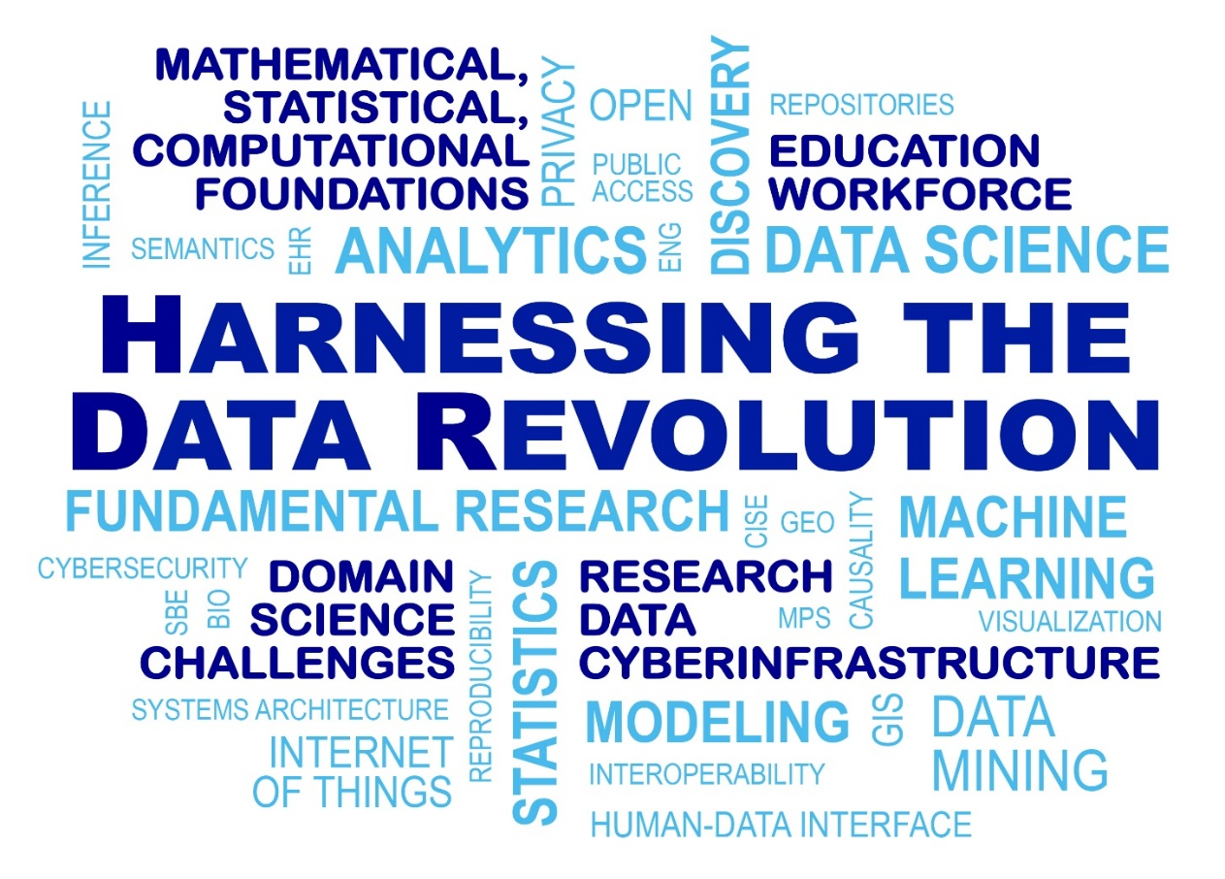
CA Track A: Open Knowledge Network
Responds to the need identified in the NSF Harnessing the Data Revolution Big Idea for:
  An advanced science data infrastructure that is interoperable and has an open architecture, making it easier to access and link heterogeneous data products
  An open semantic information infrastructure to discover new knowledge from multiple disparate knowledge sources
  A nonproprietary shared knowledge infrastructure, with a particular focus on publicly available data, e.g., U.S. Government, scientific data, and other similar public datasets.
Benefits multiple applications domains, including science and engineering research

Slide 9
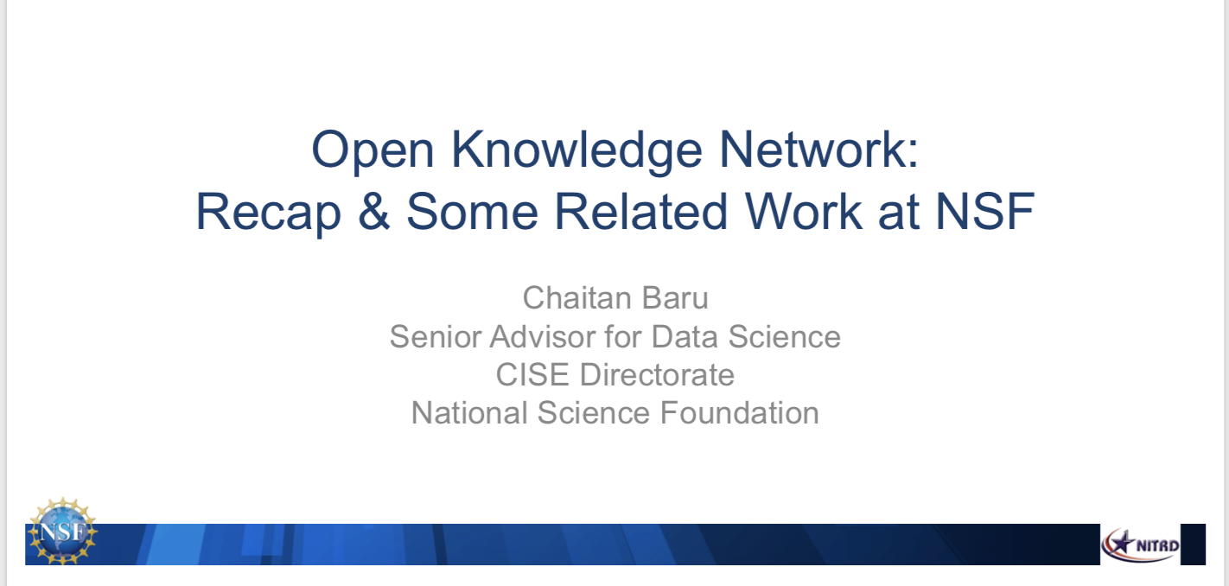
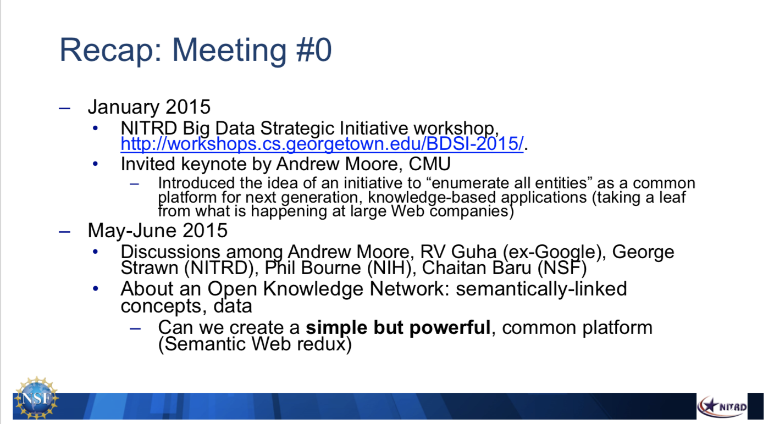
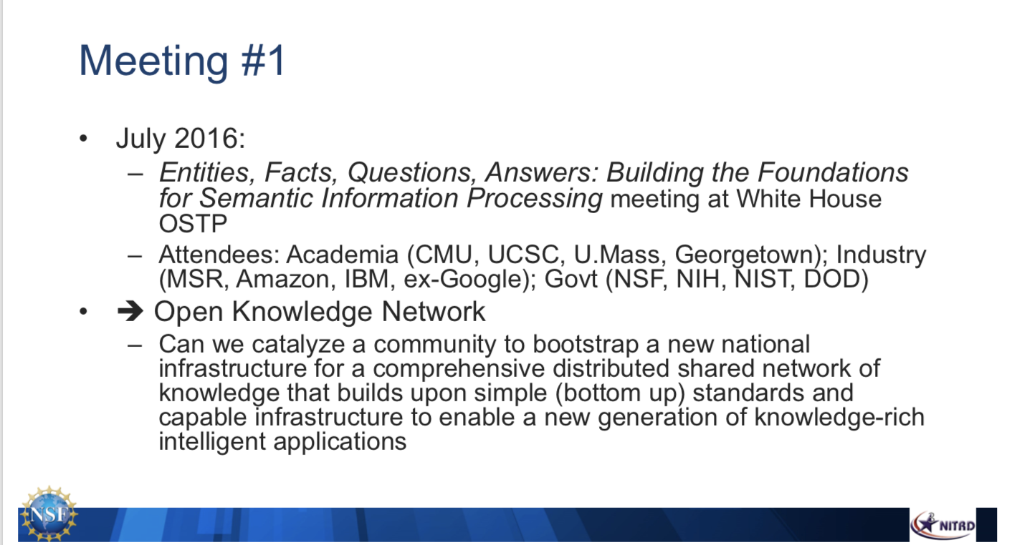
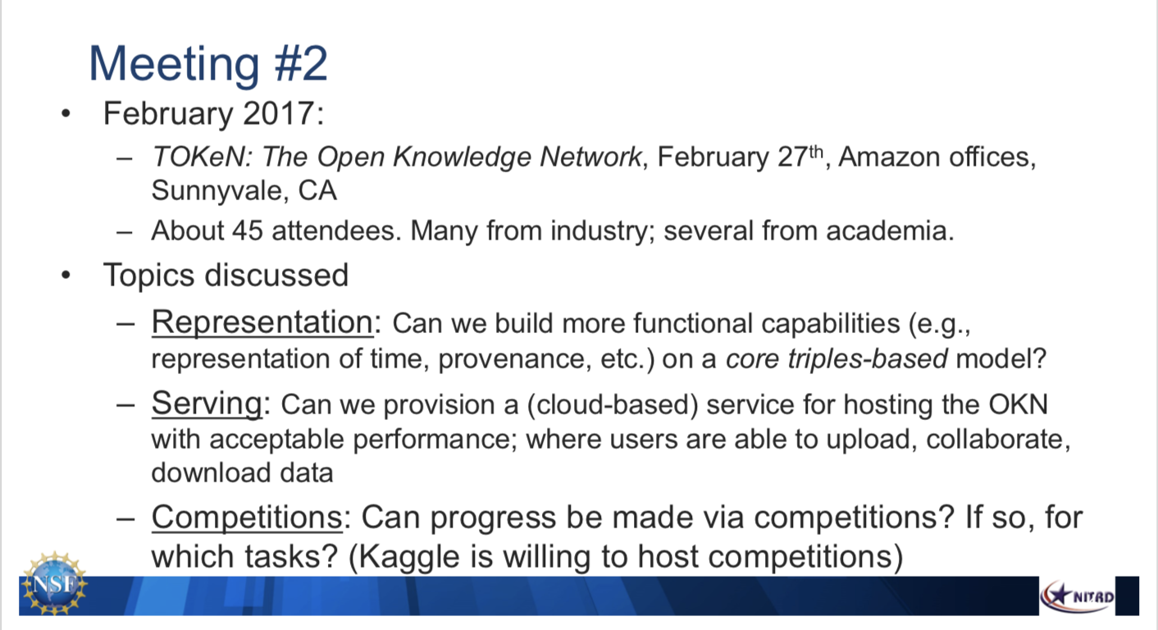
The Open Knowledge Network Idea
Jan 2015: Big Data Strategic Initiative workshop, Georgetown Univ.
  Prof. Andrew Moore describes how industry is using knowledge networks as key enabling technologies, and the need for “reference entities”.
June 2016: Meeting at White House OSTP
  Small group with govt, industry, academia
Feb 2017: Meeting in San Jose, hosted by AWS
  ~55 attendees; ~40 companies
  Lots of interest in the idea
Oct 2017: NITRD OKN Workshop
  Enabling the Community to Build the Network,
  Oct 4-5, 2017, National Library of Medicine
http://workshops.cs.georgetown.edu/BDSI-2015/
From: https://www.nitrd.gov/nitrdgroups/images/c/ca/OKN_ChaitanBaru.pdf

Slide 10
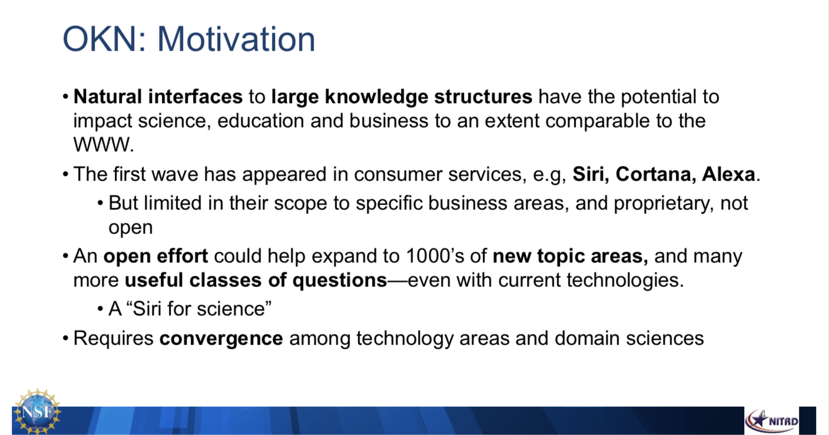
From: https://www.nitrd.gov/nitrdgroups/images/c/ca/OKN_ChaitanBaru.pdf
NSF has supported significant past research in
  Creation of knowledge bases—representation, performance, creation of ontologies, knowledge extraction, knowledge aggregation, reasoning ...

Slide 11
OKN Phase 1 Projects
“Vertical” Projects
A7160 Precision Medicine
7043 Design & Manufacturing
A7099 Urban Flooding
A7152 Space Sciences
A7017 Molecular Data
A7095 Census
A7123 Court Records
A7115 Civil Infrastructure
A7137 Energy Systems
A7134 Intelligent Textbooks
A7033 Public Policy Data
A7153 Finance
A6884 Mobility
A6950 Ocean Resources
“Horizontal” Projects
A7143 Information Credibility
A6940 Knowledge Application Development Environment
A6677 Spatial Data Models/Methods
A7165 Internet Structure & Security
A7136 Federated Search
A6731 Web Data Extraction/Integration
A7908 Spatial Decision Support
Projects should
Seek “track integration”;
Collaborate with industry;
Strive to collaborate/link with other relevant efforts in the community

Slide 12
OKN: Some common themes across projects
Integrating heterogeneous types of data
  E.g., distinct types of biomedical data : biomedical facts; bioinformatics catalogs of data; “raw” data from measurements;
  E.g., internet configuration and traffic data at various levels in the network
Accommodating dynamic information
  Newly acquired data and information are related in a network fashion to extant knowledge
  Need the capability to add new vertices and edges as new knowledge is added and schemas change

Slide 13
OKN: Common themes…
Supporting access by and contributions to the KG by heterogeneous communities of users
  Due to the multidisciplinary nature of the problems being addressed, experts as well as non-experts from each related domain must be able to contribute and share data and knowledge, and access the network to obtain answers to questions beyond their own area of expertise
Incorporating new information into the knowledge graphs using ML + crowdsourcing approaches
  E.g., Intelligent TextBooks powered by knowledge graphs. Scaling out to many domains--capturing relationships among concepts in a domain using experts(crowdsourcing) as well as ML techniques
Several Track B projects also planning to develop and refine ontologies related to job skills

Slide 14
Next Steps
CA Phase 1: Planning (Sept 2019 – May 2020)
  Monthly meetings with required participation in Convergence Accelerator curriculum
    Design thinking and user-centered design
    Team Science
    Domain-specific talks and interactions with potential collaborators
  Work with team coaches
  Team refinement
  User interviews: Must conduct at least 12 user interviews

Slide 15
CA Phase I…
Monthly meetings with the full cohort (43 teams x 3 per team)
  September 2019: Webinar
  October 2019: Kickoff in Washington DC. Interaction with government agencies.
  November 2019: Webinar
  December 2019: Face-to-face in San Francisco. Meetings at IDEO (design thinking). Interactions with industry.
  January 2020: Webinar
  February 2020: Face-to-face in San Francisco. Interact with foundations, VCs, industry.
Projects are also expected to organize community workshops to obtain input
15

Slide 16
CA Phase II: Implementation
Implementation Phase: 1+1 years (June 2020 – June 2022)
April 2020: Submit Phase II proposal
May 2020: Make a ~8-10 minutes “pitch” to a CA review panel and other potential co-funders including Foundations, VCs, other agencies, other NSF programs, other investors…
Projects will likely be evaluated on the submitted proposal; their pitch; and “expressions of interest” from potential co-funders
Total ~5 awards per Track of up to $5M each (up to $3M in Year 1)…or more, based on co-funding
  Cooperative agreements
  Year 2 funding based on Year 1 performance
  Need to demonstrate progress on quarterly milestones
16

Slide 17
Next Steps / Future Directions
OKN Projects are encouraged to link with other related efforts in the community, including industry
  Includes NSF AI Institutes; NIH, DOE, NIST, etc efforts in AI
New CA tracks under consideration for 2021, including any “gap filling” that may be needed for Tracks A and B
  Workshops have been conducted in: Quantum computing; Carbon Sequestration; AI and Disasters; Data Privacy and Data Governance; Innovative use of data science tools with scientific data, for research and education, …
Sustainability of efforts
Strategic directions for the CA program

Slide 19


CA Timeline – 2019 Pilot and the Future
2019 Pilot Cohort (Tracks A and B)
Accelerator
DCL issued
Phase I Projects
Start!
Pitch
Competition
Phase 2 Projects
Start
Year 2
Decision
Deliverables
Phase 1
Proposals
Innovation
Curriculum
RCOs
Phase 1: Team formation, res. plan dev
Phase 2: Creating Deliverables
Mar
2019
Jun
Sep
Dec
Mar
2020
Jun
Sep
Dec
Jun
2021
Jun
2022
2020 Cohort: New tracks (C and D)
RFI: 75 responses
submitted
Pitch
Comp
2020 Topic Workshops
RCOs
Phase 1 Projects
Start
2020
Solicitation
Phase 2 Projects
Start
Year 2
Decision
Innovation
Curriculum
Phase 1
Proposals
19

Slide 20
Accelerator “Tracks B1 and B2”:
Future of Work at the Human-Technology Frontier
  AI and Future Jobs. The AI and Future of Jobs track will support the development of mechanisms that connect workers with jobs of the future, reflecting the need for re-skilling and lifelong learning, such as predictive artificial intelligence tools, economic and labor market analyses of needed skills for future workplaces, and educational technologies needed for adult learning. Ensuring fair and ethical treatment of workers will be a key principle for this effort. Projects may be focused on particular industries or regions, specific populations such as veterans, or particular workplace types such as small businesses, manufacturing, or K-12 schools.
  National Talent Ecosystem. Innovative approaches for employers to support workers seeking the skills required for 21st century work related to data science, predictive analytics, AI/machine learning, and other technologies of the future. Successful projects will prototype innovative approaches, such as learning environments, simulations and tools for analysis or assessment, and vehicles for recruitment and engagement, with the potential for wider implementation by industry, educational institutions, and other stakeholders engaging in the co-creation of a national talent ecosystem.

Slide 21





Track B1/B2 Projects
B7026 - Machine learning-based national labor market information tools
B6970 – AI+AR platform for autism spectrum disorder workers
B6857 – AI-based job matching – veterans, disabled workers
B7068 – Documents competencies at the national level
Existing needs:
Positions
Skill requirements
Locations
B7118 – Connects data exchanges at state level
Existing
Qualifications:
Education
Skills
Certificates
Worker-Work Matching
Prospective
Employee
Prospective
Employer
Future needs:
Emerging jobs
Growth projections
Market demands
Workforce Training and Education
Recommendations
Curricula and Skills Training
Development
B6947 – National microcredential system
B6894 – Upskilling/reskilling for digital technologies
B7063 – Microcredential system for industrial robotics technicians
B6656 – Design based research + analytics identifies skill gaps and designs training
B6992 – AI-enabled assessment + training plan for displaced miners
B7833 – Deep learning predicts future jobs + training for hospitality industry
B7037 – AI-driven skill gap diagnostics + recommendation engine for manufacturing
B6915 – Deep learning predicts future jobs + training for manufacturing
B7010 – Assessment/Prediction/Learning – smart sensing/mixed reality
B6997 – Training platform for autonomous systems
B6968 – Machine learning based tools for gig economy workers
B7053 – Advanced robotics for training next gen emergency responders
B7019 – Cloud-based platform trains for future jobs in architecture, construction
B6956 – AI-driven tool for career management in STEM fields
B7061 – Develops ROI measurement for training programs for policymakers
B7888 – Fostering a diverse AI workforce
Education/Training
B7036 – Low cost AR training content development platform for SMEs
Graphics Designed By 30000008981 From <a href="https://lovepik.com/image-400862045/blue-circle-neon-box-lamp.html">LovePik.com</a>

Slide 22
Convergence Accelerator 2019 Pilot:
Phase 1: Planning (Sept 2019 – May 2020)
Up to $1M for ~9 months: Planning, team formation, required participation in Convergence Accelerator (CA) curriculum
  Design thinking and user-centered design. Provided by IDEO.
  Team Science
  Domain-specific talks and interactions with potential collaborators
Each team assigned a coach from a team of coaches
  Must conduct at least 12 user interviews
  May consult with any of the coaches, if they wish.

