Slide 1
ISO/IEC 21838
Barry Smith
National Center for Ontological Research
Ontology Summit
June 3, 2020

Slide 2
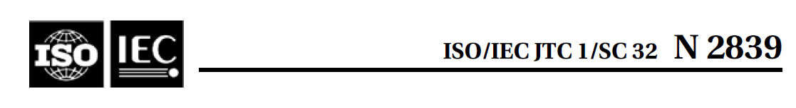
International Standards Organization (ISO)
International Electrotechnical Commission (IEC)
ISO/IEC Joint Technical Committee JTC1:
Information technology

Slide 3
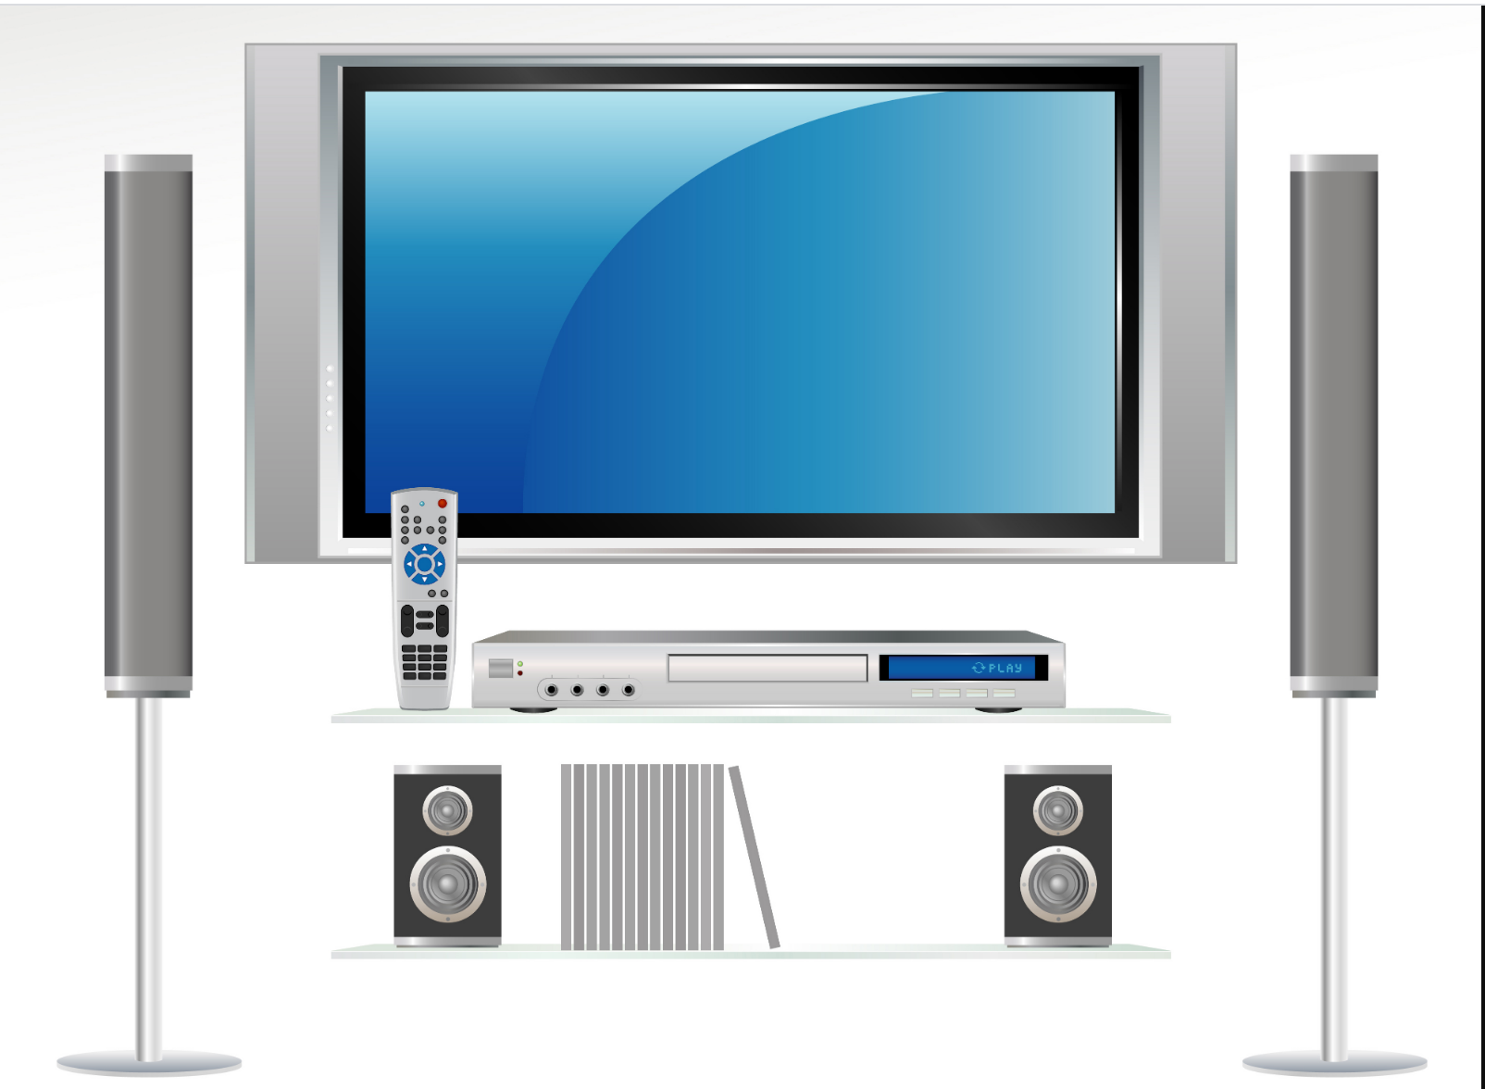
MP3, MPEG-2, MPEG-4,
…
Compatibility, Interoperability https://jtc1info.org/technology/

Slide 4
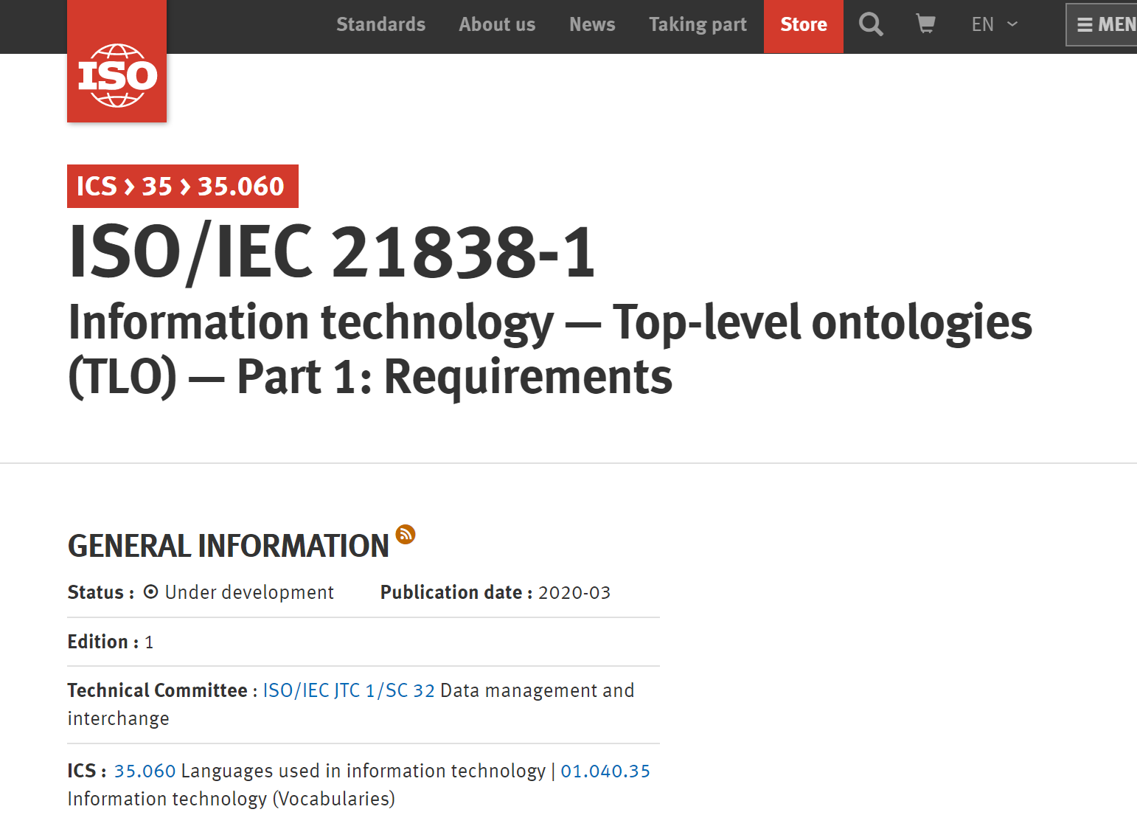
iso.org/standard/71954.html

Slide 5
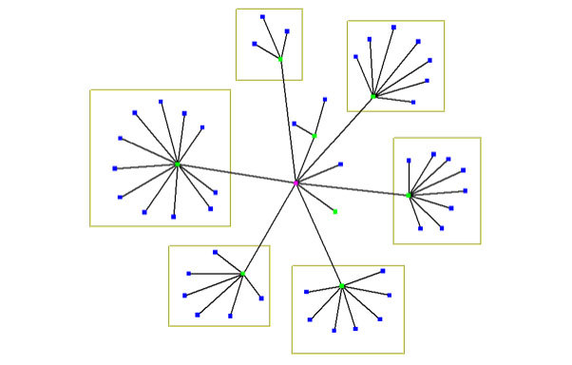
hub and spokes approach to the creation of suites of interoperable ontology modules
hub

Slide 6
Reinvent the wheel syndrome in W3C (World Wide Web Consortium)
W3C Provenance Ontology (PROV)
W3C Semantic Sensor Network Ontology (SSN)

Slide 7
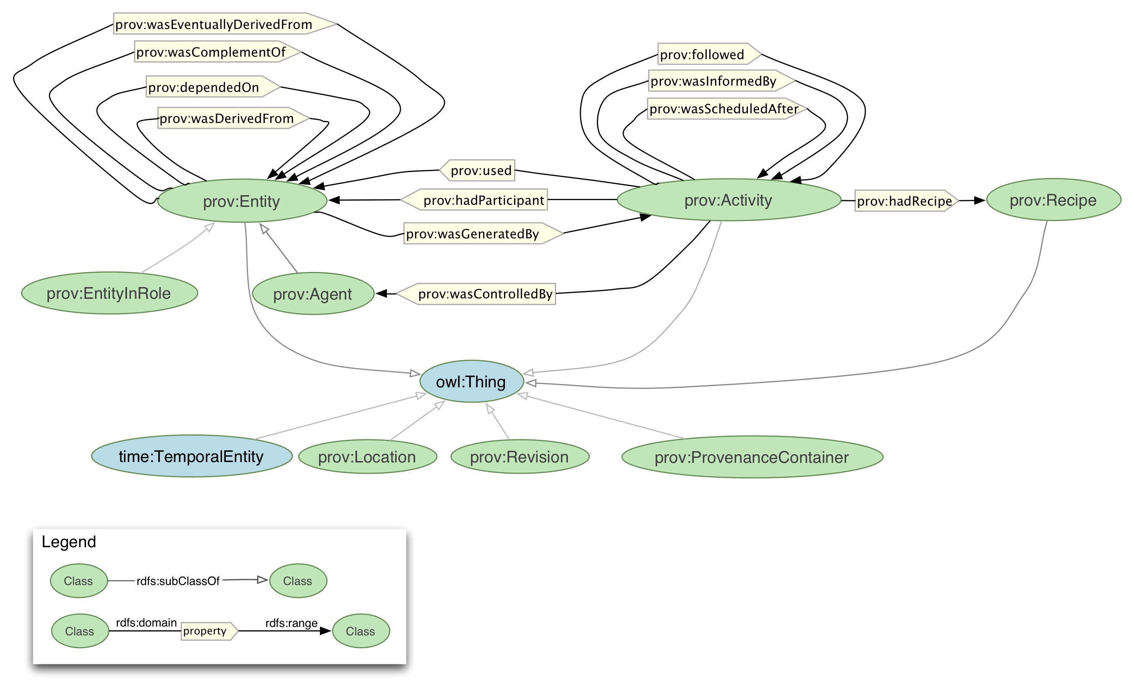
W3C Provenance Ontology (PROV)

Slide 8
W3C Provenance Ontology (PROV) upper-level terms:
Entity in Role Agent Activity | Recipe Temporal Entity Location

Slide 9
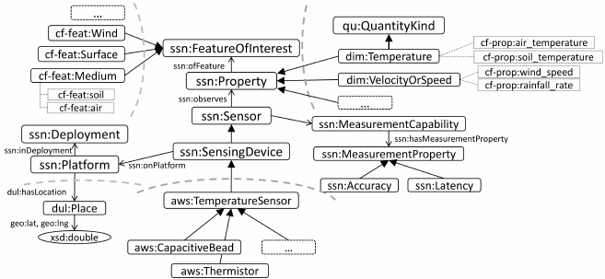
W3C Semantic Sensor Network Ontology (SSN)

Slide 10
W3C Semantic Sensor Network Ontology (SSN) upper-level terms:
Feature of Interest Quantity Kind Measurement Property | Place Platform Process

Slide 11
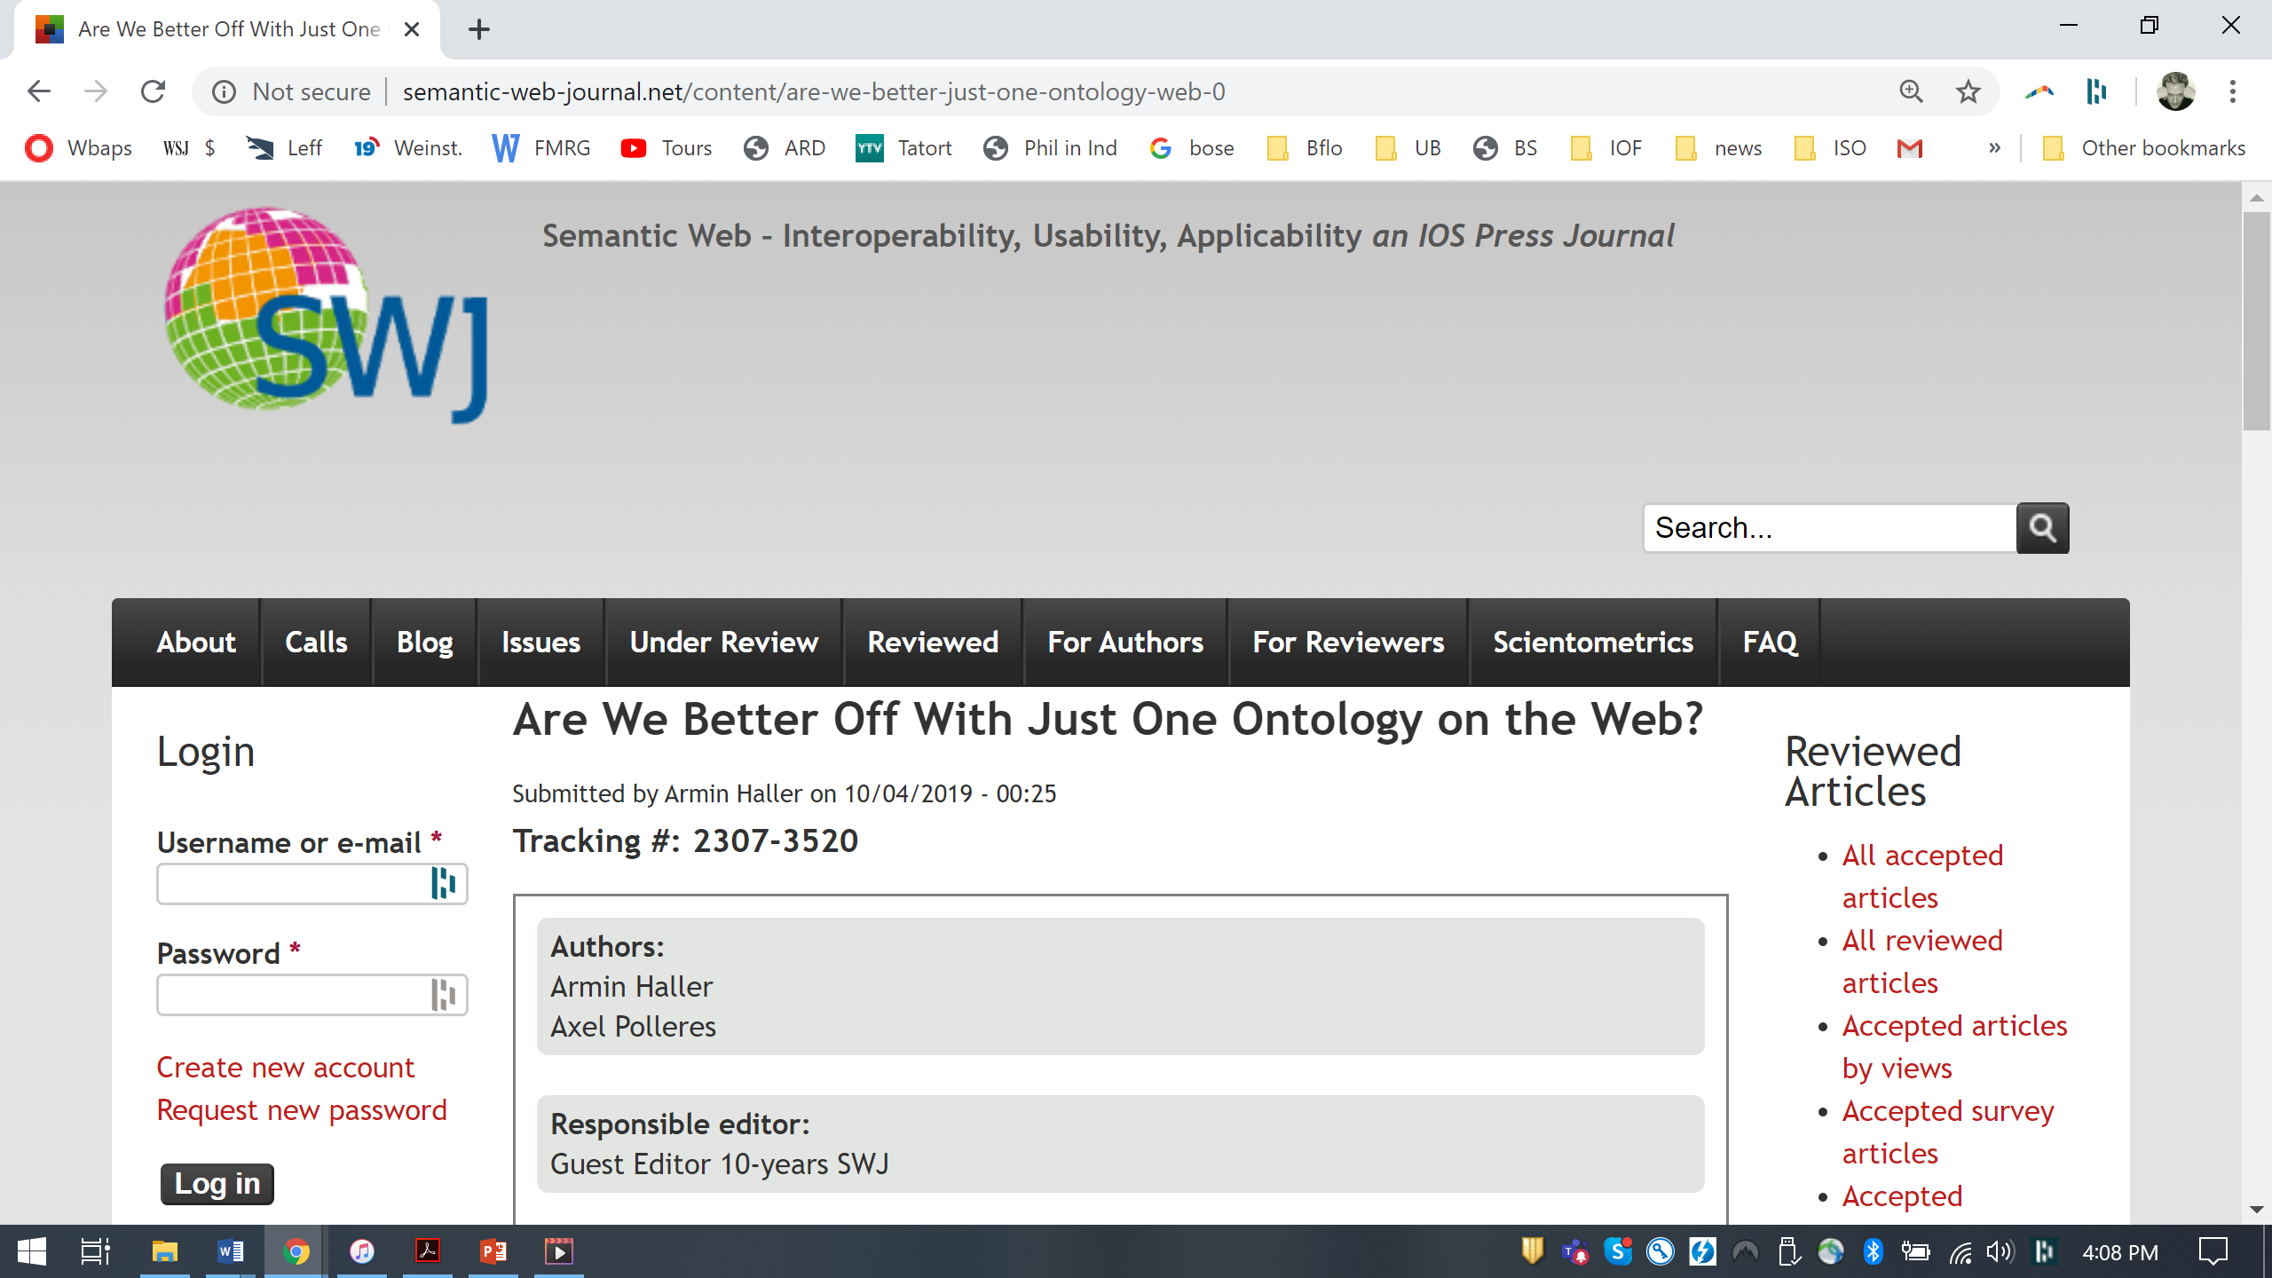
semantic web journal

Slide 12
ISO 21838-1: Definition of ‘ontology’
ontology =def. collection of terms, relational expressions and associated natural-language definitions together with one or more formal theories designed to capture the intended interpretations of these definitions
domain =def. collection of entities of interest to a certain community or discipline
domain ontology =def. ontology whose terms represent classes or types in some domain

Slide 13
ISO 21838-1: Definition of
‘top-level ontology’
category =def. general class or type that is shared across many different domains and is represented by a domain-neutral term
top-level ontology (TLO) =def. ontology that is created to represent the categories that are shared across a maximally broad range of domains

Slide 14
Requirements (1) for being a top-level ontology in accordance with ISO/IEC 21838
  Shall include no domain-ontology content
  Shall cover all entities (be maximally general)

Slide 15
How coverage achieved for data relating to:
Space and time
Time and change
Scale and granularity
Attributes
Quantities
Processes
Causality
Information
Artifacts
Mental entities

Slide 16
Requirements (2) for being a top-level ontology in accordance with ISO/IEC 21838
  Shall be available as:
  textual artefact (terms + definitions)
  OWL axiomatization
  CL/FOL axiomatization
  With proof of consistency for 3. and proof of derivability of 2. from 3.

Slide 17
Top-Level Ontologies
Basic Formal Ontology (BFO)
Domain Ontology for Linguistic and Cognitive Engineering (DOLCE)
Suggested Upper Merged Ontology (SUMO)

Slide 18
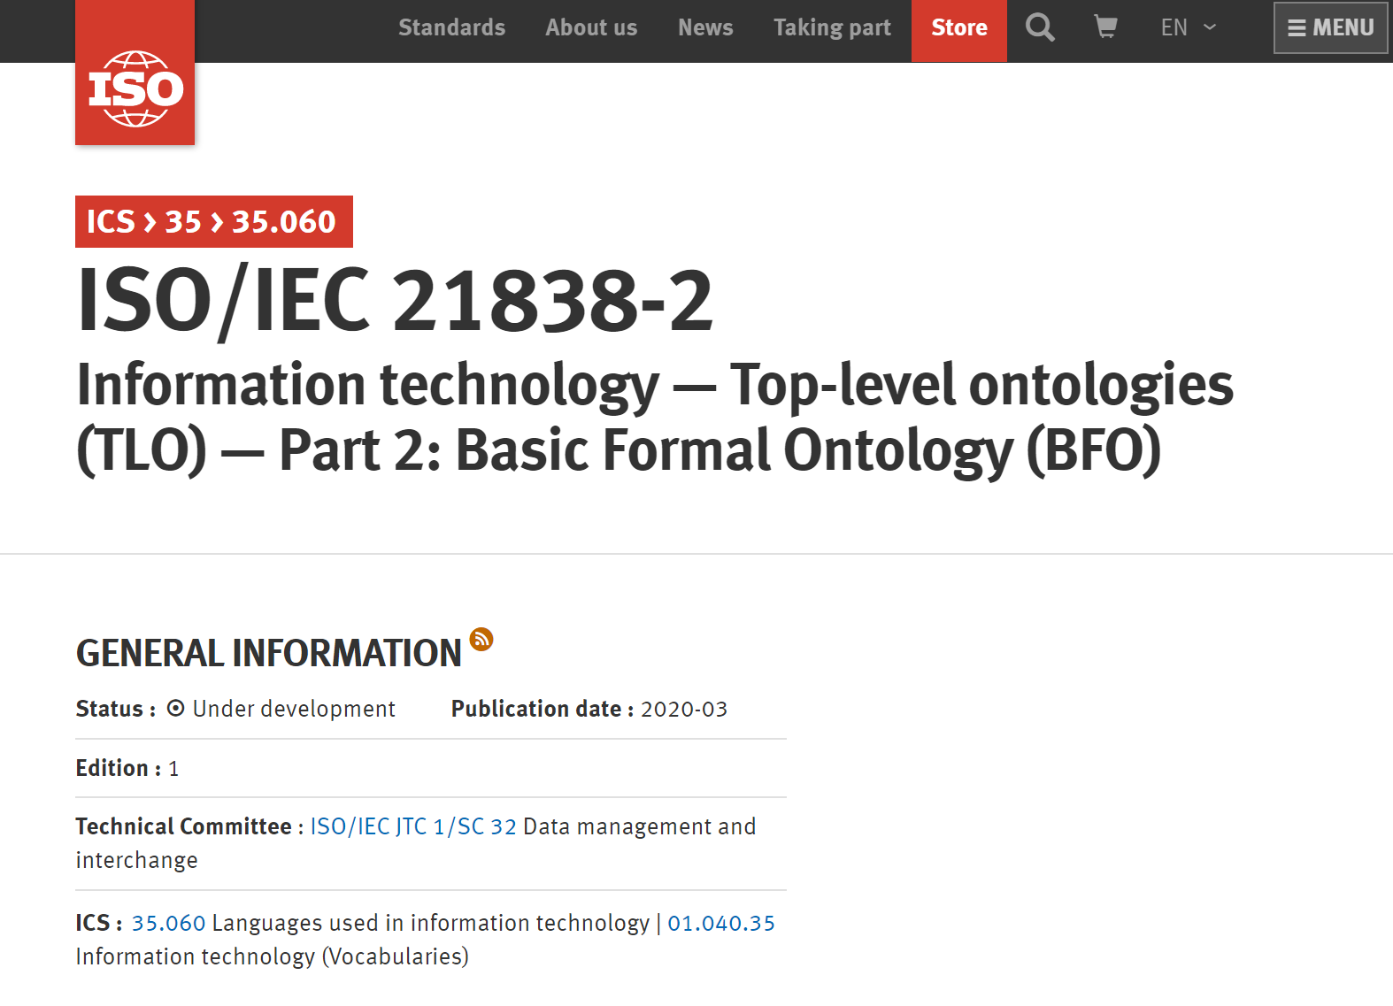
iso.org/standard/74572.html

Slide 19
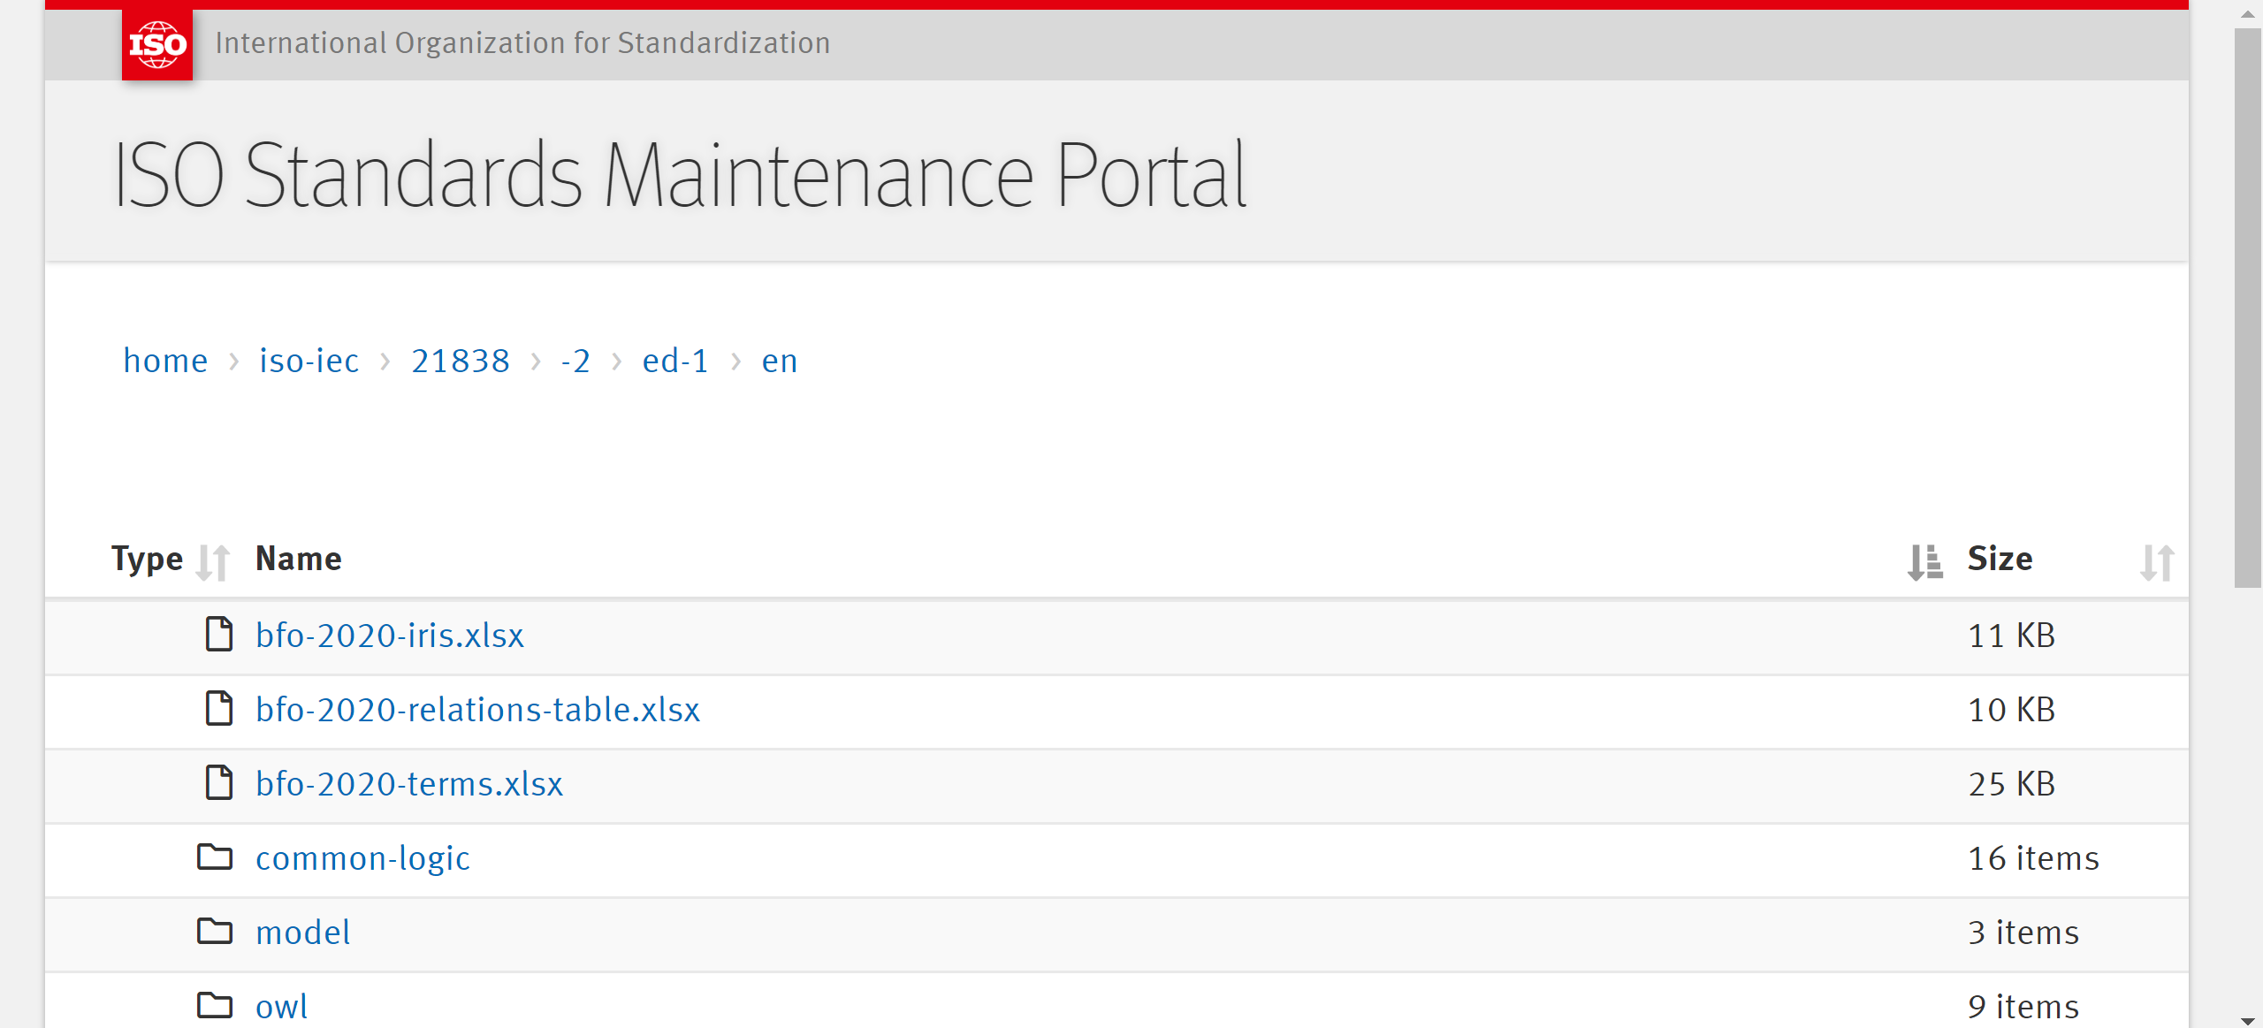
https://standards.iso.org/iso-iec/21838/-2/ed-1/en/

Slide 20
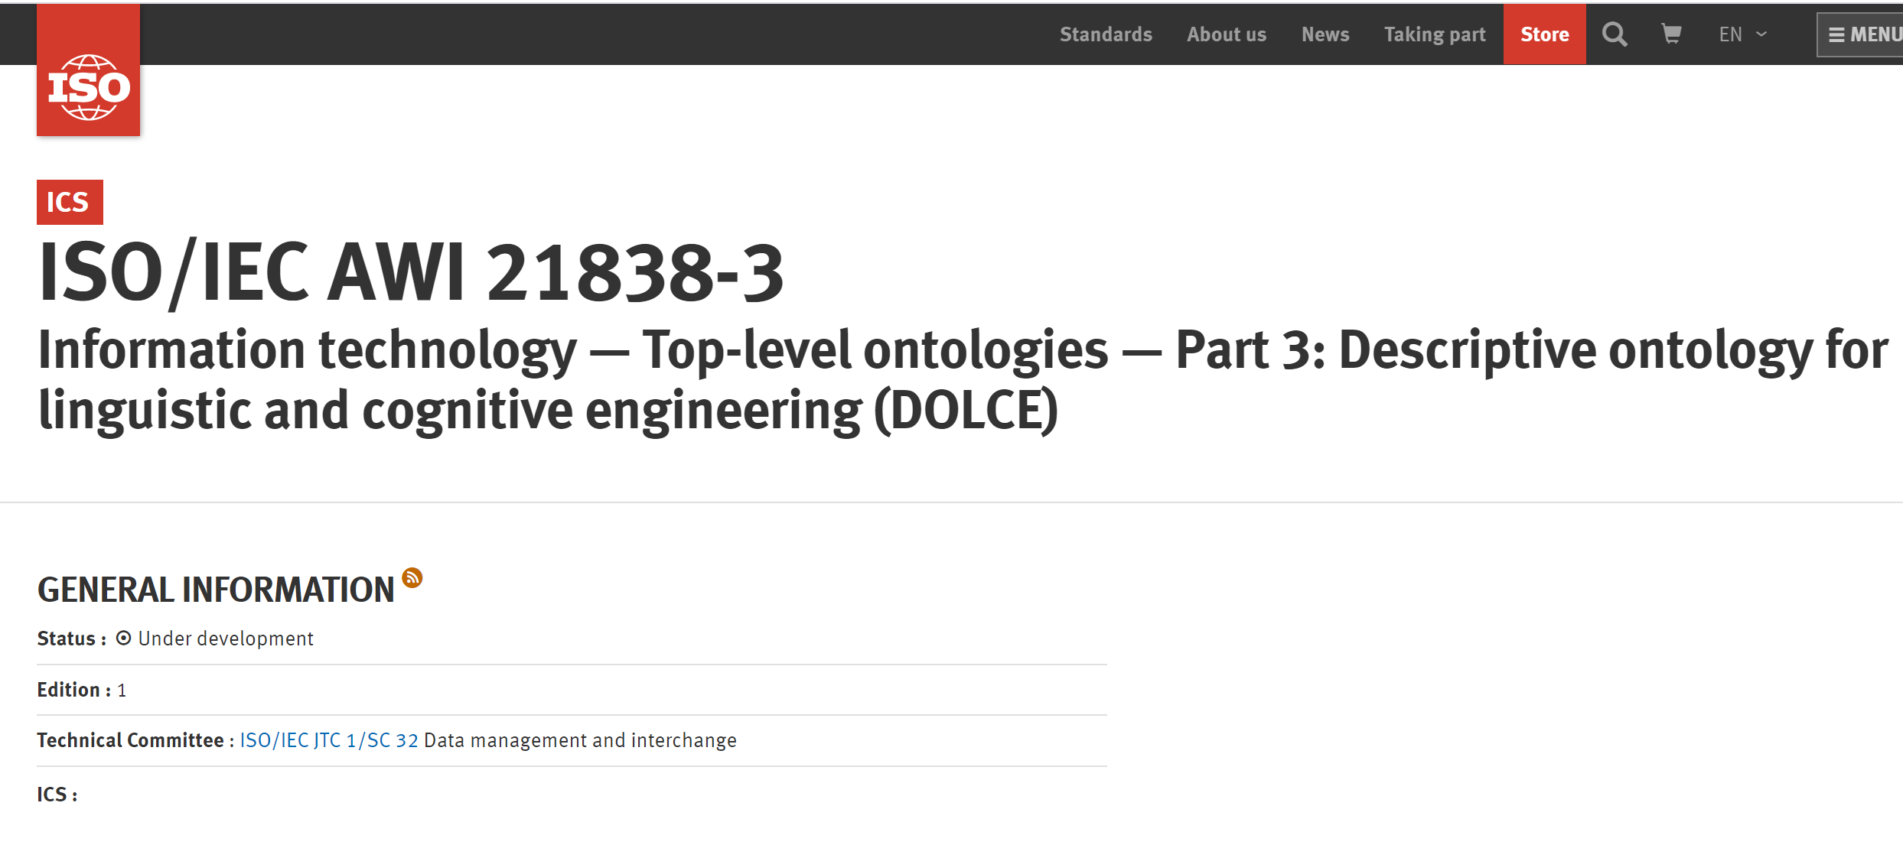
https://www.iso.org/standard/78927.html

Slide 21
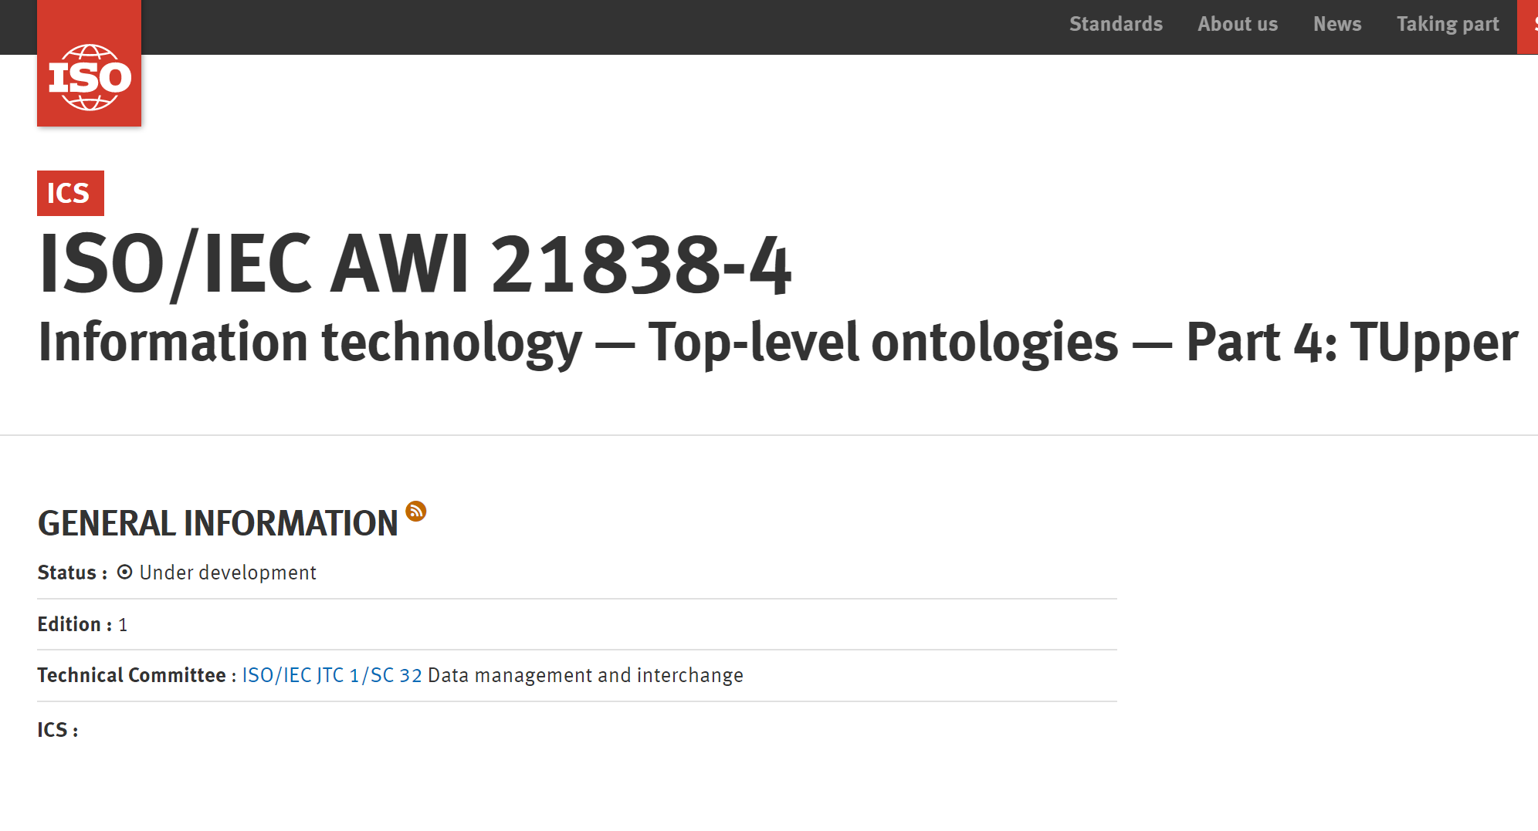
https://www.iso.org/standard/78928.html

Slide 22
hub and spokes approach to the creation of suites of interoperable ontology modules
hub

Slide 23
semantic web journal

Slide 24
While upper ontologies have experienced strong research interest in the early 2000’s, their use on the Web has largely been confined to the biomedical domain where the community, through the OBO foundry, maintained and mandated the use of the BFO upper ontology.
… in an analysis of links [29] in the LOD Cloud [1] we have discovered that not a single dataset in a corpus of 430 Linked Open Datasets that were investigated for this study reuses DOLCE or SUMO, the other two main open-source upper ontologies.
http://www.semantic-web-journal.net/system/files/swj2307.pdf

Slide 25
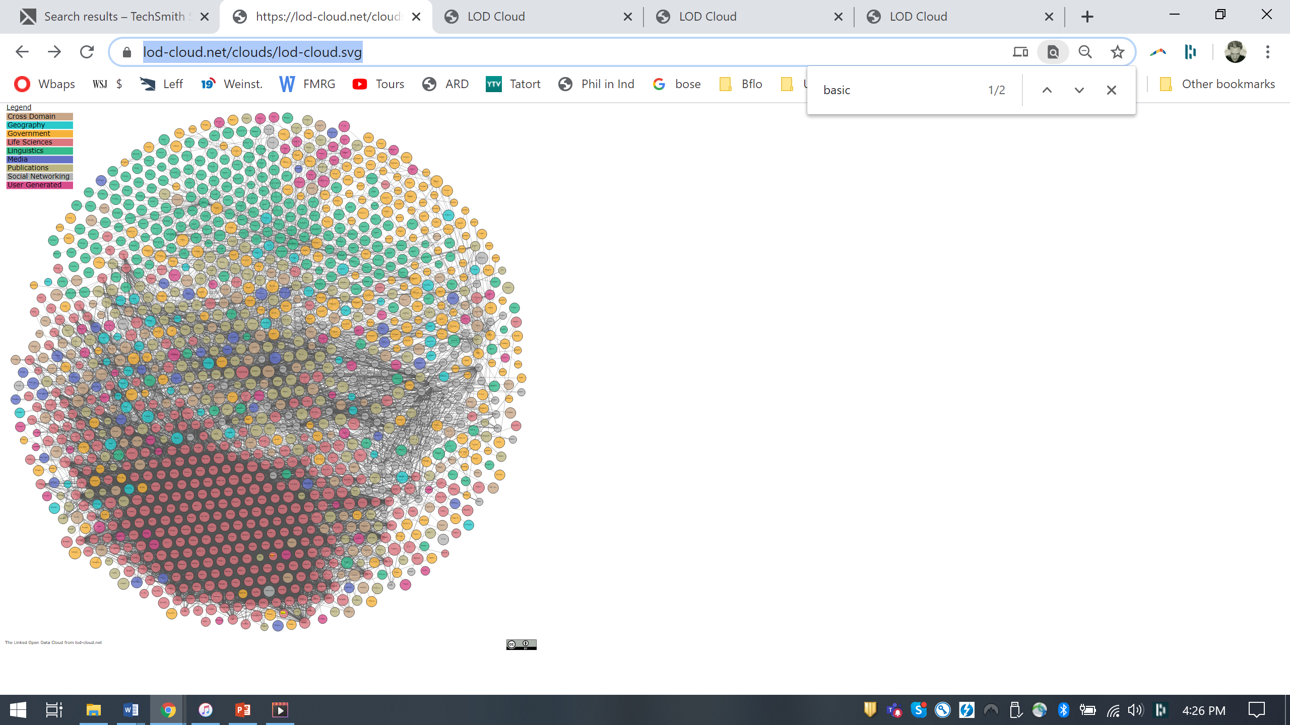

Slide 26
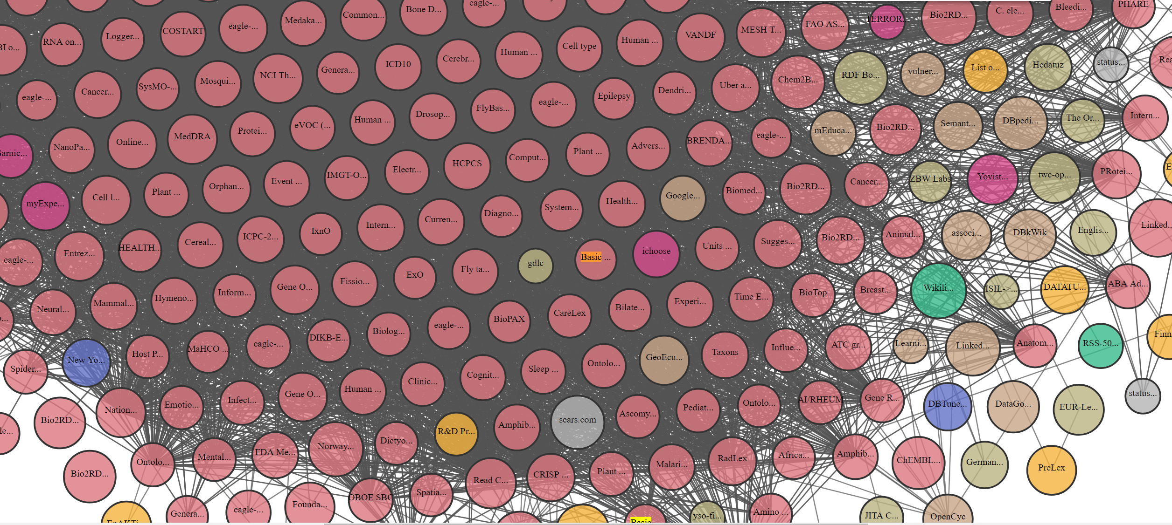
Basic Formal Ontology
https://lod-cloud.net/clouds/lod-cloud.svg

Slide 27
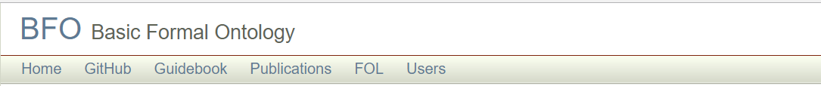
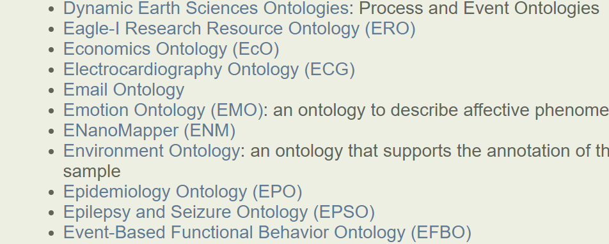
~ 300 domain ontologies extending BFO
http://basic-formal-ontology.org/users.html

Slide 28
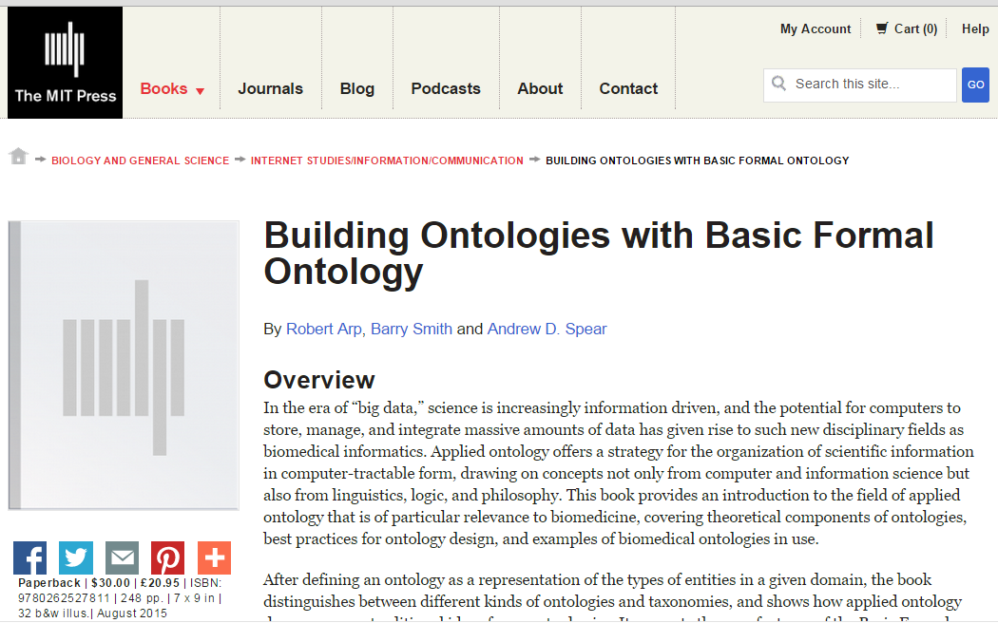
https://mitpress.mit.edu/building-ontologies

Slide 29
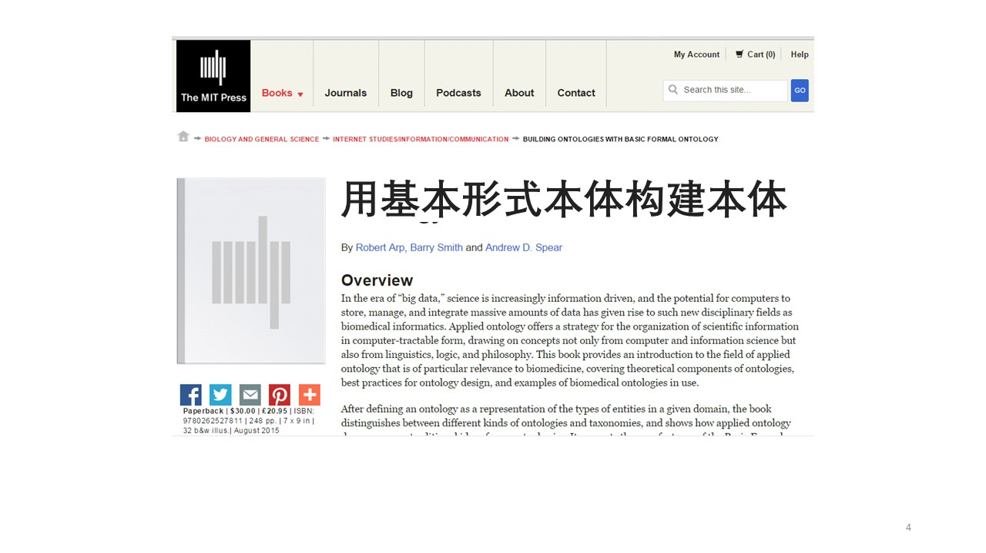

Slide 30
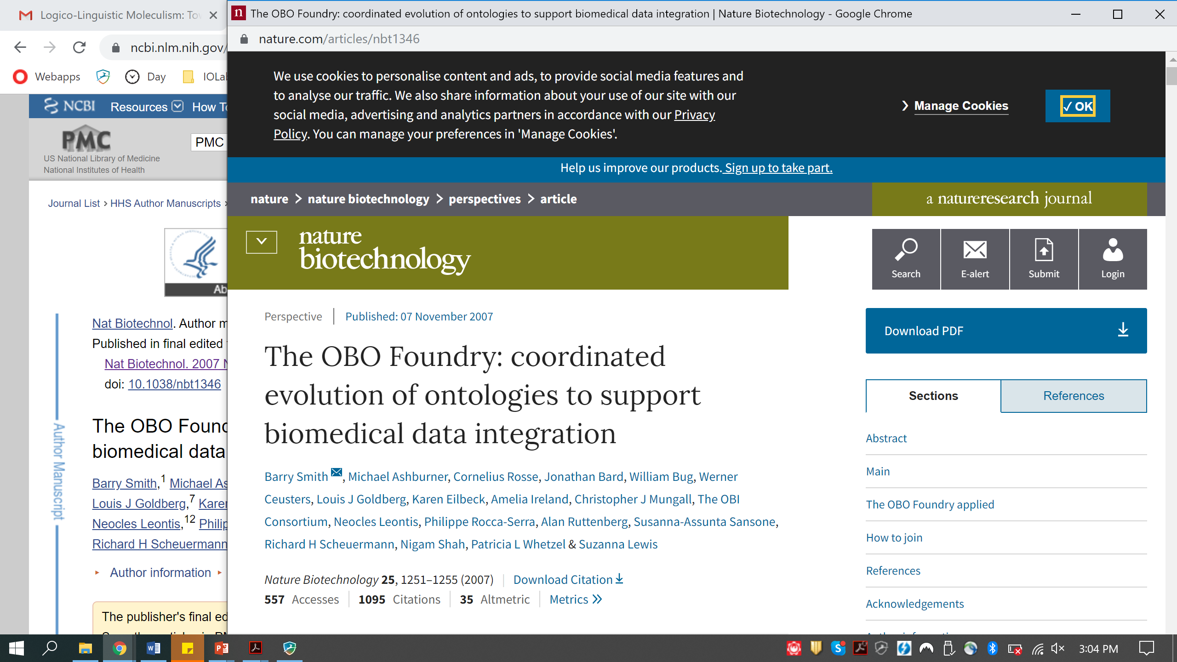

Slide 31
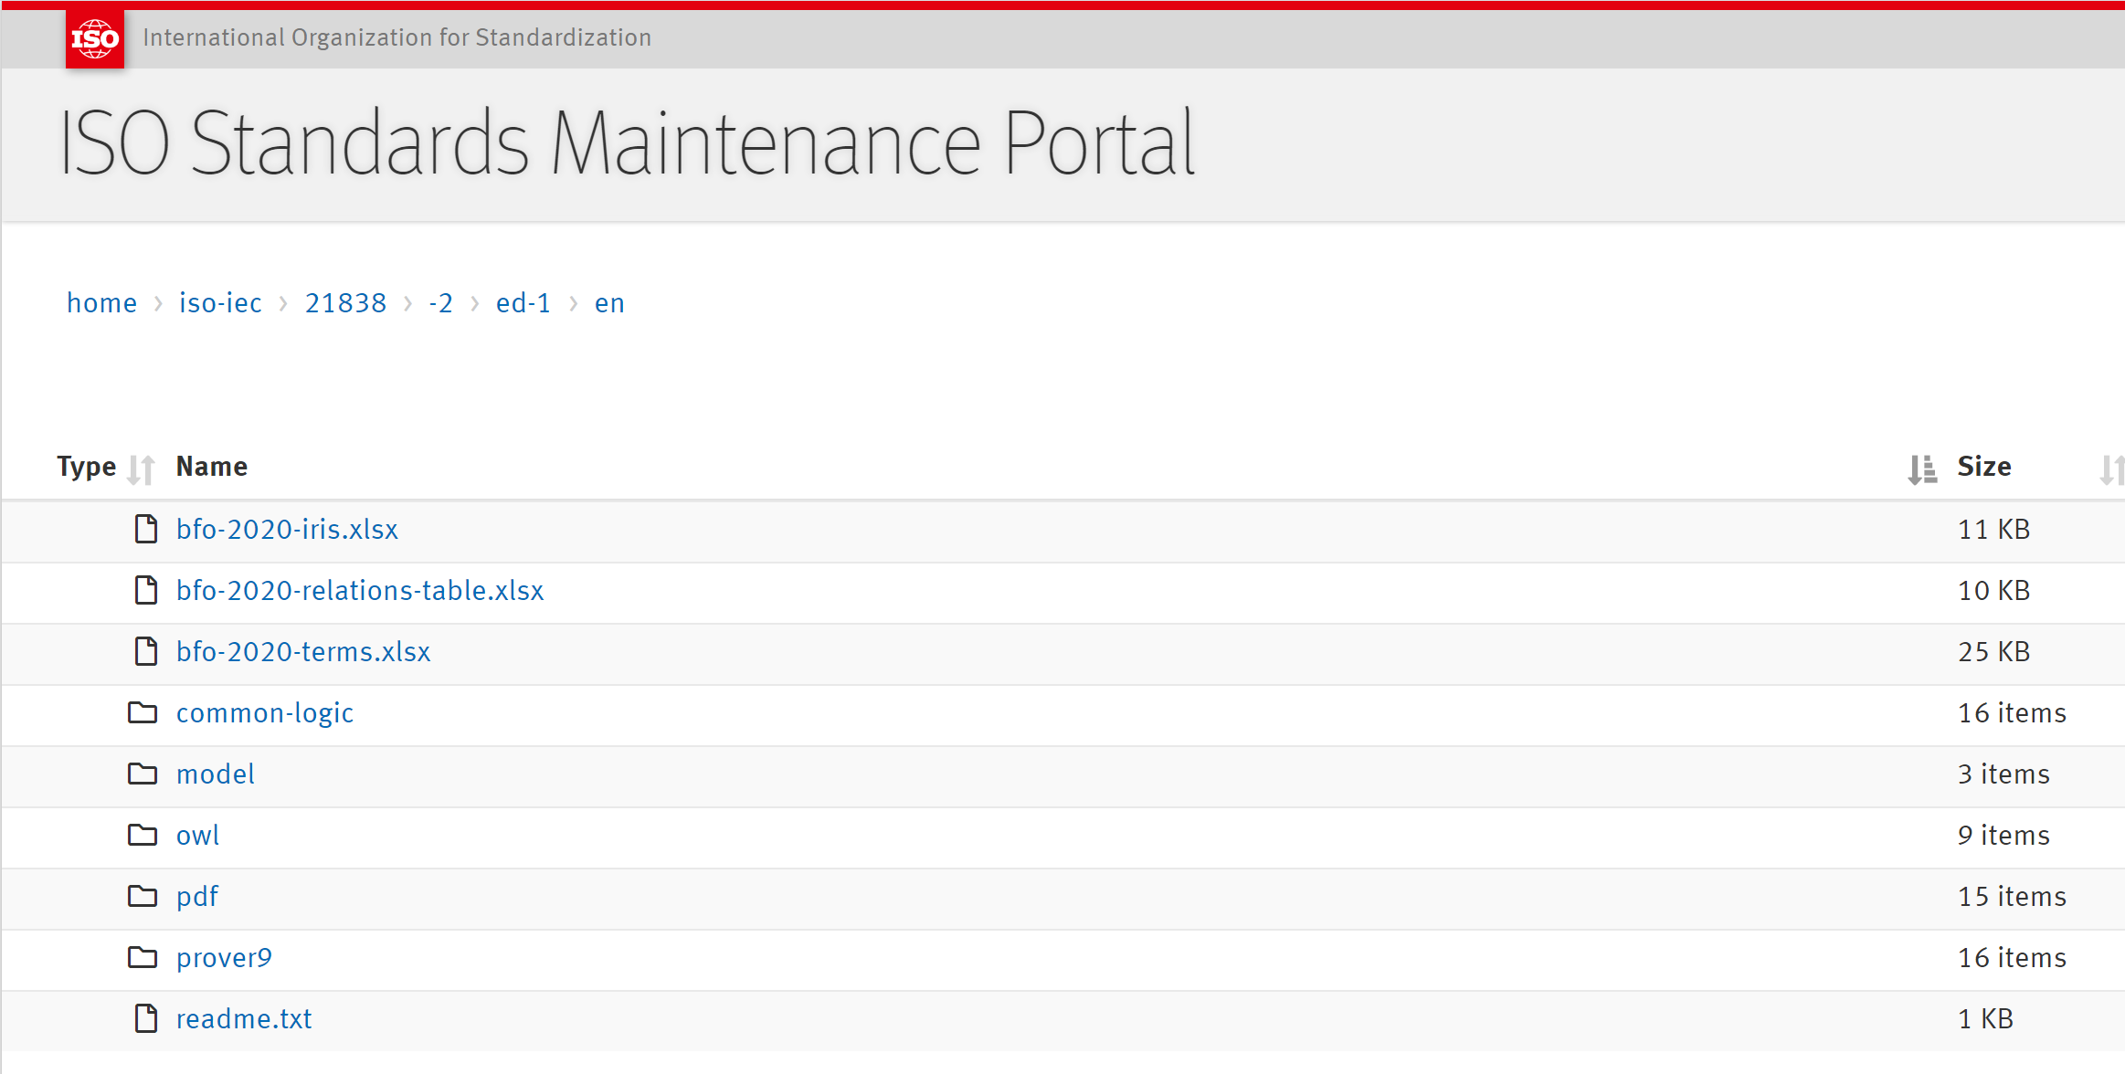
https://standards.iso.org/iso-iec/21838/-2/ed-1/en/

Slide 32
BFO-2020
entity
is a
continuant
occurrent
independent continuant
generically dependent continuant
specifically dependent continuant
process
process
boundary
temporal
region
spatiotemporal
region
material entity
immaterial entity
quality
realizable entity
history
zero-dimensional
temporal region
one-dimensional
temporal region
relational quality
disposition
temporal
instant
temporal
interval
object
fiat object part
object aggregate
role
site
continuant fiat boundary
spatial region
function
fiat point
fiat line
fiat surface
zero-dimensional
spatial region
one-dimensional
spatial region
two-dimensional
spatial region
three-dimensional
spatial region

Slide 33
Initial impact of ISO/IEC 21838-2 (BFO-2020)
ISO 29303: Interoperability Reference Framework
ISO/CEN Materials Testing
ISO 15926-14
ISO 10303 STEP
INCITS Ad hoc Working Group on Mid-Level Ontology
Joint AI Center (JAIC) ISO standard for AI
DoD/IC Ontology Suite
BFO-Based Engineering Ontologies - NCOR Wiki

Slide 34
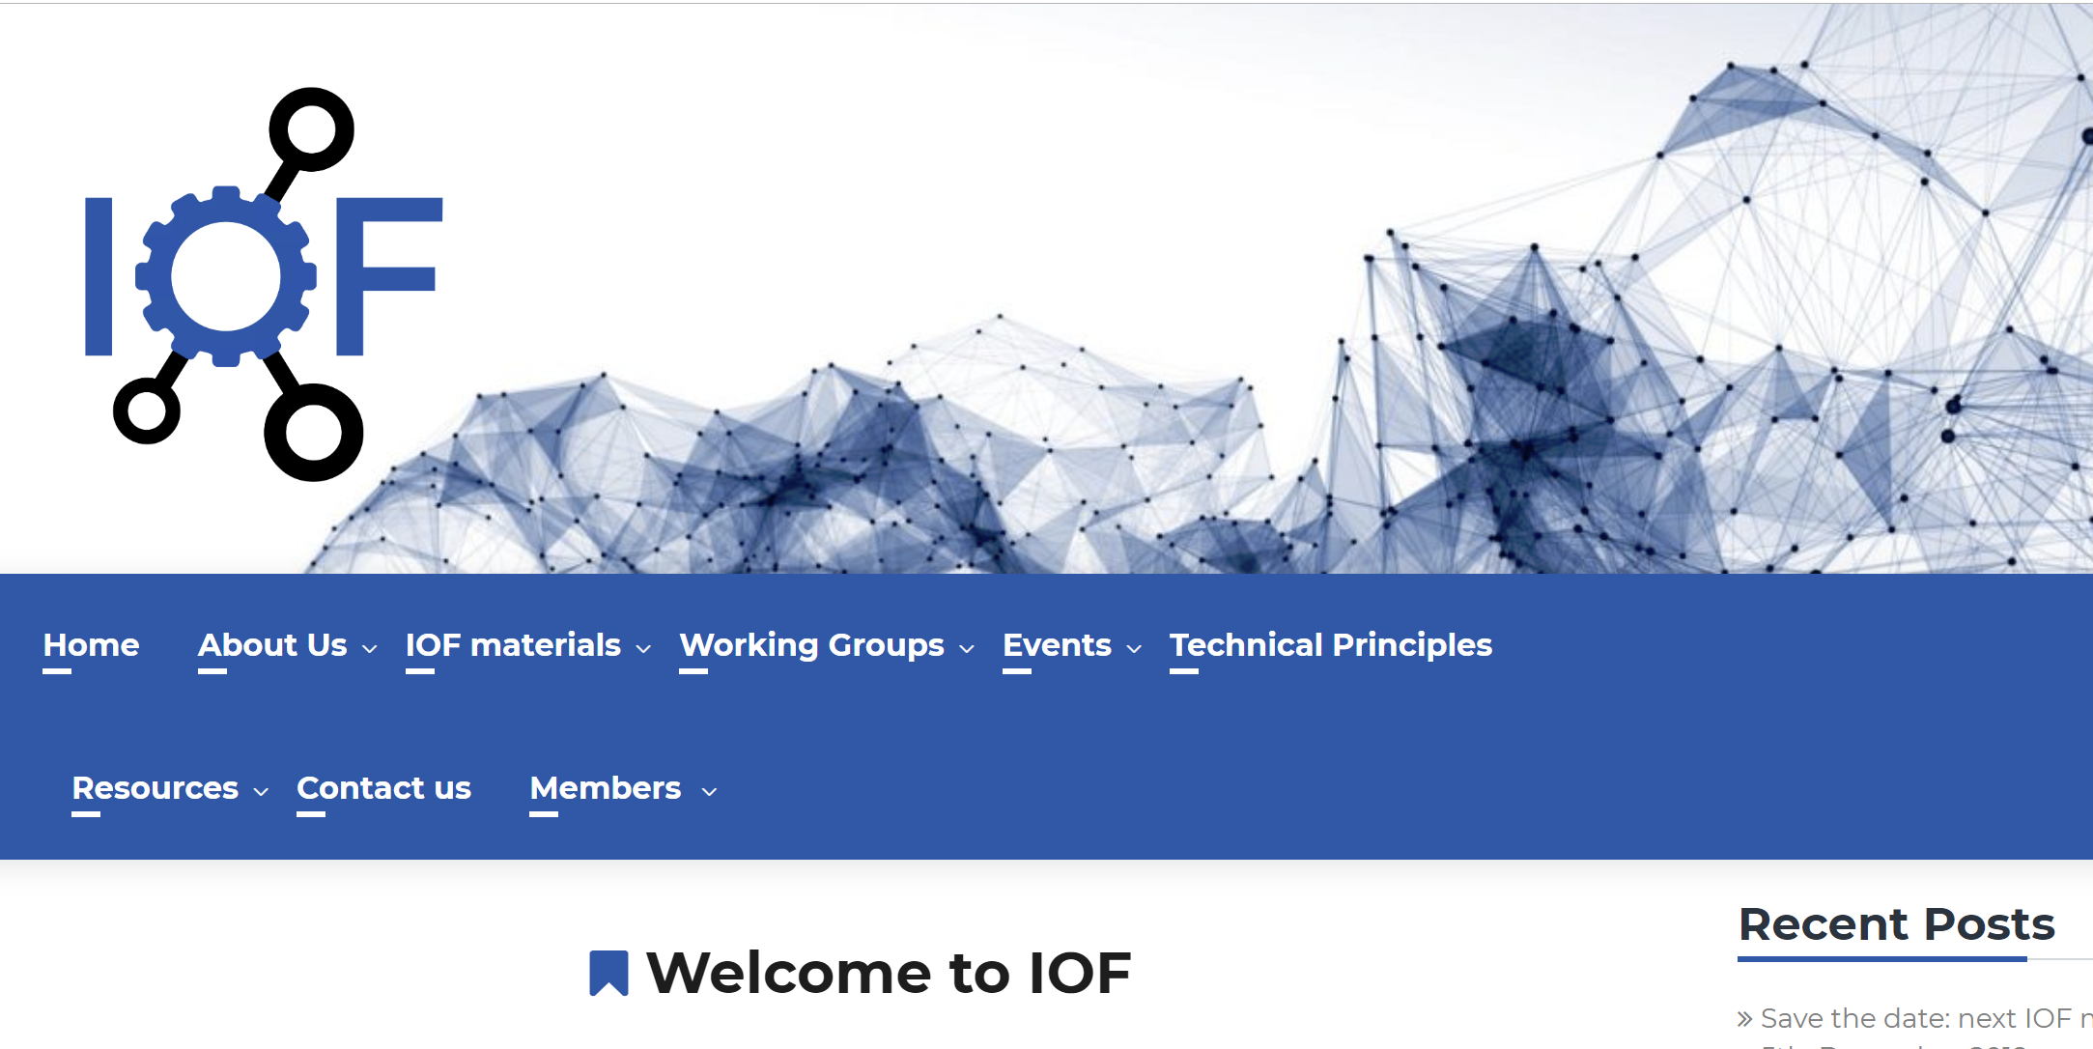
https://www.industrialontologies.org/

Slide 35
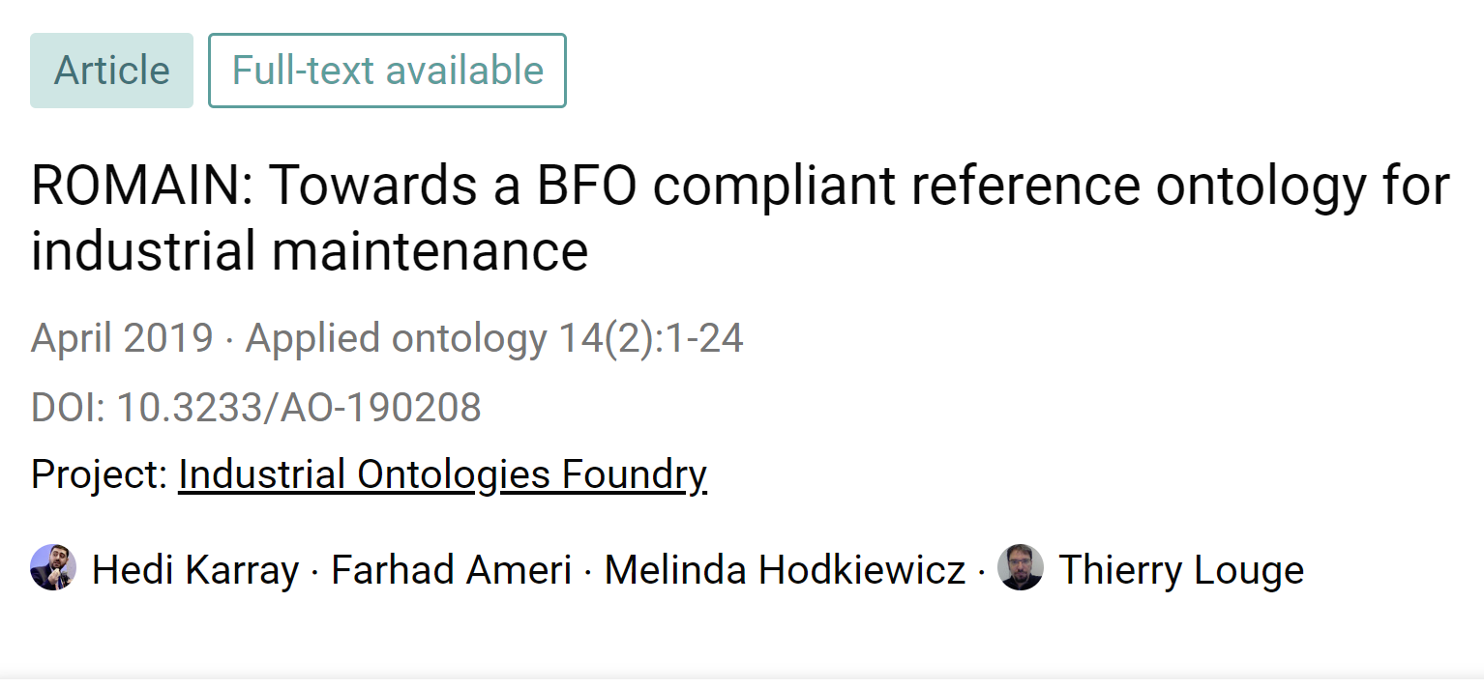
BFO-Based Engineering Ontologies

Slide 36
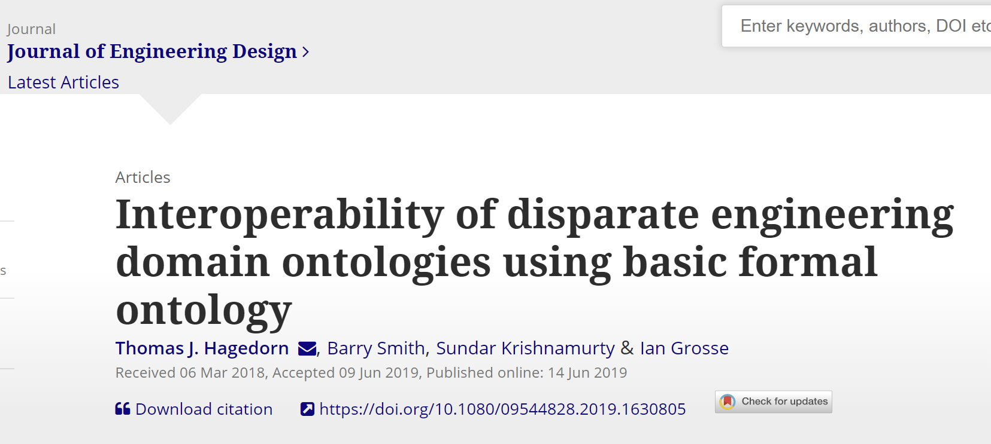
BFO-Based Engineering Ontologies

Slide 37
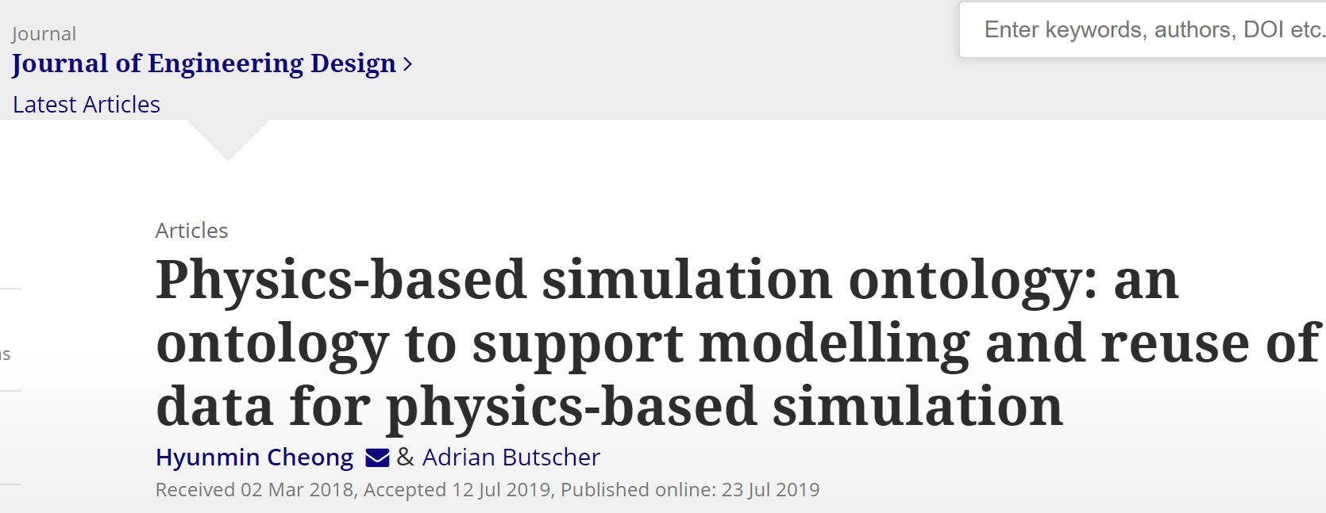
BFO-Based Engineering Ontologies

Slide 38
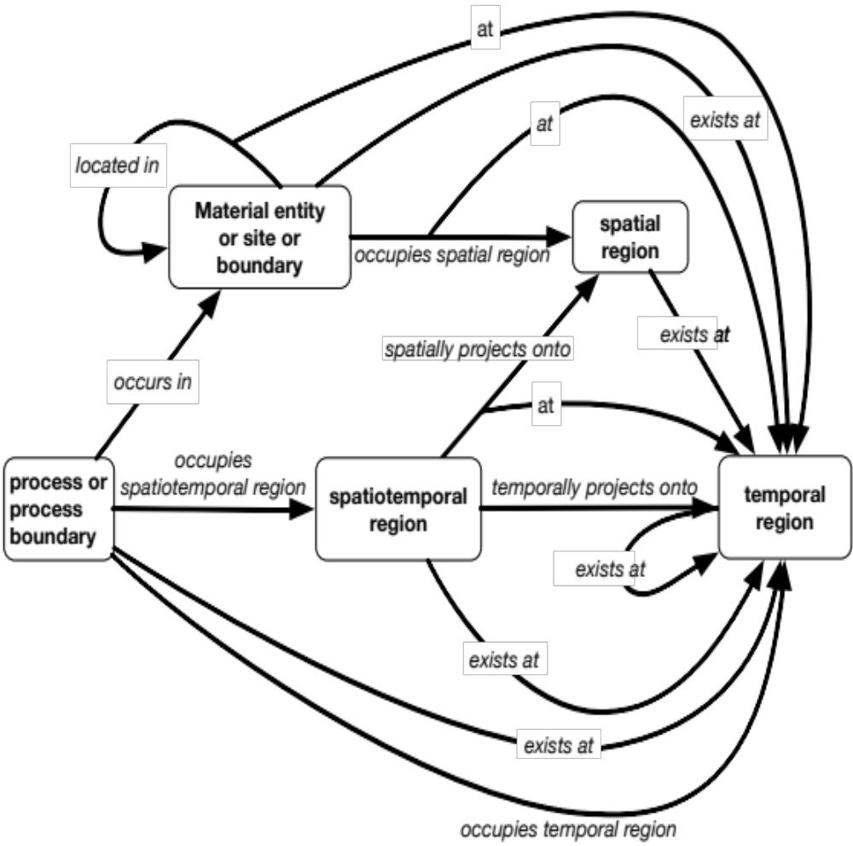
Spatiotemporal relations
Remove many same-type relations e.g
temporal region occupies temporal region
Occupation relations
range: spatiotemporal
Location relation
range: independent continuants,
but not spatial regions
Existence relation
range: temporal region
Note: ternary relations in diagram have
arrow “at” branching off arrow relating
first two relata

