Slide 1
MetaNet: Deep semantic automatic metaphor analysis
Elise Stickles
University of British Columbia
elise.stickles@ubc.ca // elisestickles.com
Ontology Summit 2020
November 6, 2019

Slide 2
Road map
Overview of MetaNet
Metaphor repository
Metaphor extraction process
Concluding remarks
If time/interest: Data Analysis

Slide 3
A brief history of MetaNet
Started in 2012 as part of IARPA’s Metaphor Program
Computational, linguistic, and psychology teams across 4 institutions (International Computer Science Institute, UC Berkeley, UC Merced, UC San Diego)
Initial objectives:
  Build a multi-lingual metaphor repository (American English, Mexican Spanish, Farsi, Russian)
  Automatically identify and extract metaphors from text
  Compare conceptual metaphors used by different groups and cultures in order to better understand their different beliefs and worldviews

Slide 4
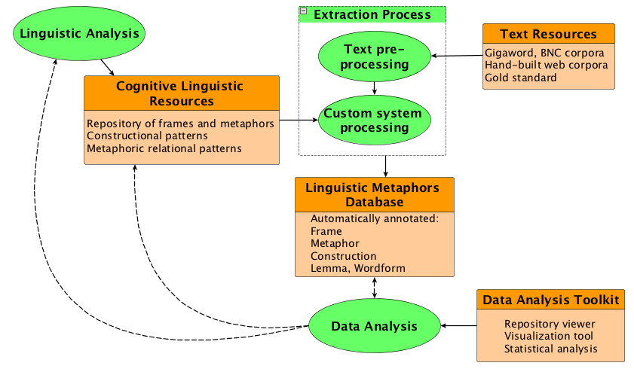
MetaNet system diagram
Notes:
This diagram shows the different parts of the system, and how they are interconnected
Processes in green ovals
resources, tools in orange boxes

Slide 5
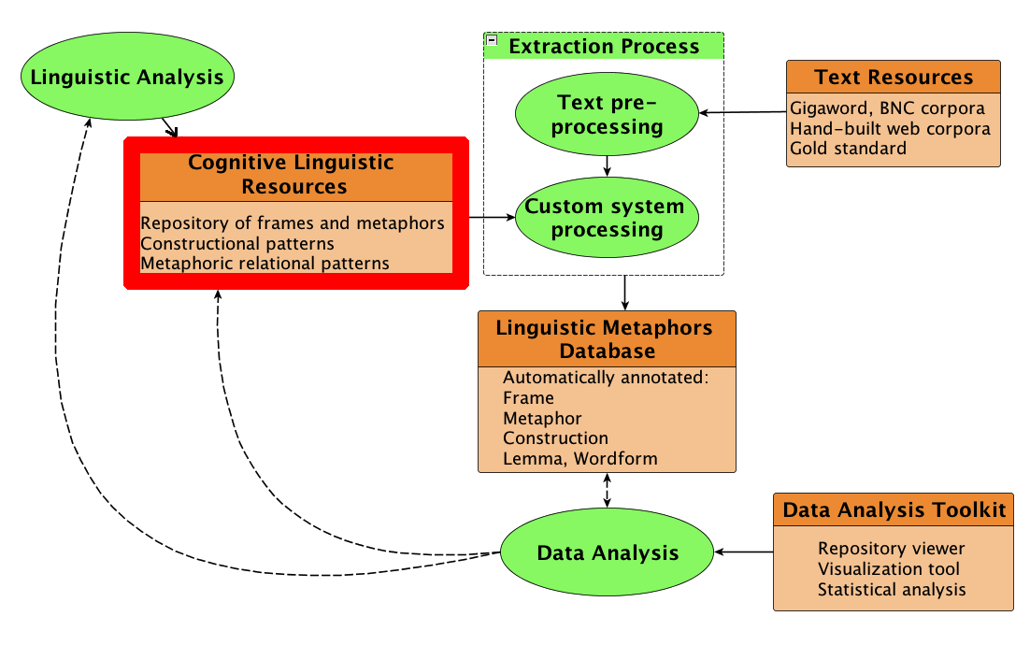
MetaNet system diagram

Slide 6
Background: Metaphor
Examples:
  a trend that experts believe will continue to climb
  let’s just walk through the numbers here
  moving beyond the more traditional definitions of empathy
Conceptual metaphor theory (Lakoff & Johnson, 1980)
  Less-directly accessible concept (‘target domain’) described in terms of more-directly accessible concept (‘source domain’)
  Metaphoric expressions are instances of more general conceptual metaphors

Slide 7
Metaphor Repository
  Formalizes conceptual metaphor theory (Lakoff & Johnson, 1980)
  Source and target domains are represented as frames (Fillmore 1976; Ruppenhofer et al. 2010)

Slide 8
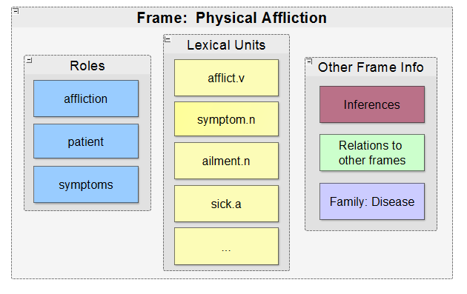
Frame: Physical Affliction

Slide 9
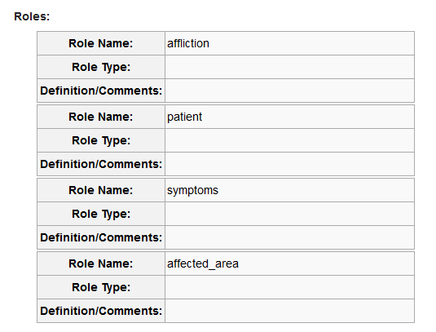
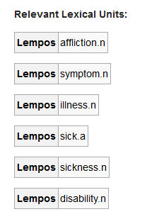
Frame: Physical Affliction

Slide 10
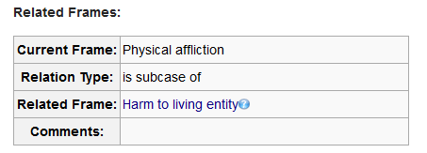
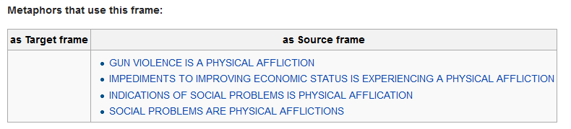
Frame: Physical Affliction

Slide 11
Metaphor Repository
  Formalizes conceptual metaphor theory (Lakoff & Johnson, 1980)
  Source and target domains are represented as frames (Fillmore 1976; Ruppenhofer et al. 2010)
Conceptual metaphors are represented as mappings from Source frames to Target frames

Slide 12
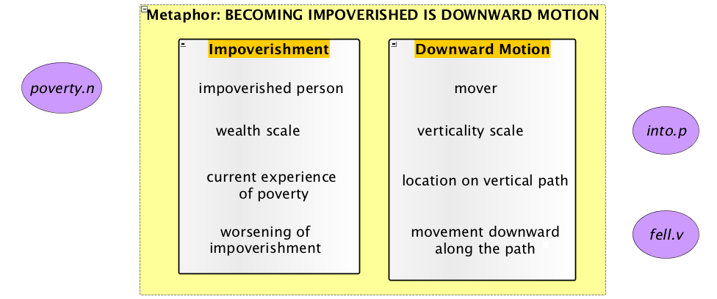
Metaphor Repository
Source and target domains are represented using frames (Fillmore, 1976; Ruppenhofer et al., 2010)
Conceptual metaphors are frame-to-frame mappings
poverty.n
impoverished.a
poor.a
poor.n
impoverishment.n
fall.v
drop.v
plummet.v
plunge.v

Slide 13
Metaphor Repository
  Formalizes conceptual metaphor theory (Lakoff & Johnson, 1980)
  Source and target domains are represented as frames (Fillmore 1976; Ruppenhofer et al. 2010)
Conceptual metaphors are represented as mappings from Source frames to Target frames
Repository includes networks of frames and conceptual metaphors

Slide 14
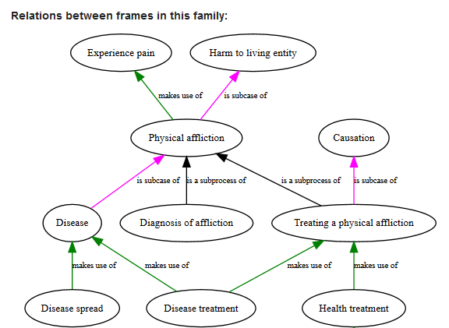
Disease frame family

Slide 15
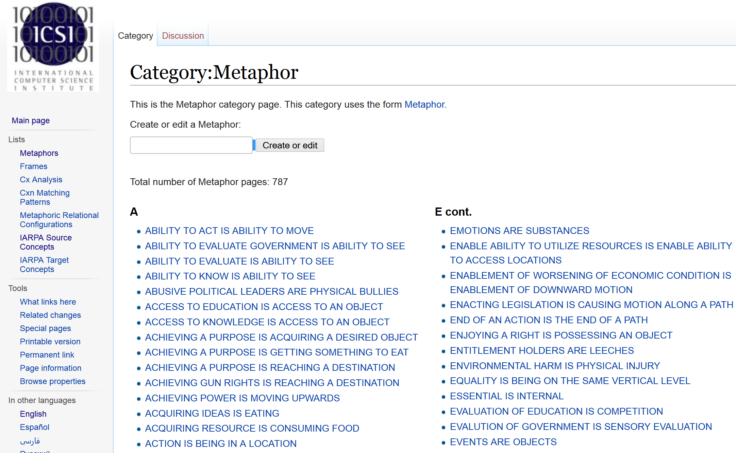

Slide 16
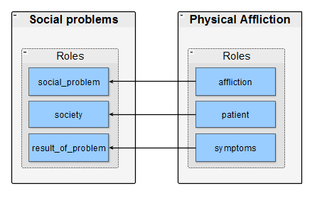
Metaphor: SOCIAL PROBLEMS ARE PHYSICAL AFFLICTIONS
Target frame:
Source frame:

Slide 17
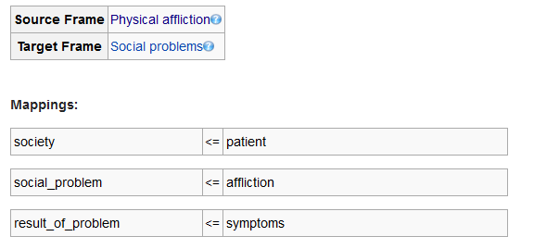
Metaphor: SOCIAL PROBLEMS ARE PHYSICAL AFFLICTIONS

Slide 18
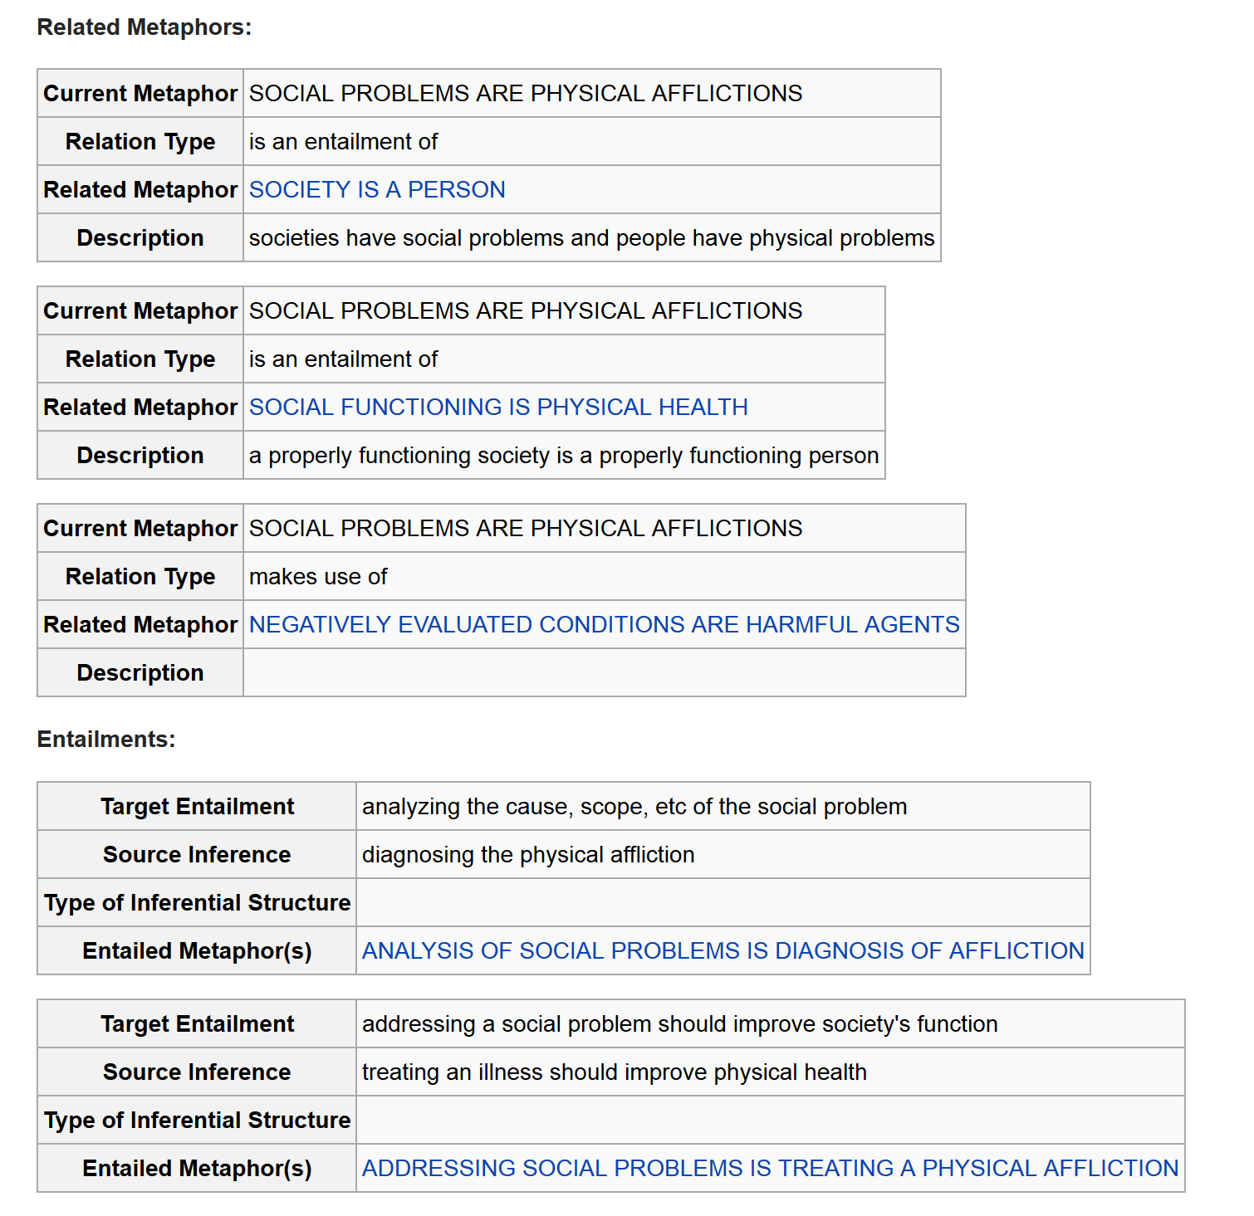
Metaphor: SOCIAL PROBLEMS ARE PHYSICAL AFFLICTIONS

Slide 19
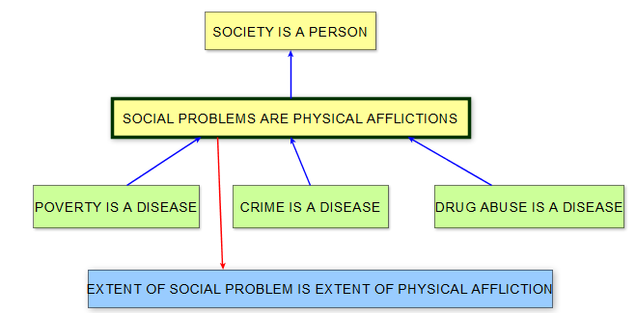
Metaphor network

Slide 20
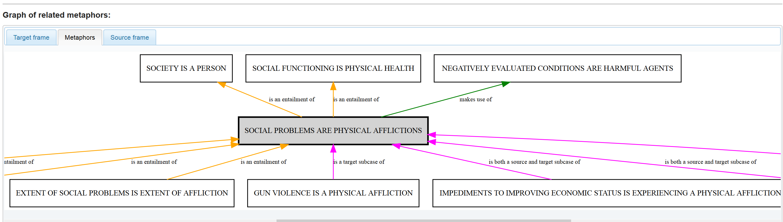
Metaphor: SOCIAL PROBLEMS ARE PHYSICAL AFFLICTIONS

Slide 21
Inter-related networks: frames and conceptual metaphors
Social Problems Are Physical Afflictions
Social Problem
Physical Affliction
Poverty Is A Disease
Crime
Poverty
Disease

Slide 22
Inter-related networks: frames and conceptual metaphors
Several different lexical items may evoke a given frame
Social Problems Are Physical Afflictions
Social Problem
Physical Affliction
Poverty Is A Disease
Crime
Poverty
Disease
crime
felony
criminal
perpetrator …
poverty
impoverishment
destitution
Indigence …
disease
illness
sickness
sick …

Slide 23
Metaphor Repository Implementation
Customized Semantic MediaWiki (Krötzsch et al. 2006), partially publicly available at https://metaphor.icsi.berkeley.edu/pub/en/
Wiki is modified by linguistic analysts using Forms

Slide 24
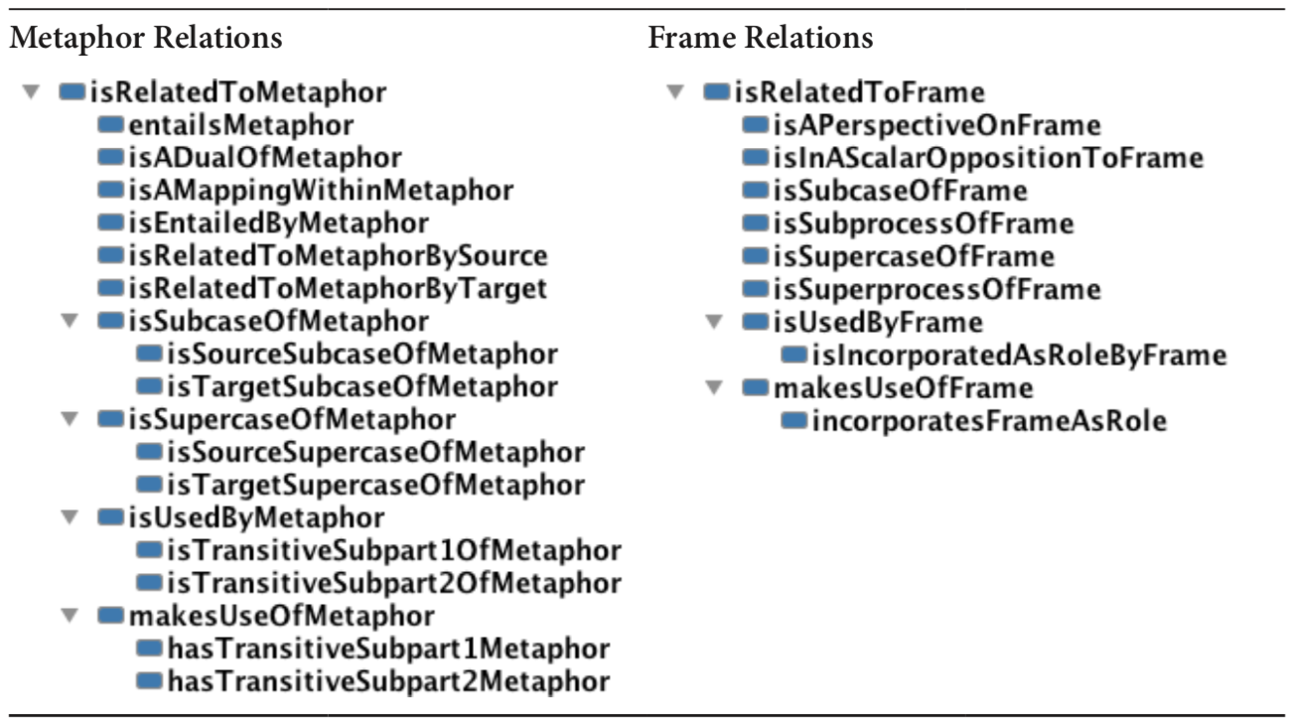
Frame and conceptual metaphor relations

Slide 25
Metaphor Repository Implementation
Customized Semantic MediaWiki (Krötzsch et al. 2006), partially publicly available at https://metaphor.icsi.berkeley.edu/pub/en/
Extraction process converts the Wiki to RDF triples using an ontology defined in OWL
  Metaphors, frames, roles, mappings, and lexical units are all object types
  Metaphors have source and target frames
  Frames have roles and lexical units
  Mappings have target and source roles

Slide 26
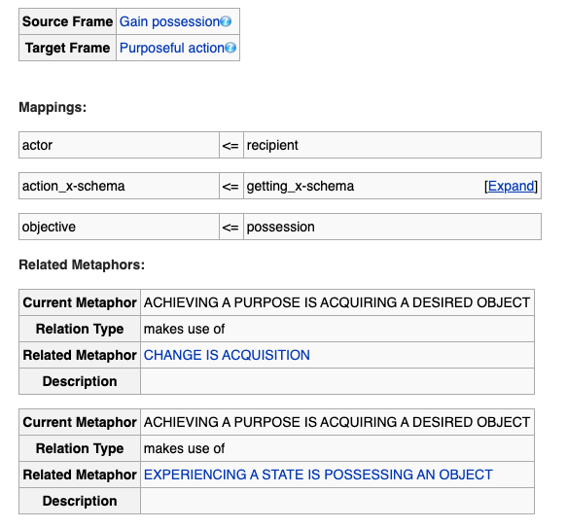

Slide 27
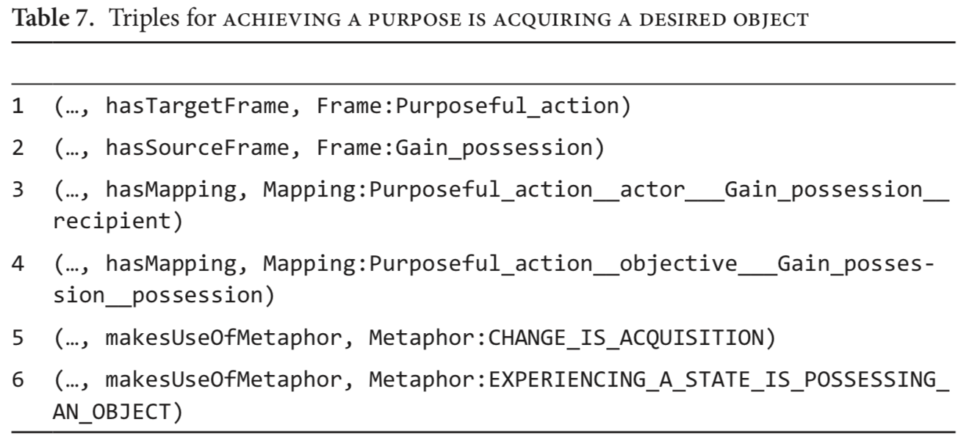
Metaphor Repository Implementation

Slide 28
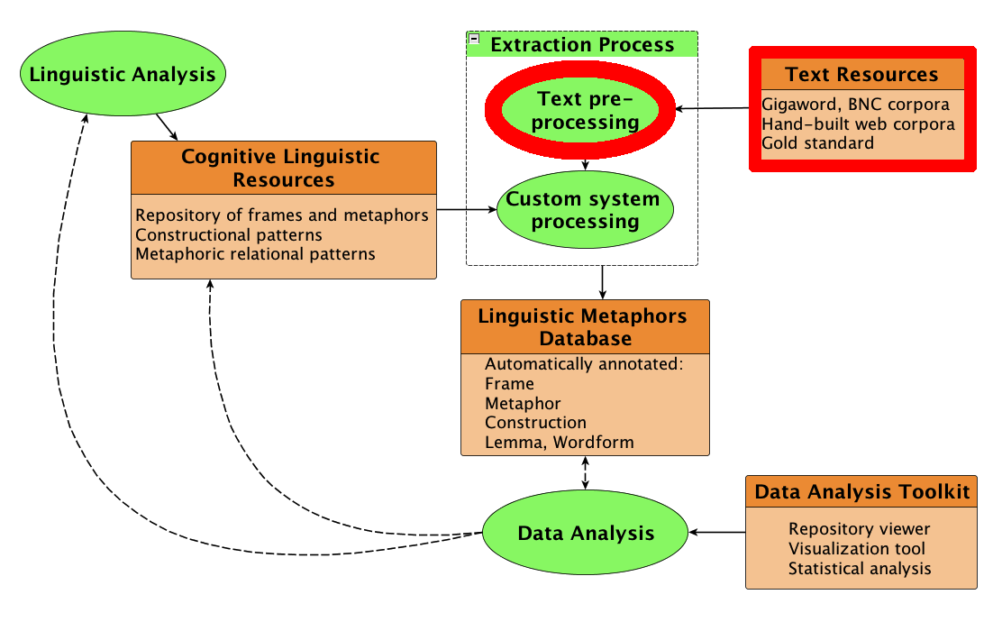
Extraction Process

Slide 29
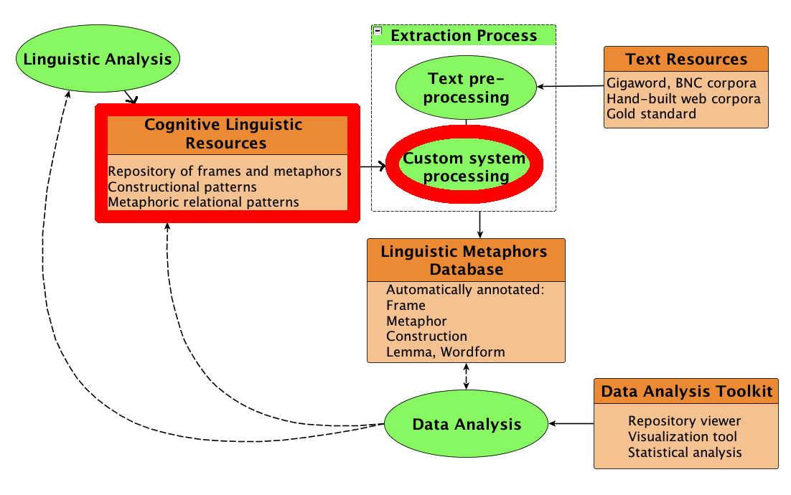
Extraction Process

Slide 30
Metaphor extraction process
1. Term search
2. Constructional pattern matching
3. Metaphor likelihood estimation
4. Linguistic metaphors
Filter by terms in the corpus:
  Target term(s) for a given semantic domain, e.g. poverty, impoverishment, destitute, …
  OR
  Source term(s) for a given semantic domain, e.g. disease, illness, sick, …

Slide 31
Metaphor extraction process
1. Term search
2. Constructional pattern matching
3. Metaphor likelihood estimation
4. Linguistic metaphors
Conceptual metaphors are typically expressed in particular syntactic patterns
Target and source lexemes reliably occupy certain grammatical slots. (Croft 2002; Sullivan 2013). E.g.:
Source is verb, Target is argument: Prices rose
not Target is verb, Source is argument: ??Higher locations priced

Slide 32
Metaphoric constructions:
Source is verb, Target is argument
Subject (Target) + Verb (Source)
  poverty and early death threatened family life (BNC:AP7)
Verb (Source) + Direct Object (Target)
  The measure was principally designed to tackle homelessness (BNC:G20)

Slide 33
Metaphoric constructional patterns
Constructional pattern | Examples
T-subj_S-verb | poverty infects
T-subj_S-verb-conj | poverty infects and maims
T-subj-conj_S-verb | homelessness and poverty infect
S-verb_T-dobj | escape poverty
S-verb_T-dobj-conj | escape despair and poverty
S-verb_Prep_T-noun | slide into poverty / pull up out of poverty
S-noun_of_T-noun | trap of poverty
T-noun_poss_S-noun | poverty's undertow
S-noun_prep_T-noun | path to poverty
T-noun_mod_S-noun | poverty trap
S-adj_mod_T-noun | burdensome poverty
T-noun_cop_S-noun-adj | poverty is a disease / poverty is burdensome

Slide 34
Pattern matching process
Identify candidate items which appear in appropriate metaphor constructional pattern
Example:
Target term: poverty:
Construction: Source(noun) – of – Target (noun)
  Trap of poverty
  Despair of poverty
  Poverty of imagination

Slide 35
Pattern matching process
Identify candidate items which appear in appropriate metaphor constructional pattern
Example:
Target term: poverty:
Construction: Source(noun) – of – Target (noun)
  Trap of poverty ✔
  Despair of poverty ✔
  Poverty of imagination

Slide 36
Metaphor extraction process
1. Term search
2. Constructional pattern matching
3. Metaphor likelihood estimation
4. Linguistic metaphors
Assess metaphoricity of candidate expressions:
Candidate source and target terms are associated with the frames they evoke within repository
Repository is searched to determine the relational path(s) that connect these two frames
Expressions are scored, based on relational configuration in the graph

Slide 37
Non-metaphoric pattern: cure cancer.
Treating a Physical Affliction
Physical Affliction
cure.v
Disease
cancer.n
Cancer
Polio

Slide 38
Non-metaphoric pattern: cure cancer.
Treating a Physical Affliction
Physical Affliction
cure.v
Disease
cancer.n
Cancer
Polio

Slide 39
Non-metaphoric pattern: cure cancer.
Treating a Physical Affliction
Physical Affliction
cure.v
Disease
cancer.n
Cancer
Polio

Slide 40
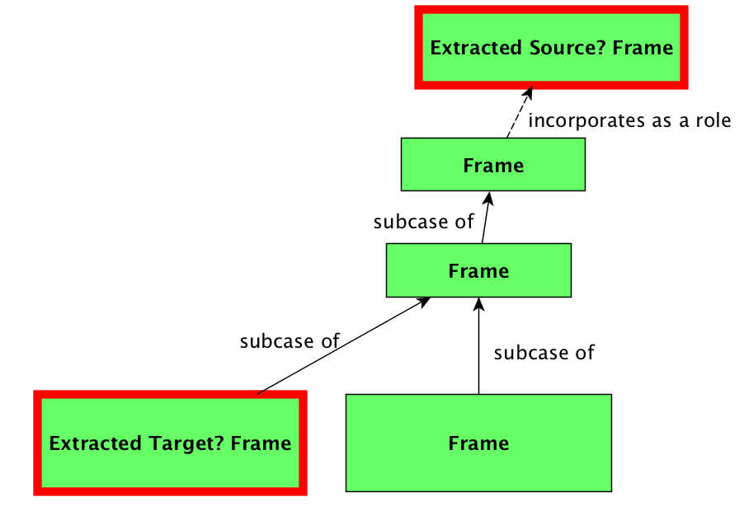
Low-scoring relational configuration
Non-metaphoric pattern

Slide 41
Metaphoric pattern: cure poverty
Social Problems Are Physical Afflictions
Treating a Physical Affliction
Social Problem
Physical Affliction
cure.v
Poverty
Disease
poverty.n
Cancer
Polio

Slide 42
Metaphoric pattern: cure poverty
Social Problems Are Physical Afflictions
Treating a Physical Affliction
Social Problem
Physical Affliction
cure.v
Poverty
Disease
poverty.n
Cancer
Polio

Slide 43
Metaphoric pattern: cure poverty
Social Problems Are Physical Afflictions
Treating a Physical Affliction
Social Problem
Physical Affliction
cure.v
Poverty
Disease
poverty.n
Cancer
Polio

Slide 44
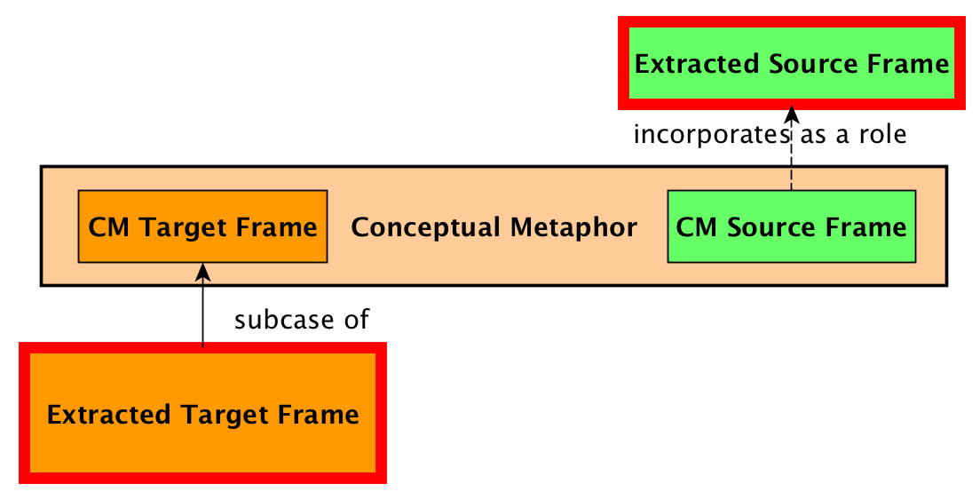
High-scoring relational configuration
Metaphoric pattern

Slide 45
Metaphor Extraction Implementation
RDF representation of the input text corpus
  Documents, sentences, and words are nodes in the graph
  Word properties (word form, lemma, part of speech) are datatype properties on word nodes
  Word relations (grammar, word order) are object properties between nodes
  Relations between words and sentences are object properties between nodes
  Relations between sentences and documents are object properties between nodes

Slide 46
Metaphor Extraction Implementation
Constructional patterns are represented using SPARQL queries

Slide 47
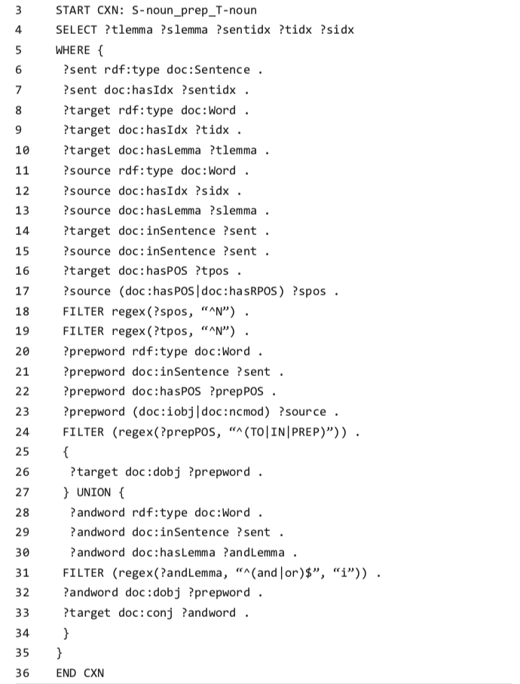

Slide 48
Metaphor Extraction Implementation
Construction search returns potentially metaphoric expressions
Metaphoricity is scored using relational configurations, via SPARQL queries run over the results of the constructional patterns search

Slide 49
High-scoring relational configuration
Metaphoric pattern: Subcase of Frames Related by CM

Slide 50
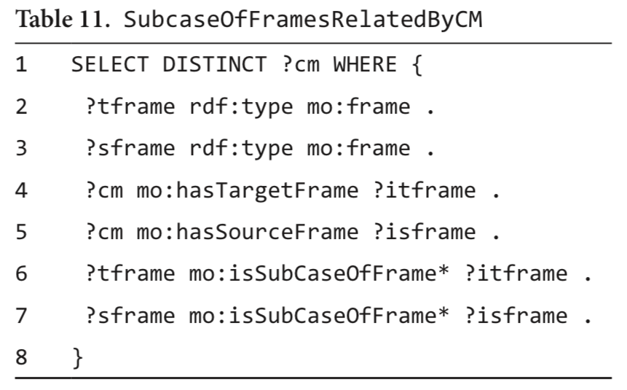
Metaphor Extraction Implementation
Metaphoricity is scored using relational configurations, via SPARQL queries run over the results of the constructional patterns search

Slide 51
Extraction process overview
1. Term search
2. Construction matching
3. Metaphor likelihood estimation
4. Linguistic metaphors
Metaphor extraction using repository and constructions

Slide 52
Metaphor Extraction Results

Slide 53
Metaphor Extraction Results
Returns a set of expressions scored for metaphoricity and annotated with linguistic information
Converted into JSON for use in database search tool and other visualization software

Slide 54
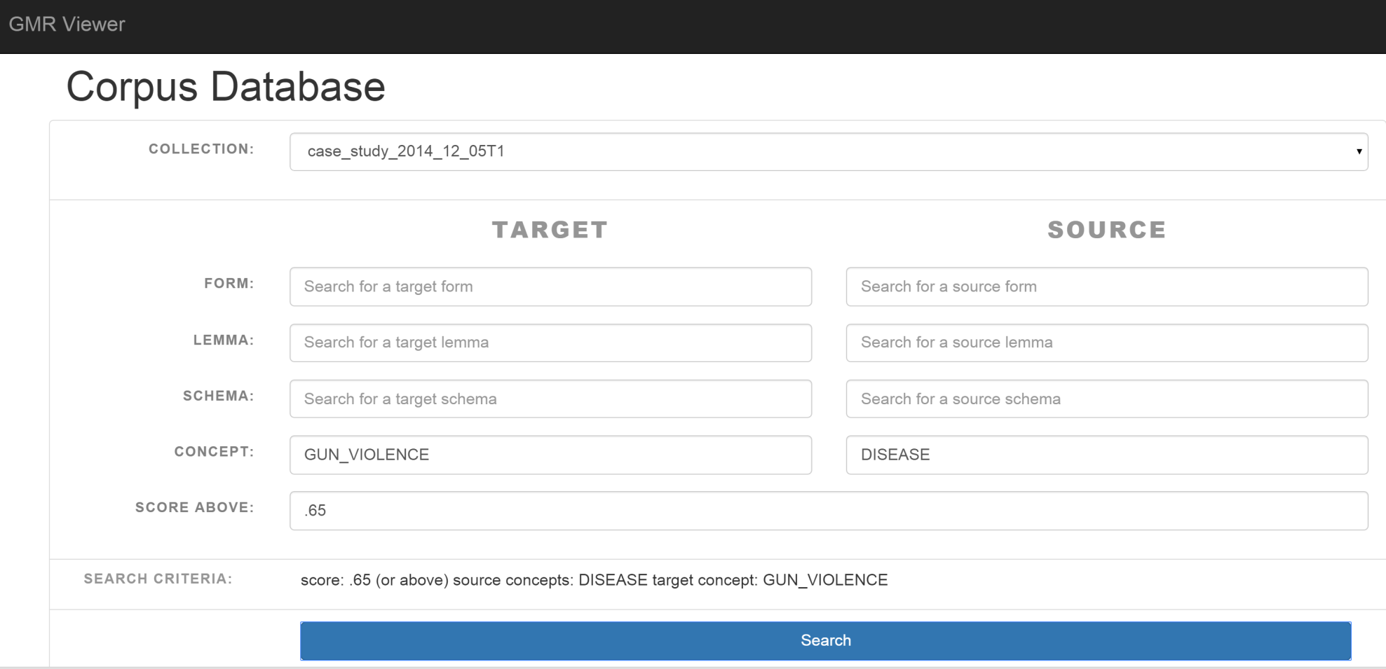

Slide 55
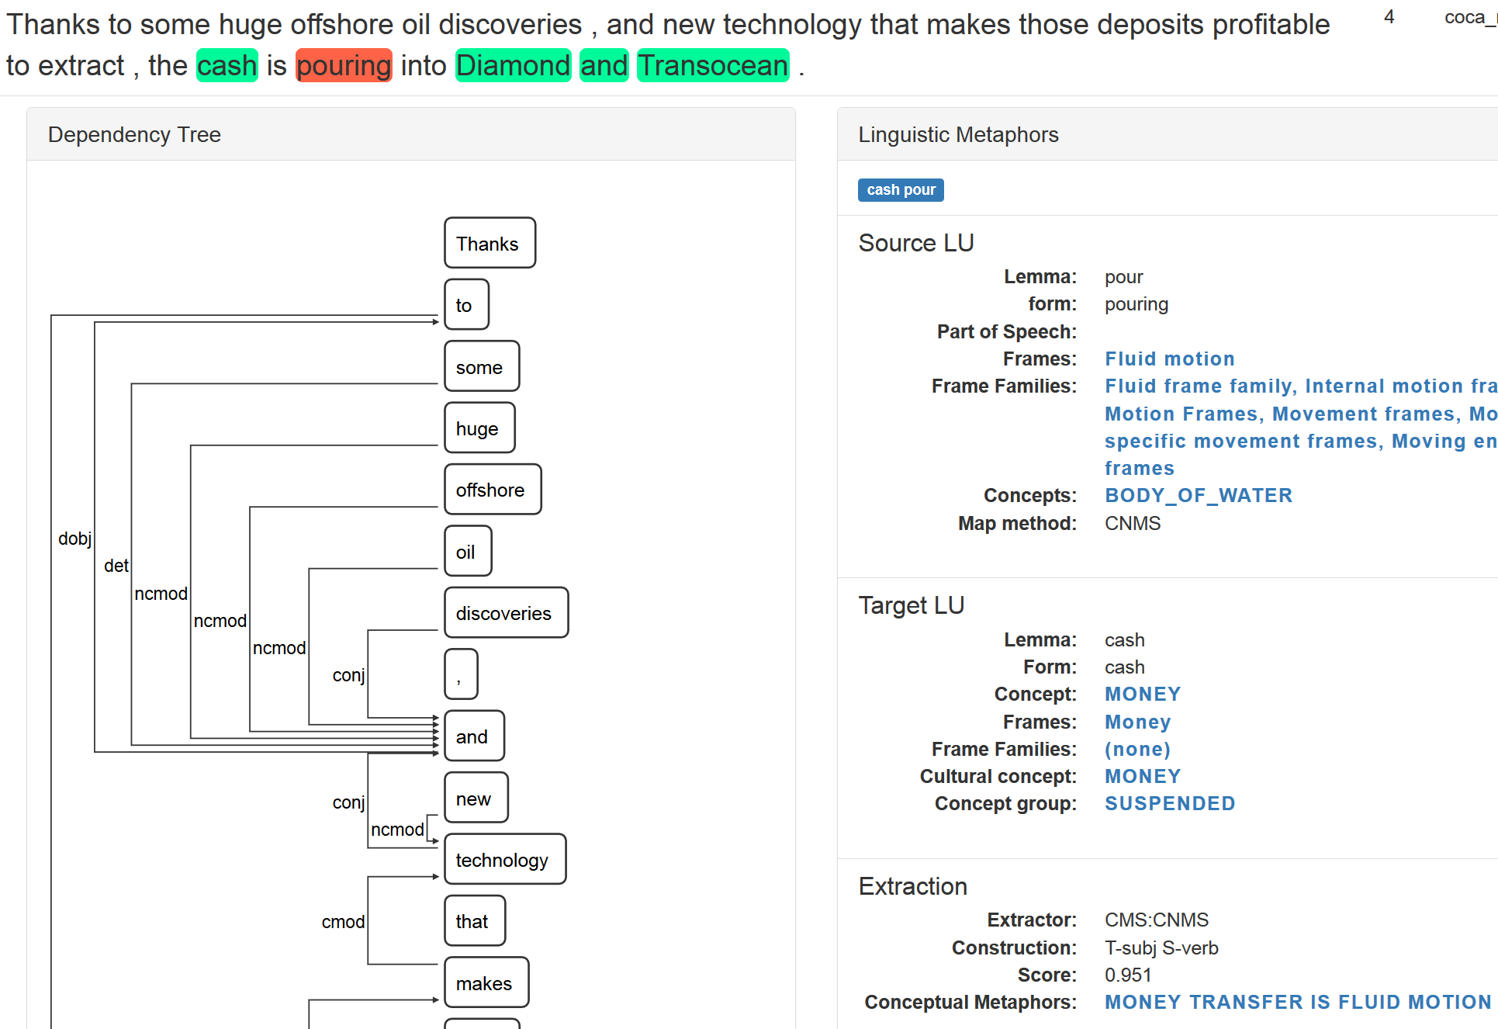

Slide 56
Extraction output
{ "extractor": "CMS",
"name": "poverty hurt",
"source": {
"end": 13,
"form": "hurts",
"lemma": "hurt",
”framenames": [ "Experience pain", "Harm to living entity” ],
"lpos": "hurt.v",
"start": 8,
},
"score": 0.93,
"cms": [ “POVERTY_IS_PHYSICAL_HARM",
“EXPERIENCING_A_NEGATIVE_STATE_IS_EXPERIENCING_HARM” ],
"cxn": "**T-subj_S-verb",
"target": {
"concept": “POVERTY”,
"end": 7,
”framefamily": “Economic inequality frames”,
"form": "Poverty",
"lemma": "poverty",
"start": 0,
”framename": "Poverty",
}
}

Slide 57
Summary remarks
Beyond metaphor detection – the MetaNet system enables us to perform many kinds of linguistic analysis of metaphors in text
Iterative developmental process
  Analysis of extracted data informs linguistic analysis, which improves repository and theory, which in turn improves quality of extractor output
Valuable resources:
  Metaphor repository
  Publicly-accessible wiki
  Large database of annotated examples
  Computational tools for extraction and data analysis

Slide 58
The future of MetaNet?
Transitory state: Moving to UBC hosting with Stickles & Sweetser as co-PIs
Short term plans:
  Expand coverage of Wiki by adding frames and metaphors
  Expanding and fixing bugs in the constructional patterns queries
  Improving the modularity of the pipeline
Long term goals:
  Incorporate machine learning
  Revive the Spanish language Wiki
  Expand text coverage to fiction

Slide 59
Selected References
Croft, W. (2002). The role of domains in the interpretation of metaphors and metonymies. Metaphor and metonymy in comparison and contrast, 161-205.
Fillmore, C. J. (1976). Frame semantics and the nature of language. In Origins and Evolution of Language and Speech, ed. by Stevan R. Harnad, Horst D. Steklis, & Jane Lancaster, 20-32. Annals of the NY Academy of Sciences, Vol. 280.
Lakoff, G., & Johnson, M. (1980). Metaphors We Live By. Chicago: University of Chicago Press
Ruppenhofer, J., Ellsworth, M., Petruck, M. R., Johnson, C. R., & Scheffczyk, J. (2010). FrameNet II: Extended theory and practice. Berkeley, California: International Computer Science Institute
Sullivan, K. (2013). Frames and constructions in metaphoric language. John Benjamins.

Slide 60
Selected MetaNet References
Overview:
Sweetser, E., David, O, & Stickles, E. (2019). MetaNet: Automated metaphor identification across languages and domains. In M. Bolognesi, M. Brdar, & K. S. Despot (Eds.), Metaphor and Metonymy in the Digital Age: Theory and methods for building repositories of figurative language (pp. 23-47). John Benjamins.
David, O. Computational approaches to metaphor: The case of MetaNet. In B. Dancygier (Ed.), The Cambridge Handbook of Cognitive Linguistics (pp. 574-589). CUP.
Technical:
Hong, J. (2016). Automatic metaphor detection using constructions and frames. Constructions and Frames 8(2), 295-322.
Dodge, E., Hong, J., & Stickles, E. (2015). MetaNet: Deep semantic automatic metaphor analysis. In E. Shutova, B. B. Klebanov, & P. Lichtenstein (eds.), Proceedings of the 3rd Workshop on Metaphor in NLP (pp. 40-49). NAACL HLT 2015.
Repository structure:
Stickles, E., Dodge, E.; David, O., & Hong, J. (2016). Formalizing contemporary conceptual metaphor theory: A structured repository for metaphor analysis. Constructions and Frames 8(2), 166-213.

Slide 61
Acknowledgements
The MetaNet Analysis and Repository teams: George Lakoff, Eve Sweetser, Jisup Hong, Ellen Dodge, Oana David, Karie Moorman, Luca Gilardi
Project Managers: Collin Baker, Jim Hieronymous, Srini Narayanan
With help from Miriam Petruck, Jerry Feldman
Many, many others
Supported by the Intelligence Advanced Research Projects Activity (IARPA) via Department of Defense US Army Research Laboratory contract number W911NF-12-C-0022. The U.S. Government is authorized to reproduce and distribute reprints for Governmental purposes notwithstanding any copyright annotation thereon. Disclaimer: The views and conclusions contained herein are those of the authors and should not be interpreted as necessarily representing the official policies or endorsements, either expressed or implied, of IARPA, DoD/ARL, or the U.S. Government.

Slide 62
Thank you!

Slide 63
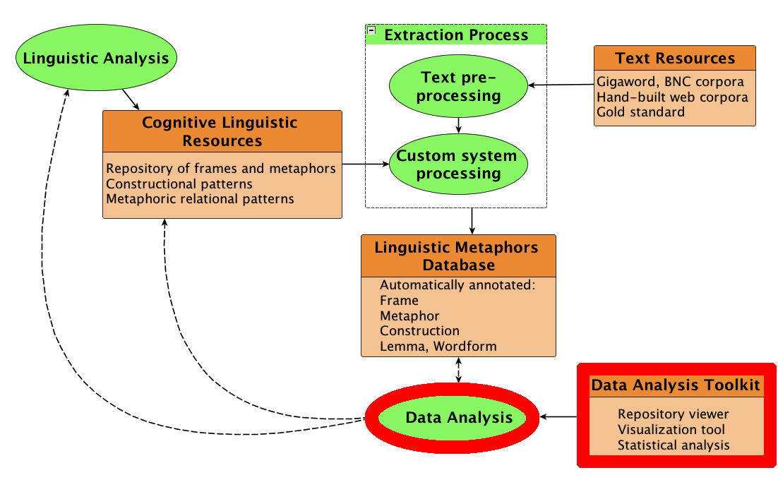
Database and Data Analysis

Slide 64
Motion metaphors in English
Basic questions:
Which target domains are most common?
Is there a preference for path or manner in the source domain?
How do syntactic patterns interact with the source domains?
Are some source domains more likely to be used metaphorically?
Stickles & Dodge (forthcoming)

Slide 65
Motion metaphors: Method
Identify potential source domain evoking-elements
  Augmented extant MetaNet repository using additional lexical resources (Levin 1993, Ruppenhofer et al. 2010)
  359 manner or path-evoking verbs
  Stickles & Dodge (forthcoming)
  Stickles 2016

Slide 66
Motion metaphors: Method
Searched Corpus of Contemporary American English (Davies, 2008)
Metaphor identification search restricted to verbal constructions
Subject (Target) + Verb (Source)
  my mind was racing
Verb (Source) + Object (Target)
  running a campaign
Verb (Source) Preposition + Indirect Object (Target)
  jumped at the chance
Verb (Source) by + Indirect Object (Target)
  rose by 6 percent

Slide 67
Motion metaphors: Results
306,382 instances of highly likely metaphoric expressions
 | Type Count
Target Lemmas | 2,088
Target Frames | 276
Source Lemmas | 154
Source Frames | 29
Source Frame Families | 8

Slide 68
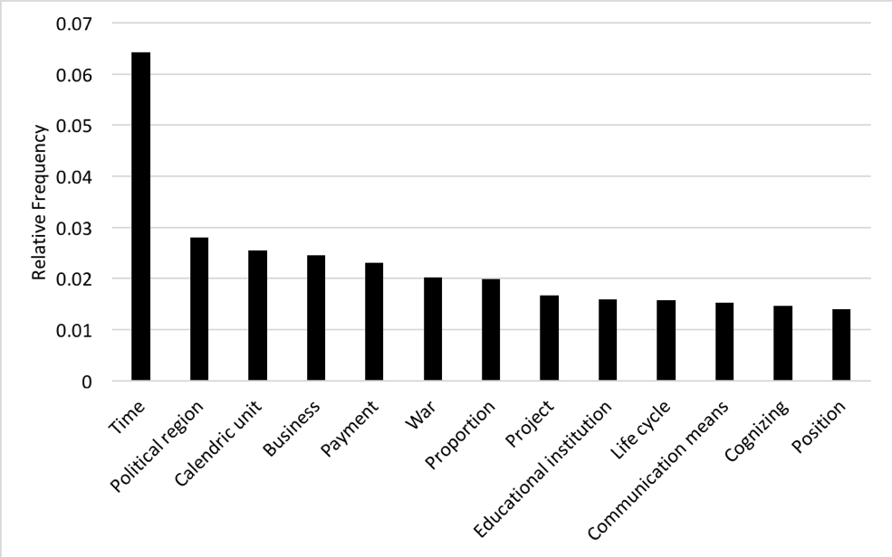
Motion metaphors: Analysis
Which target domains are most common?

Slide 69
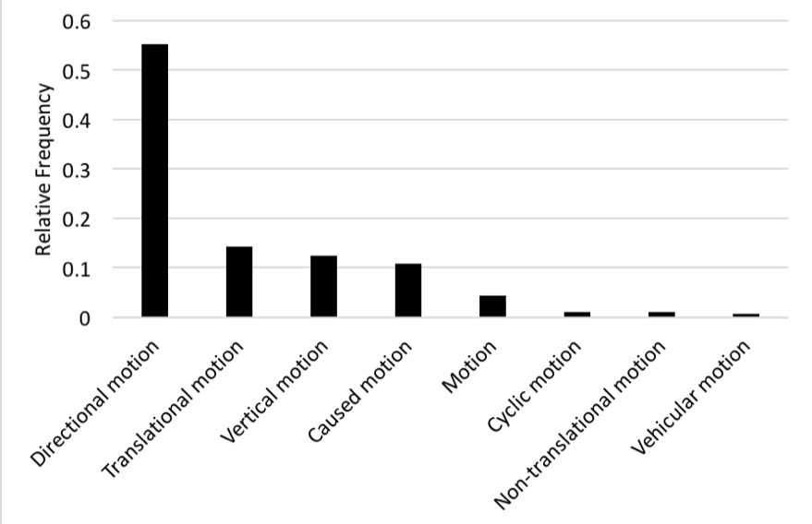
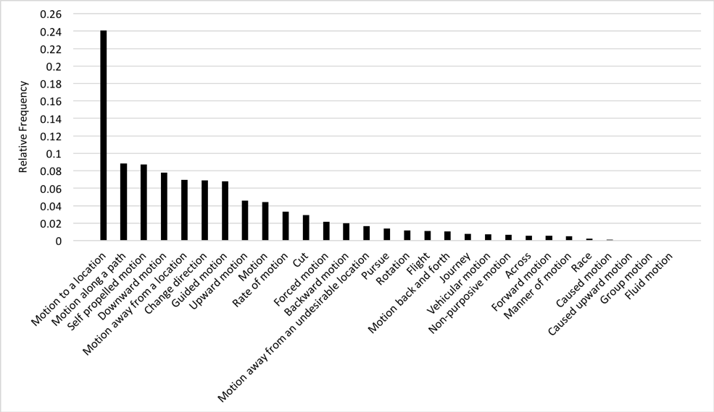
Motion metaphors: Analysis
Is there a preference for path or manner in the source domain?

Slide 70
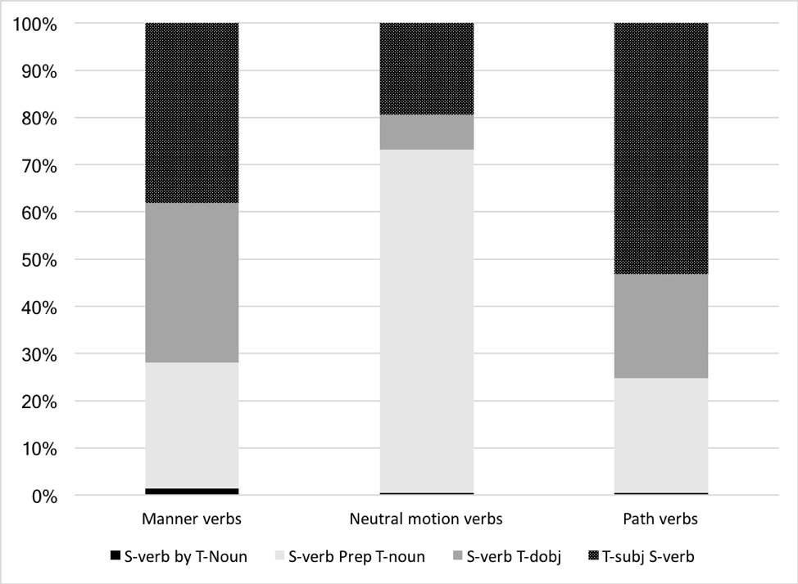
Motion metaphors: Analysis
How do syntactic patterns interact with the source domains?
?

Slide 71
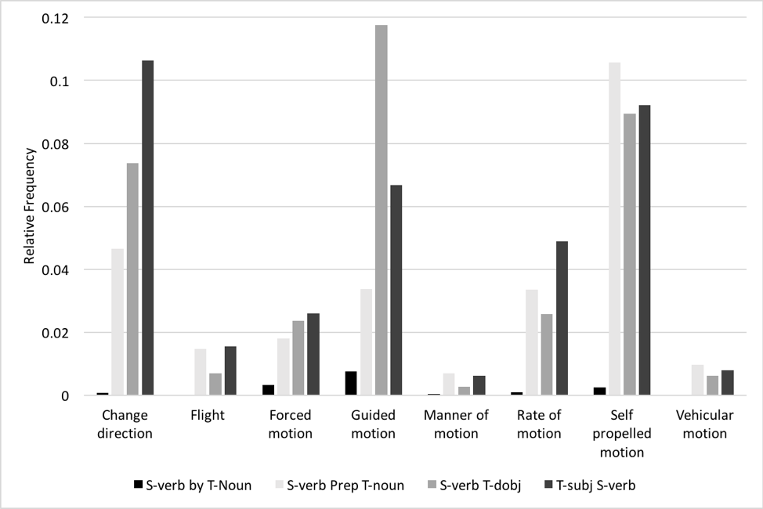
Motion metaphors: Analysis
How do syntactic patterns interact with the source domains?

Slide 72

Motion metaphors: Analysis
Are some source domains more likely to be used metaphorically?
f_{s} = raw frequency in metaphoric data
f_{g} = raw frequency in overall COCA
Score > 1 = more likely to be used in metaphoric contexts
Score < 1 less likely to be used in metaphoric contexts
  Stickles 2016

Slide 73
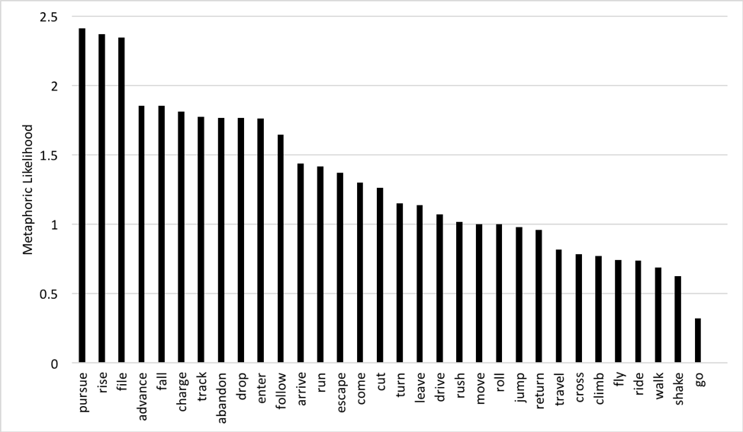
Motion metaphors: Analysis
Are some source domains more likely to be used metaphorically?

Slide 74
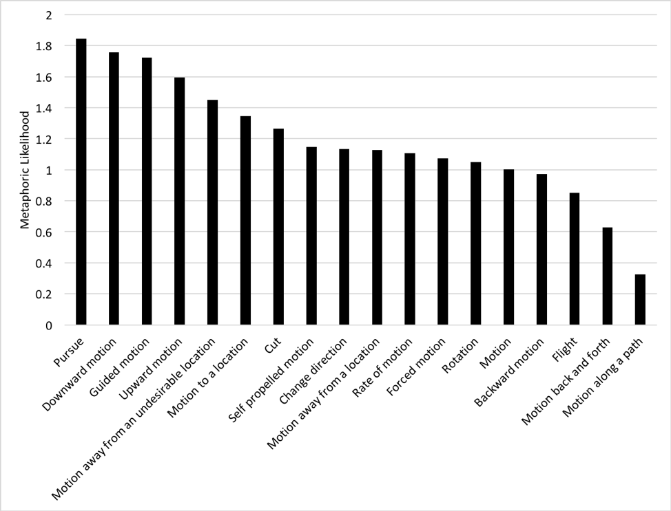
Motion metaphors: Analysis
Are some source domains more likely to be used metaphorically?

Slide 75
Motion metaphors: Summary
Target domains centered around broad semantic domains
  Time
  Social institutions
  Quantity and measurement
  Mental states or events
Source domains tend to include endpoint focus (i.e., directional motion)
Constructions contribute path (i.e., prepositions) when not already evoked by source domain frame
Goal-oriented frames have a higher metaphoricity likelihood
Despite English’s overall preference for manner verbs, metaphoric motion is path-profiling

Slide 76
Poverty case studies
Overall objective:
Analyze metaphors used to describe the target domain of Poverty:
What source domains are commonly used?
How do source domain frames interact with constructions?
How does variation in use frequency illustrate different ways of construing poverty?

Slide 77
Poverty case study #1
British National Corpus
Target domain: defined by Poverty frame family in Repository
Extraction results
  698 sentences
  209 source domain lexical units
  134 source frames; 957 frame instances
  Stickles, Dodge, & Hong 2014

Slide 78
Poverty: Source families
    cure poverty poverty attacks chained by poverty

Slide 79
Constructions in Source family data
n.s.
**
alleviate poverty
symptoms of poverty
tackle homelessness
impact of poverty
poverty trap
Notes:
Disease and Harm tend to occur in both the N of N and Verb-DO constructions, whereas Impediments to Motion is more likely to occur in N-N, χ2(8; n=405) = 99.01; p < 0.001

Slide 80
Frames within Disease family
**
Metaphors:
  Poverty is a Physical Affliction
  Addressing Poverty is Treating a Physical Affliction
Notes:
χ2(12; n=151) = 39.72, p < 0.001

Slide 81
Constructions in Disease family
**
Notes:
The Treating a Physical Affliction schema is more likely to occur in the Verb-DO construction, whereas Physical Affliction is nearly always in N of N, post-hoc comparison, p < 0.001.

Slide 82
Poverty case study #2
Investigate use frequency of constructions in metaphoric and non-metaphoric contexts
  English Gigaword corpus
  Searched for potentially metaphoric expressions with the target lexeme poverty
  Retained only expressions rated highly metaphoric or highly non-metaphoric
  Final corpus size
    Highly metaphoric: 50,413 expressions
    Unlikely to be metaphoric: 30,308 expressions
  Stickles & Dodge 2016

Slide 83
Examples
Noun-Noun
Metaphoric: poverty trap
Non-metaphoric: poverty project
Verb-Prep-Noun
Metaphoric: mired in poverty
Non-metaphoric: blame for poverty

Slide 84
Results
n.s.
*
*

Slide 85
All comparisons significant

Slide 86
Poverty case studies: Summary
Typically construed in terms of three source domains
  Disease: POVERTY IS A PHYSICAL AFFLICTION
  Harm: POVERTY IS PHYSICALLY HARMFUL
  Impediments to Motion: POVERTY IS A PHYSICAL IMPEDIMENT
British English preferentially profiles addressing poverty
Variations in use frequency of different constructions
  In verbal constructions, poverty is more likely to be a patient or location than an agent

